Slide 1
You request it, we get it for you FREE
Zheng Ye (Lan) Yang (zyang@tamu.edu) Head of Document Delivery/Interlibrary Services, Texas A&M University Libraries
Document Delivery Services provided by Texas A&M University Libraries

Slide 2
Information about Texas A&M University
TAMU was founded in 1876, a land grant, sea grant, and space grant university
Seventh largest university in the U.S.
Over 48,000 registered students (including distance education students)
2,345 full-time faculty/staff
In 2002, TAMU – Qatar branch was established

Slide 3
Information about TAMU Libraries
Five branch libraries
Ranked 13th among US public university libraries by ARL
As of June 2009, TAMU libraries holdings include: 4 million volumes, 10,134 print journals, 76,603 ejournals, 461,225 ebooks, over 650 databases, and 5.5 million microforms
85 librarians, 192 staff members and over 200 student assistants

Slide 4
Description of the Document Delivery Services Offered
In July 2002, we implemented a free document delivery service to all TAMU students, faculty, staff, researchers, distance education students, and Texas state agriculture extension service employees.
Use Illiad software
Brand name the services as “deliverEdocs”
Scan up to 50 pages per request from items in our own collections, FREE
Limit of 10 requests per day per patron
In July 2005, we started scanning items in our microform collections for our patrons, FREE.
In January 2008, we launched a book retrieval service for our patrons, FREE.
Our business hours: Monday – Friday: 6:00 a.m. till 6:00 p.m. Closed on weekends.

Slide 5
Statistics

Slide 6
Statistics
From July 1, 2002 to June 30, 2009, we processed 381,130 borrowing requests; 28,226 were for our distance patrons.

Slide 7
Statistics

Slide 8
Statistics

Slide 9
Statistics
From July 1, 2002 to June 30, 2009, we processed 312,119 in-house document delivery requests; 29,808 were for our distance patrons.

Slide 10
Statistics

Slide 11
Statistics

Slide 12
Turnaround Time
On an average working day, we process about 500 - 550 requests. On Mondays, we usually process around 700 requests.
Turnaround time for articles: 90% within 24 hours (thanks to Rapid and Odyssey)
Turnaround time for loans: if the item is in our own collections, 90% within 24 hours; if not in our own collections, 3-7 days.

Slide 13
Staff, Equipment, and Student Worker Budget
13 full-time staff members. (3 of them for lending, 1 as a “utility player”, 1 as my “right hand”)
20 student workers (annual student workers’ budget: $60,000, some are paid via work study)
We have 8 scanners: including 1 Bookeye, 1 Minolta PS 7000 flat bed scanner, and the rest are all Fujitsu
I report directly to our Associate Dean for Collections and Services.

Slide 14
Method of Delivery
Article: PDF posted on our server for 30 days
Loan: Deliver to patron’s home library
Starting this fall: for faculty only, items delivered to their office mail stop via campus mail service
For distance patrons: use UPS to ship to their home address (with a prepaid UPS return label)
For Qatar campus patrons: send the packages to our Qatar support office on campus on a daily basis, and they send them to the Qatar campus every afternoon around 3:00p.m. via UPS.

Slide 15
Cost of this service to the TAMU Libraries
The service is FREE to our students, faculty, and staff. However, each registered student pays $10.73 per credit hour for up to 14 hours per semester to the TAMU Libraries as a Library Use Fee.
TAMU Libraries spend about $320,000 per year for WorldCat Resource Sharing access, ILLiad, Rapid subscription fees, copyright fees, purchase on demand, as well as UPS ground shipping fees per year to support this service.
This figure is about 10.7% of the total library operations budget ($2, 977,962), and 1% of the total library budget ($31,738,533). (Our total collection management budget is: $13,494,381, of which $9,620,775 is designated for databases/serials and $3,398,673 for books)

Slide 16
User Satisfaction
“deliverEdocs has got to be the single greatest service of all at TAMU libraries. It makes research so much easier and faster. Thank you very much.”
“deliverEdocs service is worth 90% of all the tuition and fees I pay. It is critical to enabling the research I do – as a commuter and distance education student. Fantastic service done at a high quality.”
“Just want you to know how wonderful this service is! The entire deliverEdocs system, the quickness of the delivery, the historical book list I have access to on deliverEdocs, is just unbelievable. I appreciate it so much and value what you offer to the faculty, staff, and students.”

Slide 17
User Satisfaction
“I am amazed at the “blitz” response from your department, and wish to offer my heartfelt appreciations to the staff for their very fast response and help in sending me the required article, thanks again!”
“The deliverEdocs is a great feature. I am glad they include items owned by the library.”
“One of the best improvements was the Get It button added to the LibCat record screens. I order most of my books for delivery to PSEL library and never understood why I had to hand enter all of information again…Thanks.”

Slide 18
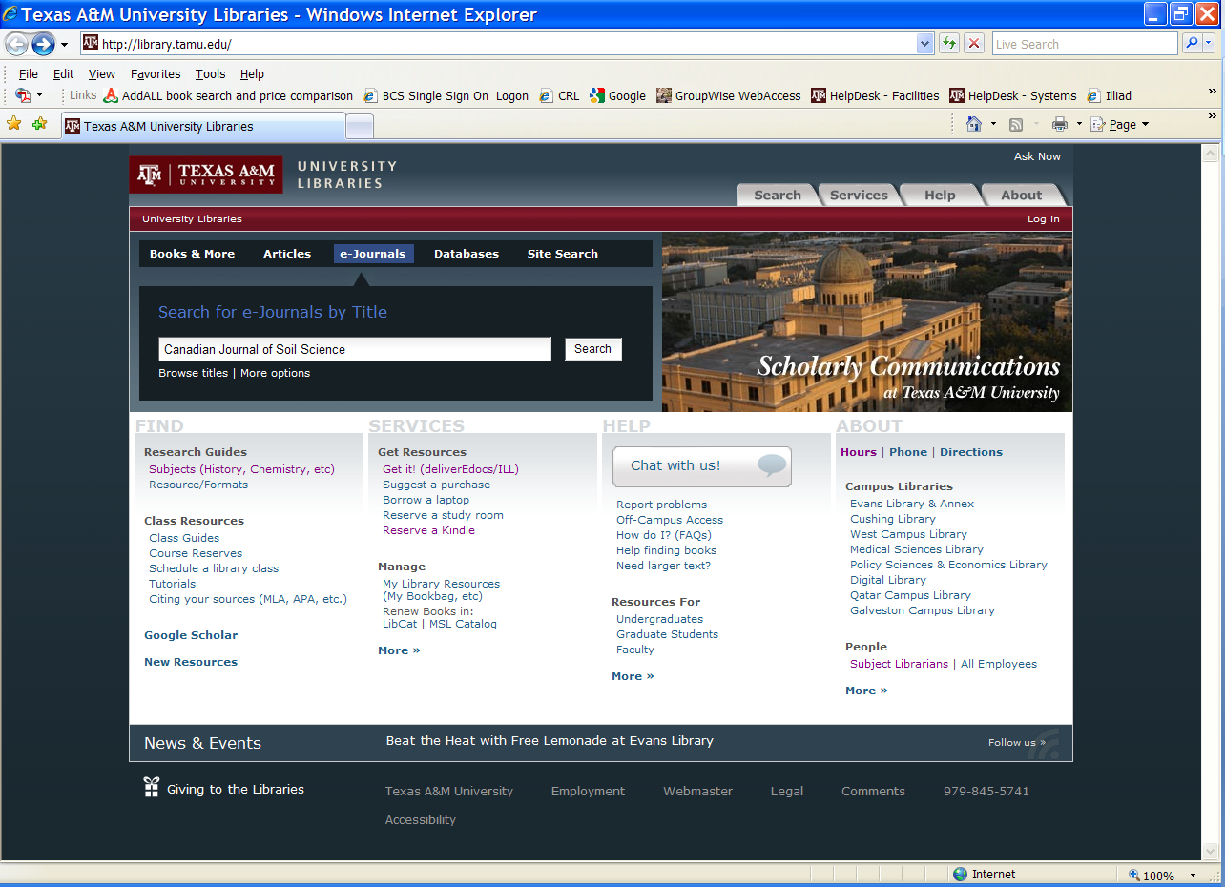
Description of Process
Article Requests: Submit via SFX link

Slide 19
Description of Process

Slide 20
Description of Process

Slide 21
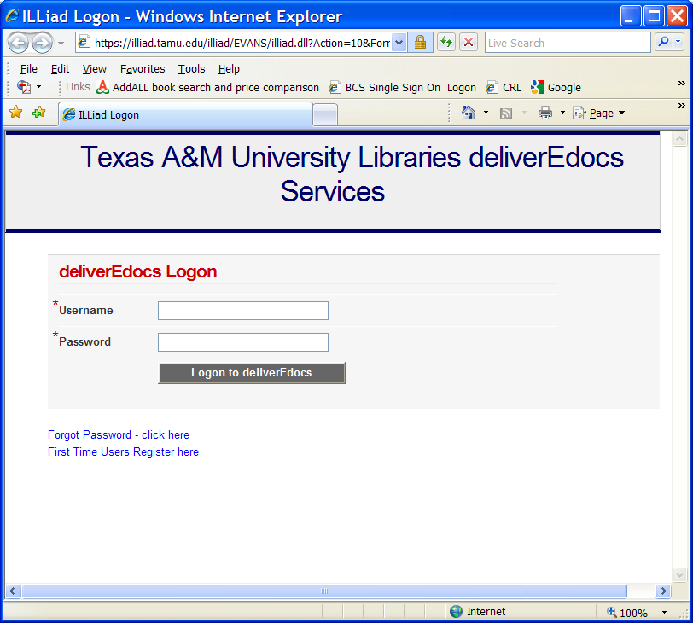
Description of Process

Slide 22
Description of Process

Slide 23
Description of Process
TransactionStatus MatchString NewProcessType NewTransactionStatus
Awaiting Request Processing t.RequestType=‘Article’ and t.CitedInlike “%SFX%’ Borrowing Awaiting SFX Request Processing

Slide 24
Description of Process

Slide 25
Description of Process

Slide 26
Description of Process

Slide 27
Description of Process

Slide 28
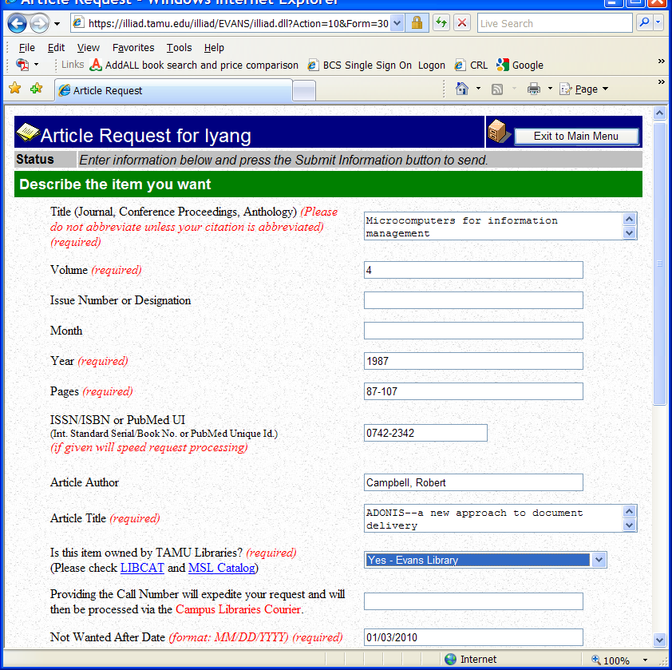
Description of Process
Article request: submit manually

Slide 29
Description of Process
TransactionStatus MatchString NewProcessType NewTransactionStatus
Awaiting Copyright Clearance t.RequestType=‘Article’ and t.CitedInlike “Yes%’ Borrowing Awaiting Doc Del Request Searching

Slide 30
Description of Process

Slide 31
Description of Process

Slide 32
Description of Process

Slide 33
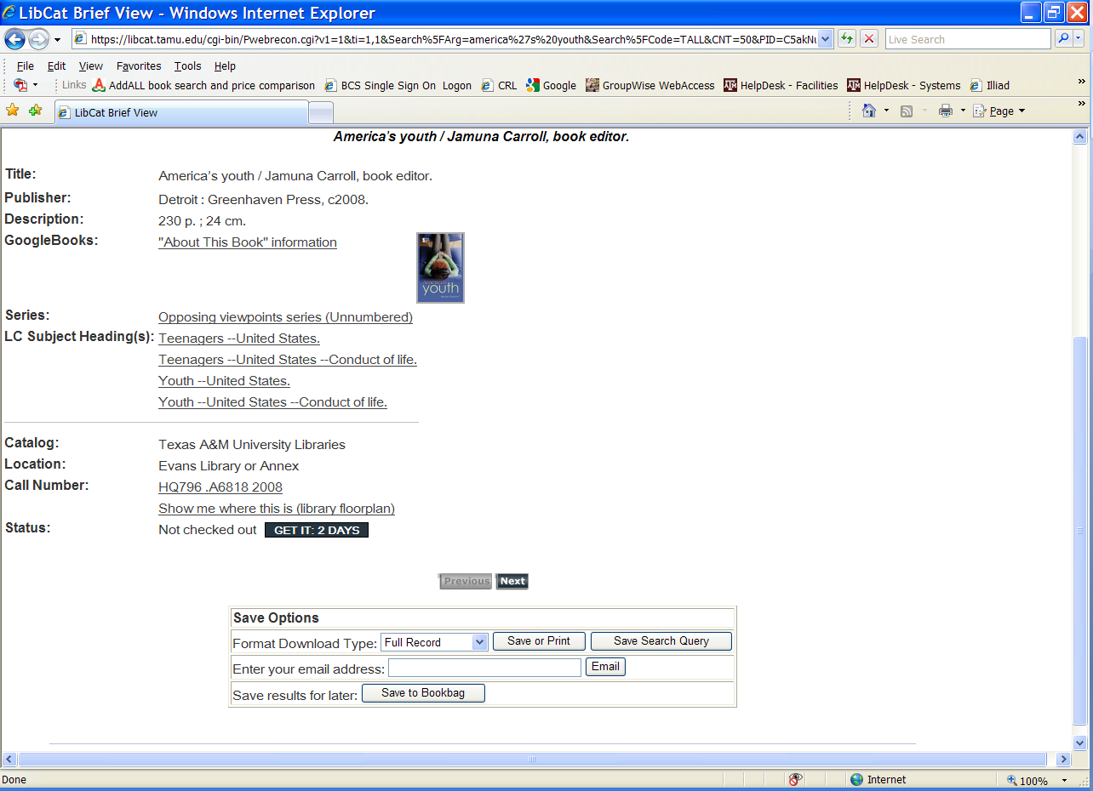
Description of Process
Book request – submit via LibCat Get it button

Slide 34
Description of Process

Slide 35
Description of Process

Slide 36
Description of Process
TransactionStatus MatchString NewProcessType NewTransactionStatus
Awaiting Reqiest Processing RequestType=‘Loan’ and t.CitedInlike “%DocDel’ Borrowing Awaiting Get It For Me Processing

Slide 37
Description of Process

Slide 38
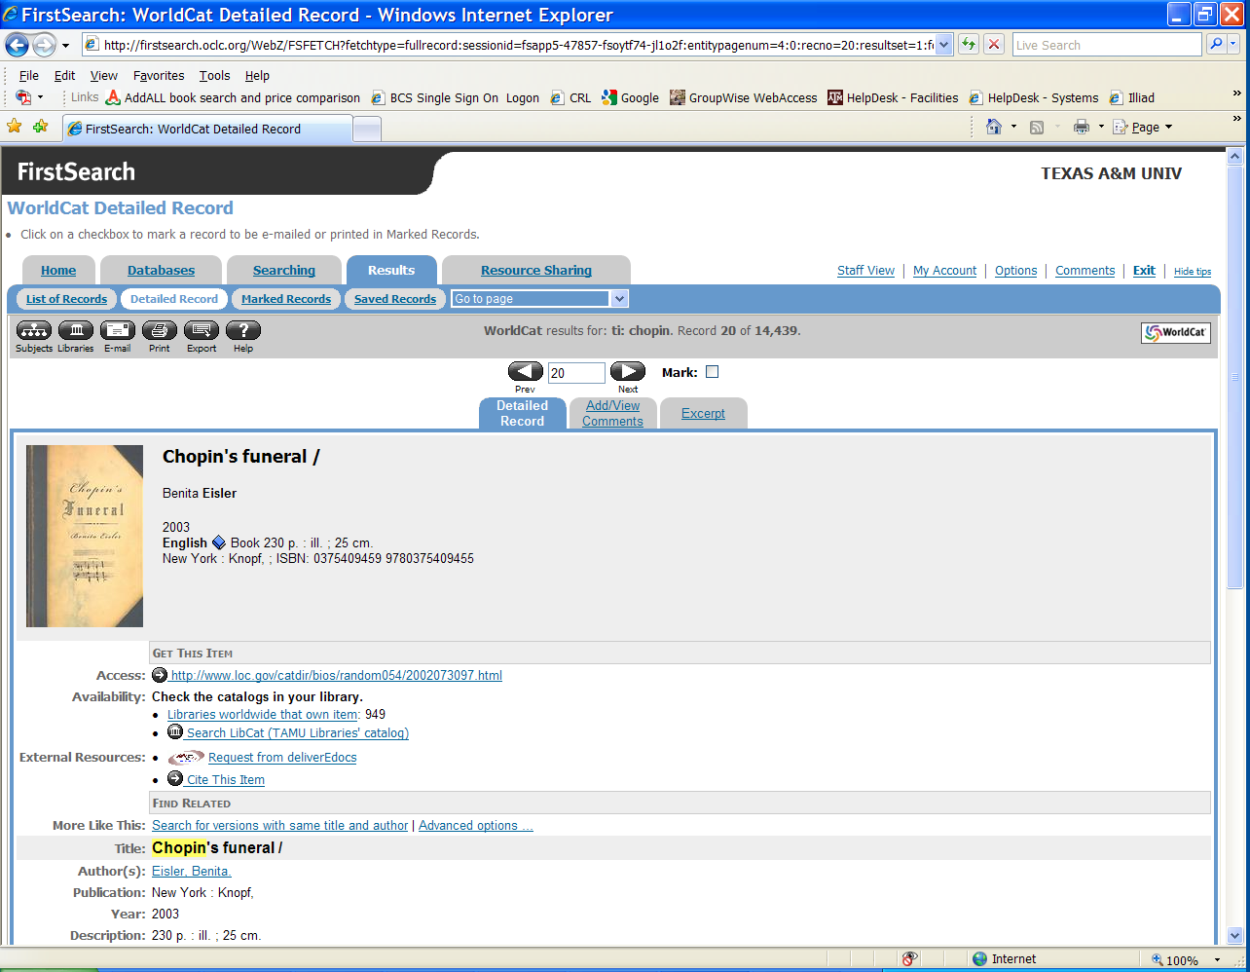
Description of Process
Book request – submit via WorldCat database

Slide 39
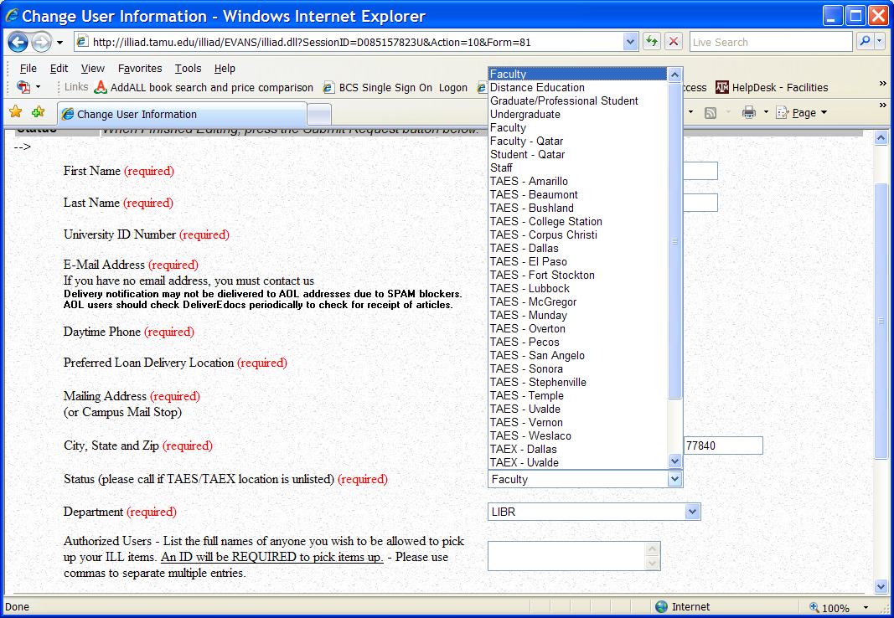
Description of Process
Find out patron status and pick-up location

Slide 40
Description of Process

Slide 41
Description of Process

Slide 42
Description of Process

Slide 43
Purchase on Demand
Recent publications (published in the last 12 months)
Exhausted all the lenders, but the item is still available
Textbooks (in library use)
Articles published in the most recent journal issue, only available via commercial suppliers or publishers, such as Ingenta, SAGE journal, etc.
Industrial standards not available from any other libraries, such as Lind Hall Library, I would purchase from SAI Global, ANSI, Scitation Document Store, SAE, etc.
Annual budget for this effort: $20,000 (for anything under $500, I don’t need to consult with our subject specialists; average monthly spending: $1663.00 via MasterCard)

Slide 44
Office Areas

Slide 45
Office Areas

Slide 46
Office Areas

Slide 47
Office Areas

Slide 48
Staff’s Initial Reactions to the Change
“You got to be kidding!”
“We are crazy!!”
“It’s impossible that we can make it!!!”
“We are switching to a new Interlibrary Loan Management system-ILLiad, we don’t know how to operate it yet, and on top of that, you ask us to provide free document delivery service to everyone? We will be overwhelmed by the requests!”
“If we start providing free document delivery services to everyone, then nobody will need to come to the library, we are spoiling the library users!”

Slide 49
Current Staff’s Attitude
“The only way to be successful is to TRY!”
“We are one of the indispensible library services offered to the entire campus community, job security guaranteed!”
“I am glad we can make a difference in our users’ academic lives.”
“Our patrons do not even need to come to the library to use our service, what a convenient offer.”
“It’s a pleasure to try to excel and make this one of the best services our library has to offered. Glad to be part of it!”
“We provide a foundation of knowledge that would otherwise not be available to researchers throughout the world.”

Slide 50
Keys to Success
The TAMU Libraries administration’s support
A committed staff with a strong sense of leadership
The department head monitors the daily workflow closely
Student workers are fully trained
A strong technical support from TAMU Libraries’ system employees

Slide 51
Thank You!

