Slide 1

Educational Theory to Design a Training Program for Alma’s Fulfillment Module but mostly Circulation

Slide 2
Our Agenda
About Me
Our Challenge
How we overcame it
What it looks like
Where we’re going with it

Slide 3
About Me
BS Adolescent Education (Spanish 7-12)
  SUNY Geneseo (2005)
  NYS Certified Teacher
MLS
  University at Buffalo (2007)
  SLMS tract
MS Information Design & Technology
  SUNY IT (now SUNY Poly)

Slide 4
Our Challenge
New Leadership
Shuffle of the Org. Chart
Fulfillment, Assessment, Systems, & Technology

Slide 5
Project Goal
Circulation will have a comprehensive training program in place by Fall 2018 to train Circulation Desk student workers and managers on the tasks necessary for the fulfillment of their duties.

Slide 6
Project Method
To meet this need, a modified version of the Understanding by Design (UbD) template will be used to plan the overall program. From that point, specific modules and/or trainings (lessons) will be created according to the goals and needs of the Department. Assessment of the training program will be planned as part of the project.

Slide 7


The Frameworks
Booth, C. (2011). Reflective teaching effective learning: Instructional literacy for library educators. Chicago, IL: ALA Editions.
Wiggins, G., & McTighe, J. (2011). The understanding by design guide to creating high quality units. Alexandria, VA: ASCD.

Slide 8
USER by Char Booth
Understand
What’s the problem that instruction will solve?
What do I know about the context?
What do the students need to know?
What tools do I already have?
Structure
What are my goals and objectives?
What’s in it for the learner?
How is this meaningful and relevant?
Engage
What are the messages and objects I need to create? How can PAT help?
Am I using Gagné’s Events of Instruction?
Reflect
Were my targets met?
What do I need to keep?
What should I re-structure?

Slide 9
Backward Design for Learning
Goals
Objectives
Learning Activities
Assessments

Slide 10
Stage 1

Slide 11
Intro to Educational Theory
Learning Theories
Instructional Theories
Active Learning
Memory
Motivation
Prior Knowledge
Environment

Slide 12
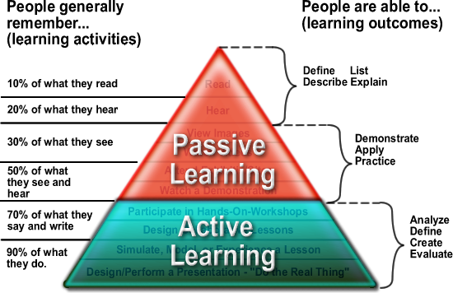
Learning Pyramid

Slide 13
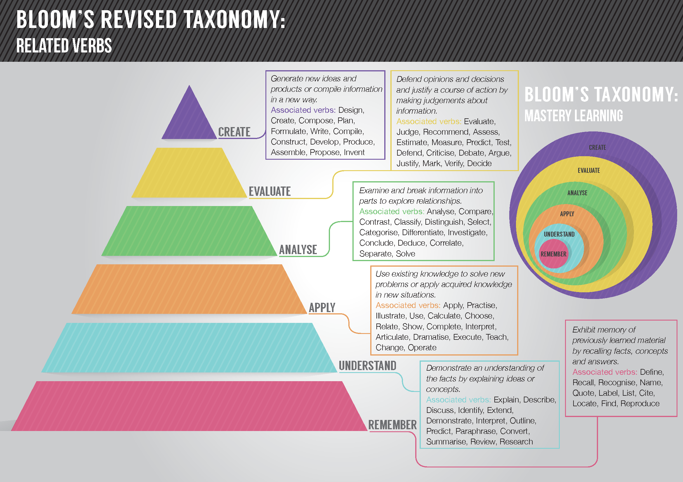

Slide 14
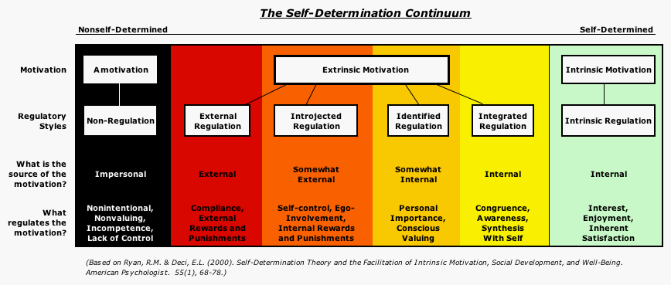
Self-Determination Theory
Reiche, S. (2013). The psychology of ex-pat motivation: From theory to practice. Retrieved from https://blog.iese.edu/expatriatus/2013/09/20/the-psychology-of-expat-motivation-from-theory-to-practice/

Slide 15
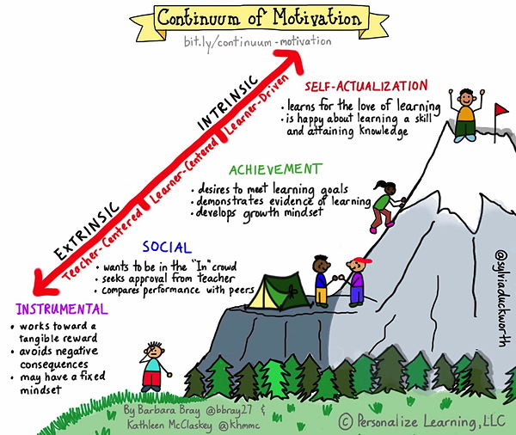
Continuum of Motivation TM by Barbara Bray and Kathleen McClaskey is licensed under a Creative Commons Attribution-NonCommercial-NoDerivatives 4.0 International License. Based on work at bit.ly/continuum-motivation* Graphic design by Sylvia Duckworth
Notes:
Continuum of Motivation TM by Barbara Bray and Kathleen McClaskey is licensed under a Creative Commons Attribution-NonCommercial-NoDerivatives 4.0 International License. Based on work at bit.ly/continuum-motivation* Graphic design by Sylvia Duckworth

Slide 16
Our Process
Establish desired results
Determine acceptable evidence
Group learning activities into chunks (cognitive load theory) (Sweller, 1988)
Notes:
Sweller, J. (1988). Cognitive load during problem solving: effects on learning. Cognitive Science, 12(2), 257–285.

Slide 17
Program Goals
Drake Library Circulation Student Workers will provide a pleasant experience for patrons using circulation services.
Drake Library Circulation Student Workers will effectively assist patrons with all tasks related to Circulation

Slide 18
Project Acquisitions
Providing excellent customer service
Executing circulation procedures
Explaining policies and procedures
Maintaining accurate time records
Identifying when a supervisor is needed and bringing a supervisor to the Desk
Identifying when a librarian is needed and contacting the appropriate librarian

Slide 19
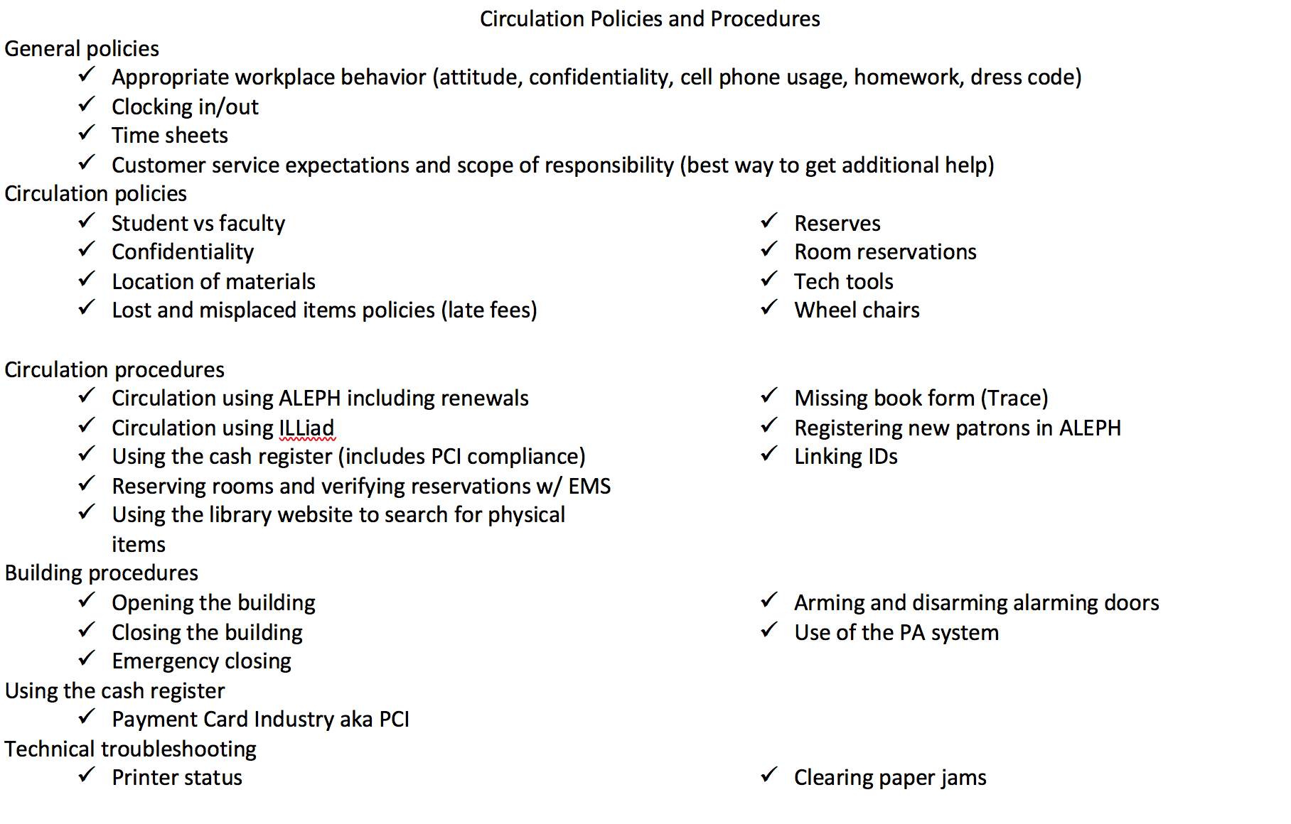
Project Acquisitions

Slide 20
Assessments
Blackboard Quizzes & Tests
Checklist for in-person events
Reflections (rubric-based)

Slide 21
Assessment - Checklist
Each student gets one
Only supervisors/trainers can initial it
Requires student accountability

Slide 22
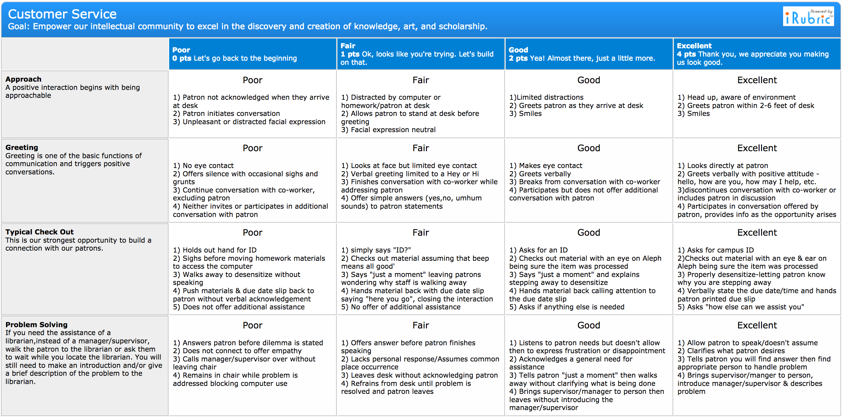
Assessment – Rubric

Slide 23
Modules – Standard Layout
Goals & Deliverables
Instructional Content
Assessments (if electronic)

Slide 24

Modules Brainstorm
Theoretical based
Notice Aleph is the last module listed.
Aleph content will be swapped with ALMA content next Summer.

Slide 25
Module Planning Process
Start with the Goals
Write down the assessments
  Checklist items
  Blackboard activities
Brainstorm activities
  Order them consecutively

Slide 26
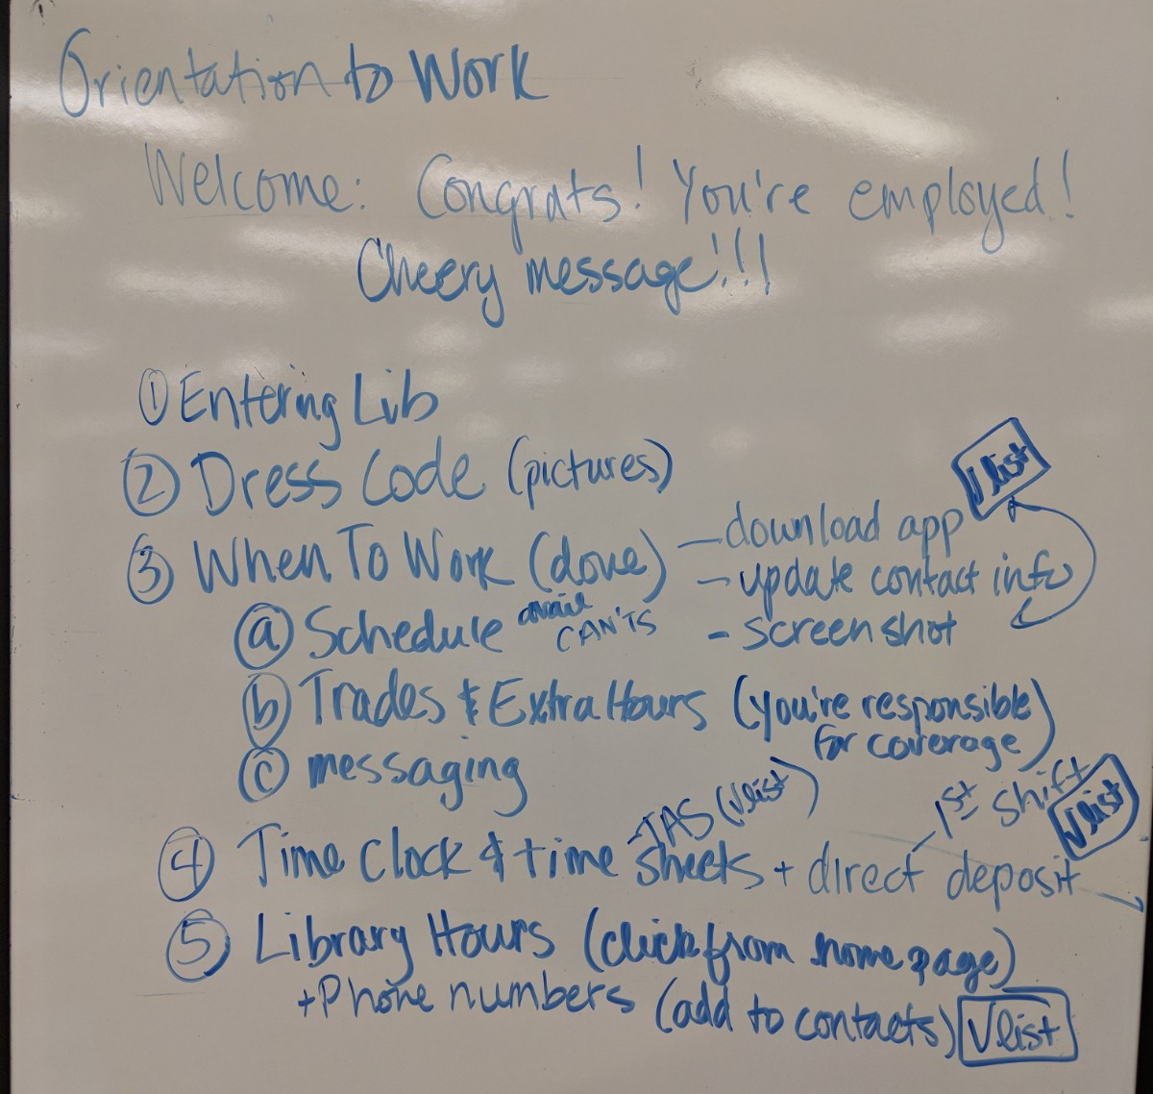
Module Planning Process

Slide 27
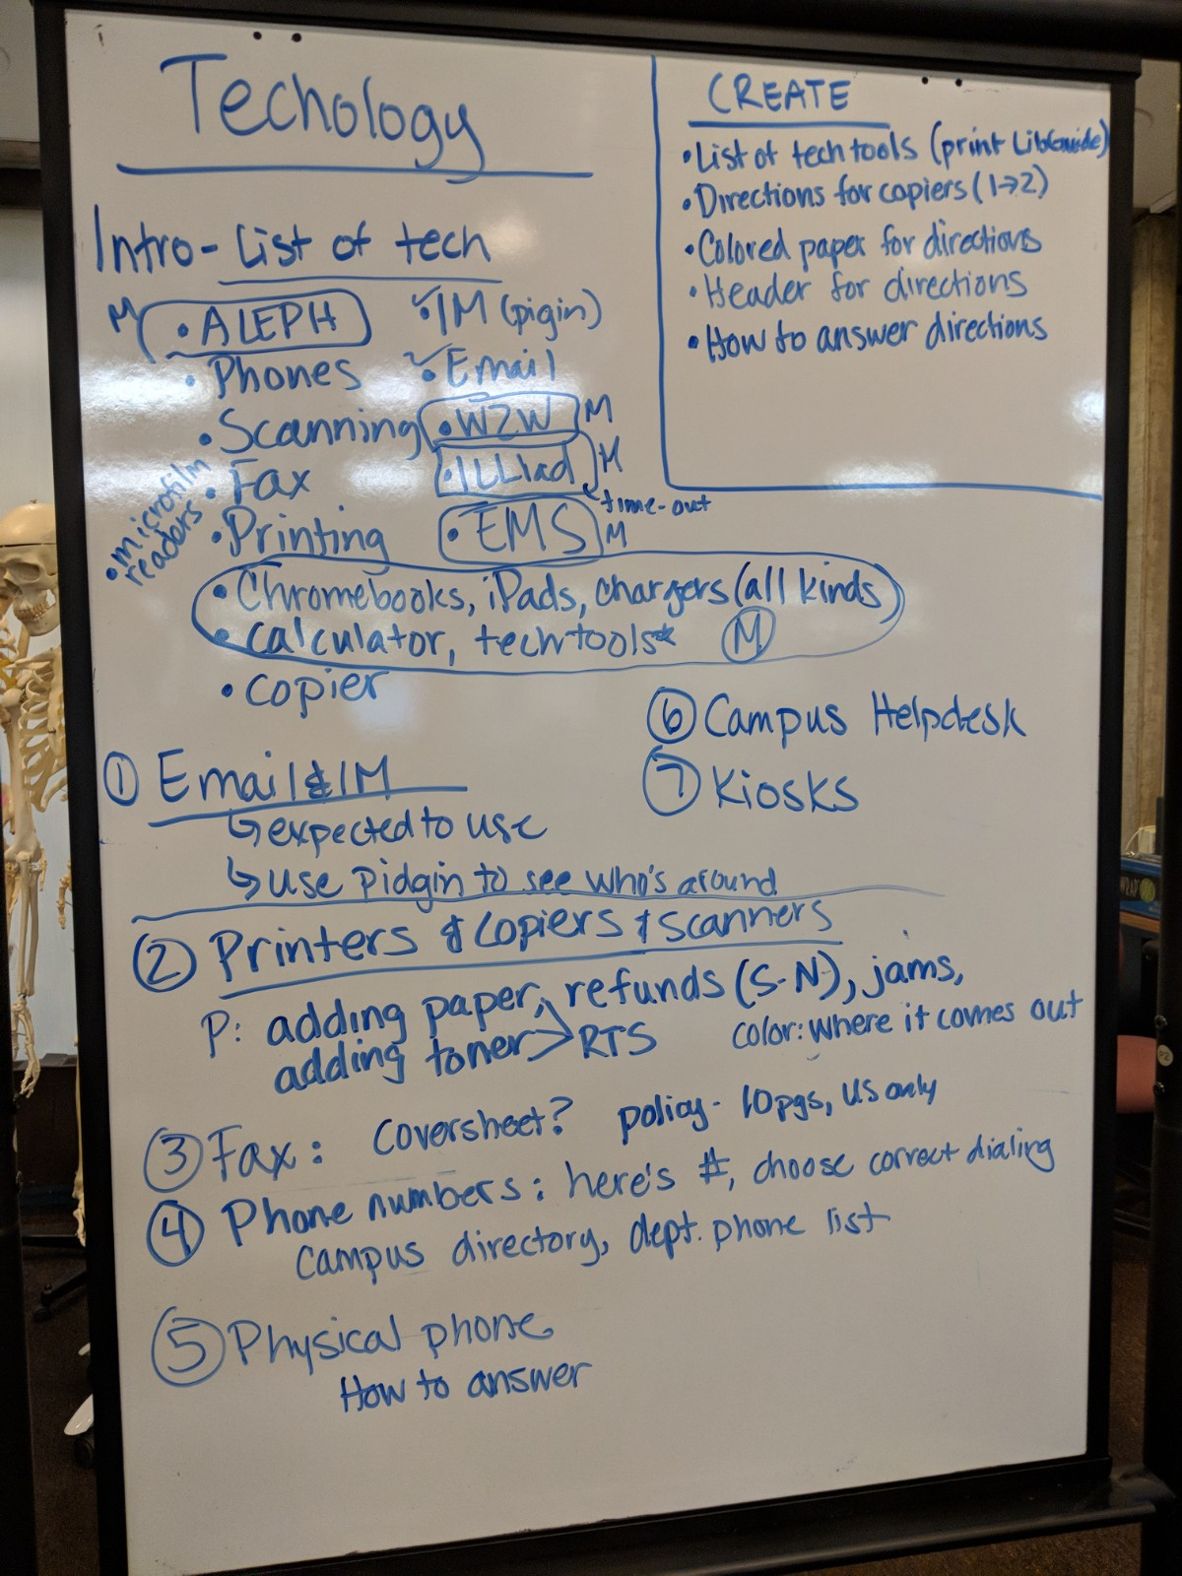
Technology Module
See how quickly a module gets to be huge.

Slide 28
Implementation
Planned on a Word doc
Group think and individual work
Weekly meetings (1-1.5 hrs)

Slide 29
Plans for ALMA
Training is mostly theory based
Vendor videos or TWG videos will be used
Seen as part of a normal revision process.

Slide 30
Questions?
Logan Rath
lrath@Brockport.edu

