Slide 1
You, the People, make it possible
Kurt Munson
26 July, 2018

Slide 2
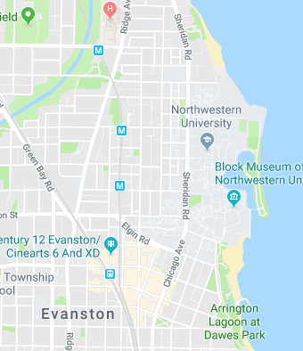
When Zack came to Evanston…
Ostensibly to talk about IDS Logic and Staffing…
But we ended up talking policy changes based on data we were independently collecting…

Slide 3
It’s People that make change

Slide 4
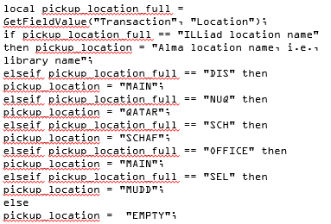
We always want to go to the software, first.
But the people are really much more important.
Having those conversations and discussing those points of friction…

Slide 5
Because…
Conversations lead to position changes…
Changes provide opportunities to make things better…

Slide 6
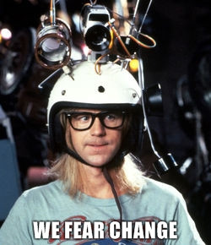
Do not be Garth, do not fear change.
Question the why behind it, yeah.
But do not fear it.
http://i0.kym-cdn.com/photos/images/newsfeed/000/488/482/30f.jpg

Slide 7
We need to define and make our own future less others force their version of it upon us.
You have to be engaged. You have a right and an obligation to contribute to the conversation.
But let’s face it- ILL folks, really never shut up.

Slide 8
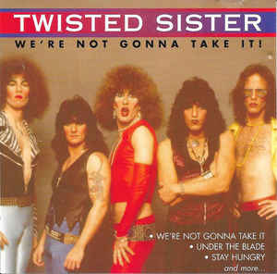
Engagement makes you a partner.
Moreover, it gives you the ability to say:
“No, we’re not gonna to take it!”
https://www.discogs.com/Twisted-Sister-Were-Not-Gonna-Take-It/release/880915#images/26168096

Slide 9
It’s OK to have opinions, you just have to back them up with reasons.
“If wishes were trees, the trees would be falling Listen to reason, reason is calling”
- Stand, R.E.M

Slide 10
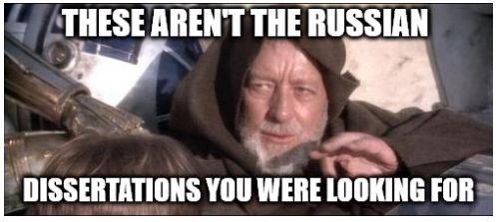
You have Tacit Knowledge built over the years. Use it.

Slide 11
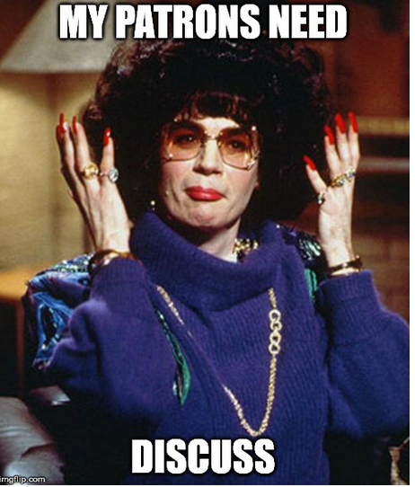
What do your observations tell you?
Are other people observing
the same thing?

Slide 12
What do your interactions with your users tell you?
Are other people experiencing the same thing?
https://3ovyg21t17l11k49tk1oma21-wpengine.netdna-ssl.com/wp-content/uploads/2014/09/Feedback_Loop.png

Slide 13
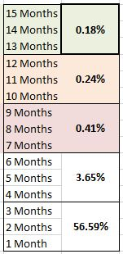
What does your data tell you? Does somebody else’s data show the same thing?

Slide 14
You are the Experts
Repeat ^{x} ¹⁰⁰⁰

Slide 15
You have Trust Networks. ILL is basically one ginormous trust network.
Trust networks are a radical idea for lots of people to grasp.
We have each other’s backs, we have to.

Slide 16
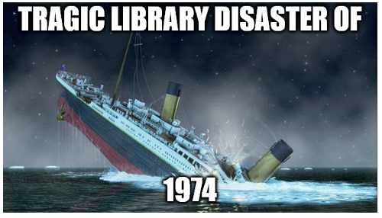
We do NOT need to do it the same way we have always done it.
AKA: The tragic library disaster of 1974 that we must ensure never happens again.

Slide 17
“Can’t never did anything”
- Ida De Schepper (my great grandmother)

Slide 18
Change provides an opportunity to do things better.
NOT!

Slide 19
Steer the future of the service.
Use your knowledge.
Make it better for you and your users.

Slide 20
Thank You
Kurt Munson
Northwestern University
kmunson@northwestern.edu
@KurtMunson

