Slide 1
Welcome
IDS Project Members!

Slide 2
IDS Community

Slide 3
VUG discussion Topics
Please submit your discussion topics for the Discussion Group Meetings.
https://forms.gle/gXCkWgL6myXnE8nC9

Slide 4
VUG Discussion Groups
Western User Group Discussion
May 7, 2020 11:00 AM Eastern Time (US and Canada)
Virtual User Group Discussion
May 7, 2020 03:00 PM Eastern Time (US and Canada)
METRO User Group Discussion
May 8, 2020 11:00 AM Eastern Time (US and Canada)
Eastern User Group Discussion
May 8, 2020 02:00 PM Eastern Time (US and Canada)
https://www.idsproject.org/usergroups.aspx

Slide 5
New directors
Jessica McGivney, Director of Regional User Groups
Beth Posner, Director of Mentors
Logan Rath, Director of Online Learning

Slide 6
Admin updates
Cathy Taylor has rejoined the IDS Project!
Currently revising Basecamp and our onboarding policies and processes for new member libraries
The Online Learning Institute and Online Mentor Institute are now combined under Director of Online Learning
We will be looking at a time for the next Mentor Institute
Jennifer Acker will continue to work with the IDS Admin Team – Thank you Jennifer!

Slide 7
IDS Project Membership Growth

Slide 8
Mentors:
Jennifer Acker (Hudson Valley Community College)
Silvia Cho (CUNY Graduate Center)
Michelle DeLaFleur (Utica College)
John De La Fontaine (Occidental College)
Ronald Figueroa (Syracuse University)
Heather Gad (SUNY Oneonta)
Timothy Jackson (SUNY)
Jay Kibby (College of St. Rose)
Will Koch (CUNY Brooklyn College)
Jessica McGivney, Director of Regional User Groups (SUNY Farmingdale)
Melissa Perez (University of Texas San Antonio)
Beth Posner, Director of Mentors(CUNY Graduate Center)
Logan Rath, Director of Online Learning (SUNY Brockport)
Sarah Shank (Ithaca College)
Chris Sisak (Nazareth College)
Elise Thornley (Binghamton University)
Heidi Webb (Upstate Medical)
Chris White (Sage Colleges)

Slide 9
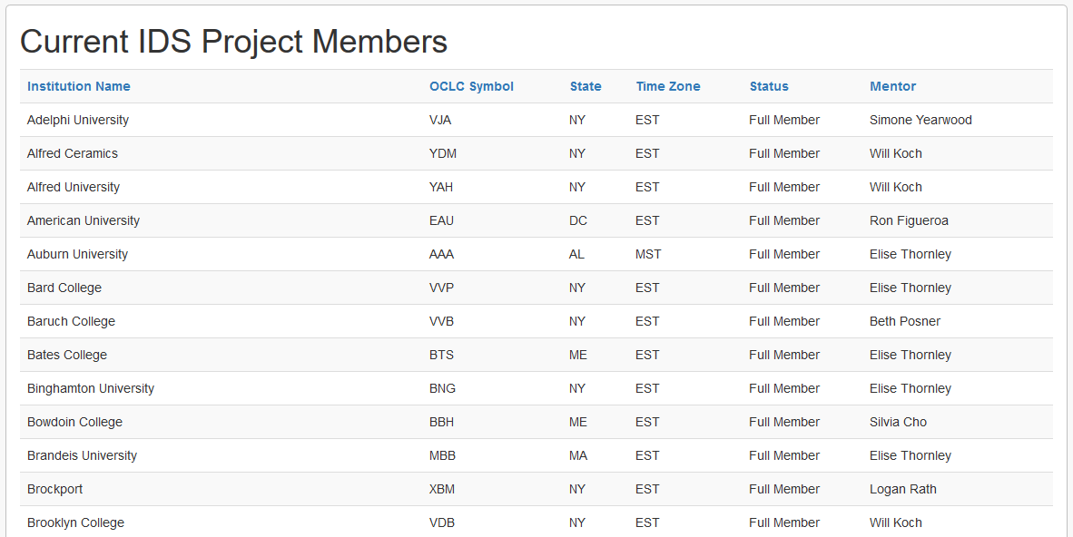
https://www.idsproject.org/About/memberlist.aspx

Slide 10
IDS Technology

Slide 11
Tableau

Slide 12
Data Services
Looking for Tableau developers
Need volunteers to help with statistics needs
If you are interested or know someone that is, please send an email to mark@idsproject.org
Will use data from IDS Logic to build charts and reports
Project wide charts similar to original TPAM charts
Individual library charts and reports for end of year

Slide 13
Decision support Pipeline

Slide 14
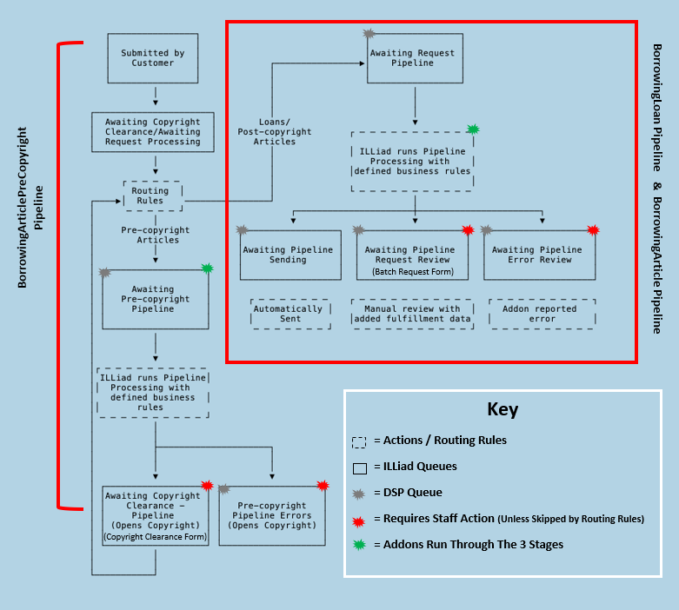

Slide 15
DSP and IDS Logic
Article Gateway works on Awaiting Copyright Clearance queue
A routing or Logic rule is required to move requests out of the ACC queue to the Awaiting Pre-Copyright Pipeline
DSP addons, such as DOI Import and Open Access Button run at this point
Requests are processed then moved to Awaiting Copyright Clearance – Pipeline or completed if an OA item is available
Requests are updated with a set text value in one unused field then sent back to Awaiting Copyright Clearance
The set text value prevents the routing or Logic rule from moving the request back into the pipeline

Slide 16
DSP and IDS logic
More testing over the next few weeks to get the process working completely
Thank you to Angela Persico at U Albany for all the work she has done.
Thank you to Tim Jackson at SUNY.

Slide 17
IDS project website
We will be updating the IDS Project website over the next year
Currently forming a group of people to determine our needs and to design the site
Once the design is set, we will determine the best way to procede on development
If you are interested in working on the new site, please send an email to mark@idsproject.org

Slide 18
The summer conference will be virtual due to COVID-19, travel bans at many colleges, and general financial issues that all colleges are facing.

Slide 19
We are currently accepting proposals for presentations and round table discussions: Resource Sharing Best Practices Shared Staffing and Training Electronic Resources and Resource Sharing Workflow Improvements Cooperative Collection Development Shared Print Collections Resource Sharing in Next Gen Systems Purchase on Demand Addon Development Decision Support Pipeline API Development/Use https://bit.ly/2L17Wz8 The All Region User Group will not be held this summer.
Notes:
The IDS conference was established in 2004 to support the training and collaboration of the IDS community ; one which continues to grow. With funding for staff development and training at a premium we have strived to make this conference not only relevant but affordable.

Slide 20
Thank you!
https://github.com/idsproject

