Slide 1
Tips & Tricks
for Setting Up Your
Custom Holdings
Kristen Heinrich
Purchase College (ZPM)
Notes:
I think reviewing custom holdings groups and holdings is not an easy task especially if it hasn’t been done in a while or you have never been the one to update them!
However, it is very important to review groups and paths if you use automation!
The first time I tried to complete the task without any kind of planning and didn’t get very far. Because it was so overwhelming I had mentor Jen help me get started! I decided to start from scratch and decide what groups would work best and how those groups fit into my libraries paths!
Since then I have created an Excel and Word document to help me organize everything. I will share them with you a little later on in the slides
I try to review my groups and paths twice a year now but sometimes I just update my IDS new members. Summer is is when I do a major overhaul of all groups and paths!
“Nothing runs well when it is ignored!”

Slide 2
Agenda
What are Custom Holdings Groups and Paths?
Where are Custom Holdings Located?
How to set your Automated Request Manager
How to customize your Groups and Paths for your libraries needs.
Examples of what works for my library.

Slide 3
What are Custom Holdings Groups and Custom Holding Paths?
Custom Holdings Group
A custom holdings group is a record that contains the OCLC symbols of preferred lenders for a particular category of borrowing activities.
Ex: IDSALL, IDSNY, ONLYSUNY, MetroNoChargeArticles, LVISSCORESNE...
(20-character limit, with no special characters)
Custom Holdings Path
A custom holdings path is a record that contains the names of holdings groups appropriate to a set of requests. Within the holdings, path record are listed holdings group records in order of borrowing preference.
Ex: Direct Request, Books, Articles, Scores…
(20-character limit, with no special characters)
Notes:
The examples are what works for my library
Make yours the way that work for your library or what you will remember what they include!
They limit to you to 20 letters with no spaces and special characters

Slide 4
Where are your
Custom Holdings Located?

Slide 5
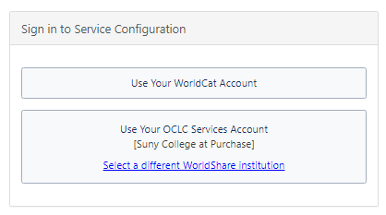
Custom Holdings are located in your Worldcat/WorldShare Account
ILLiad Client
ILLiad Client > System > OCLC Resource Sharing Settings > Sign in to Worldcat/Worldshare Account
Notes:
Link to Worldshare is located in your ILLiad Client in the System tab click on OCLC Resource Sharing Settings
You will have to have your account information to sign in.
For more information on the Login https://www.oclc.org/en/services/logon.html

Slide 6
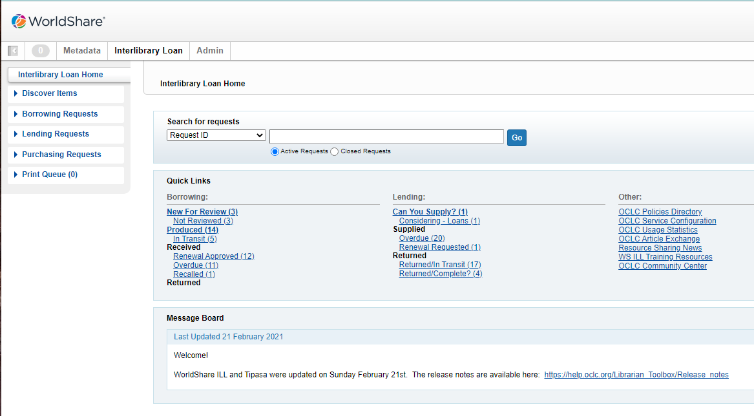
Worldshare Webpage > Quick Links > OCLC Service Configuration
Notes:
Once you are in Worldshare look for quick links and then in other you will see OCLC Service Configuration

Slide 7
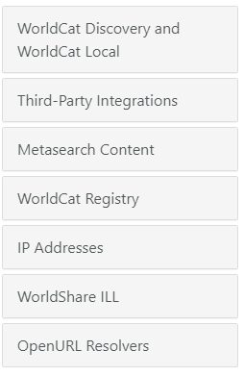
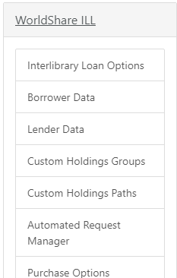
WorldShare ILL > Custom Holdings Groups, Paths and ARM
Locate & Select WorldShare ILL
You will see Custom Holdings Groups, Custom Holdings Paths & Automated Request Manager (ARM aka. Direct Request)
Notes:
Once Service Configuration opens the menu on the left hand side you will see Worldshare ILL.
That will open all ofthe Custom Holdings ILL information

Slide 8
Custom Holdings
Groups
OCLC Help Guide: Custom Holdings Groups https://help.oclc.org/Resource_Sharing/WorldShare_Interlibrary_Loan/Service_Configuration_Settings/040Custom_Holdings_Groups

Slide 9
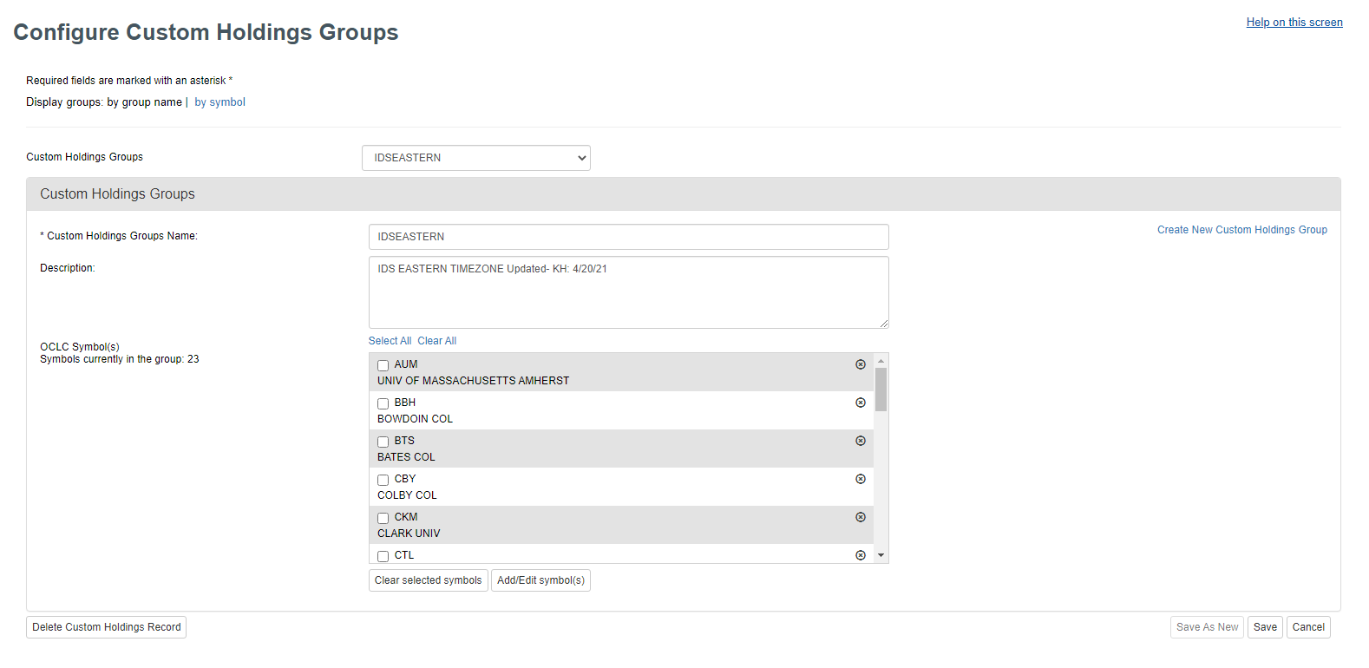
Custom Holdings Groups Page Layout
Holdings Groups
Custom Group Name
Group Description
Holdings Group- List of Custom Groups you have made
Custom Group Name- Custom Names that work for your library
Group Description- what symbols are included in the Group, Date and Initials of who made the updates
SAVE- SAVE SAVE SAVE! THERE IS NO AUTOSAVE!

Slide 10
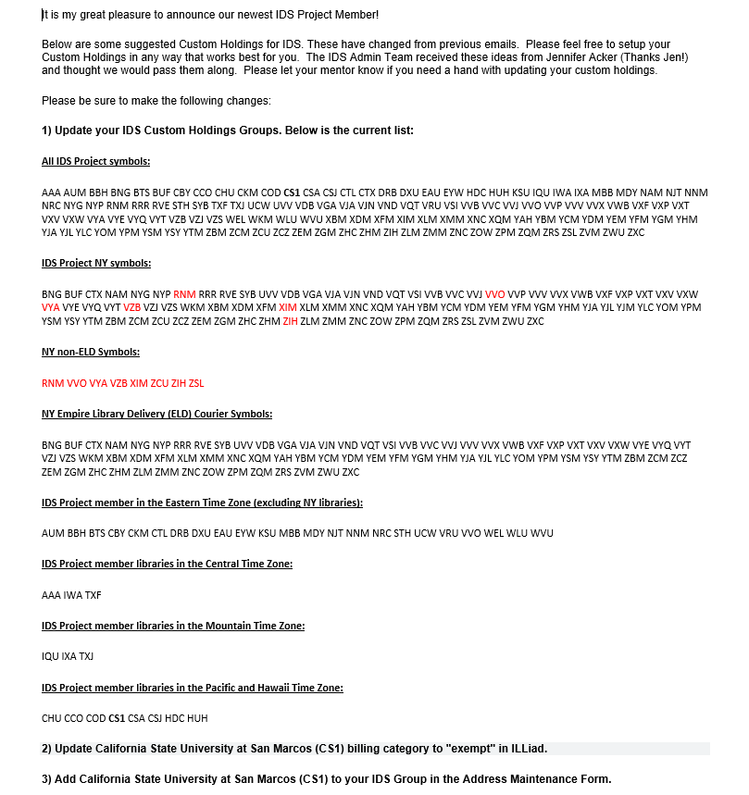
How do you Customize Group Symbols?
IDS Listserv New Member Announcement
Policies Directory in ILLiad Client
IDS Discussion lists/listservs
Notes:
Everytime is a new member is add to the IDS Project and email will be sent to the IDS Listserv
You can customize from the Policies Directory

Slide 11
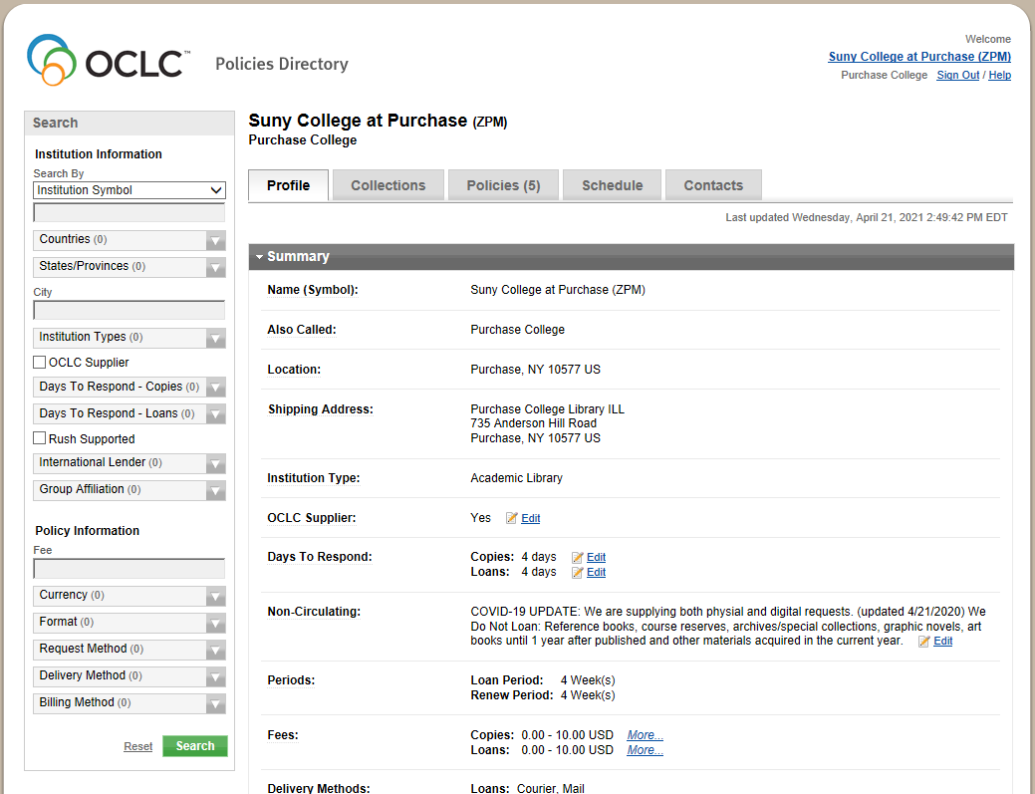
Find Library Symbols using Policies Directory in ILLiad Client
Ways to Narrow Searches for Symbols
State
City
Type of Institution
# of Days to Respond - Copies and Loans
Group Affiliation- IDS, LVIS, Metro, etc.
Billing Method- IFM, Invoice, Credit Card, etc.
Format- Book, CD., Scores, etc.
Request Method- Docline, Mail, etc.
Delivery Method- Odyssey, Article Exchange, etc.
Notes:
From the Policies Directory you have the ability to change the search options that work for your library.

Slide 12
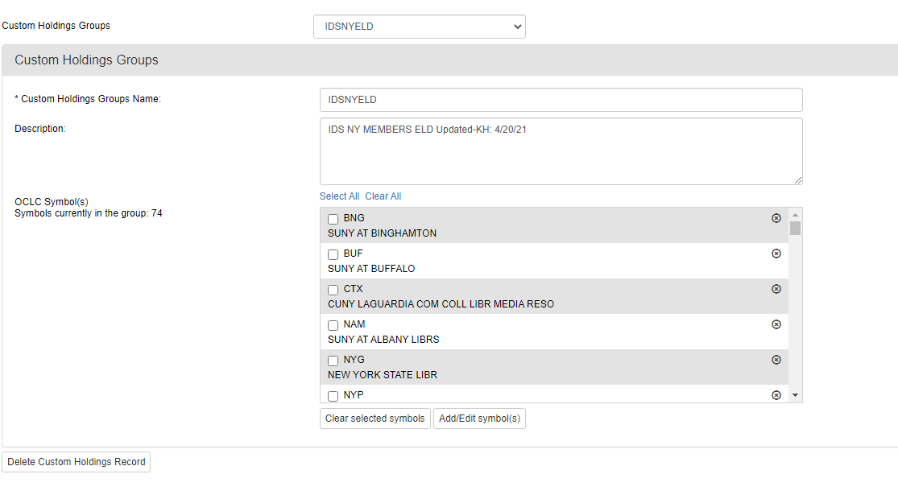
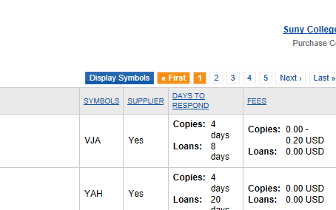
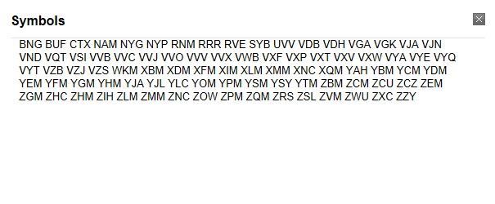
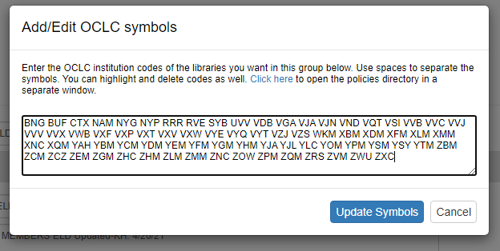
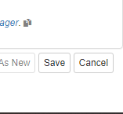
How to Display Symbols and add them to your Custom Holdings Group
Add/Edit Symbols
Notes:
On the right is the Policies directory where you gather your custom symbols and on the left is your Worldshare account Custom Holdings Groups

Slide 13
Custom Holdings
Paths
OCLC Help Guide: Custom Holdings Paths https://help.oclc.org/Resource_Sharing/WorldShare_Interlibrary_Loan/Service_Configuration_Settings/050Custom_Holdings_Paths

Slide 14
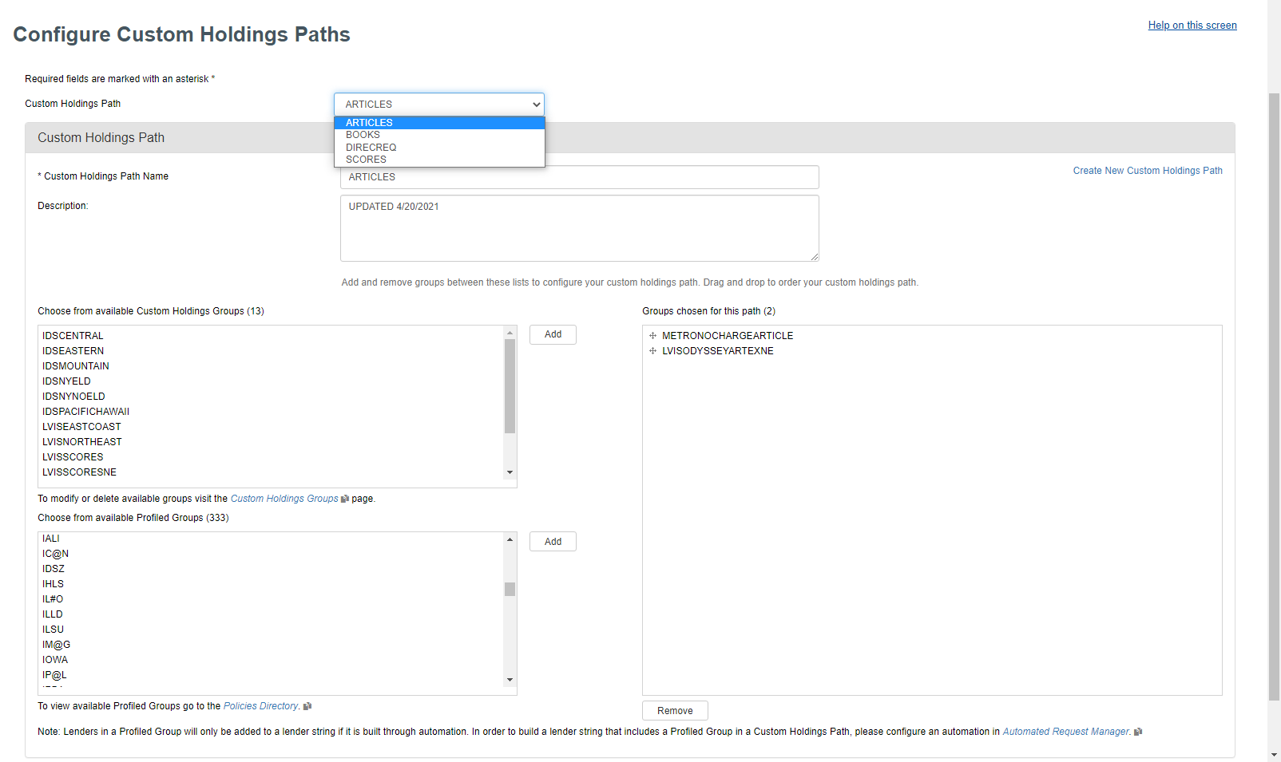
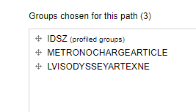
Create New Custom Holdings Path- how to make a new path that works for your library
Paths- List of Custom Paths you have made that works for your library
Custom Holdings Groups- Custom Groups that work for your library (previously made.) CLICK ADD
Profile Groups- IDS is IDSZ (OCLC automatically updates when changes are made to this profile group.) CLICK ADD
SAVE AFTER EACH EDIT- THERE IS NO AUTOSAVE!
Holdings Groups
OCLC Profile Groups

Slide 15
How to set your Automated Request Manager (formerly Direct Request)
OCLC Help Guide: ARM > Direct Request https://help.oclc.org/Resource_Sharing/WorldShare_Interlibrary_Loan/Service_Configuration_Settings/060Automated_Request_Manager

Slide 16
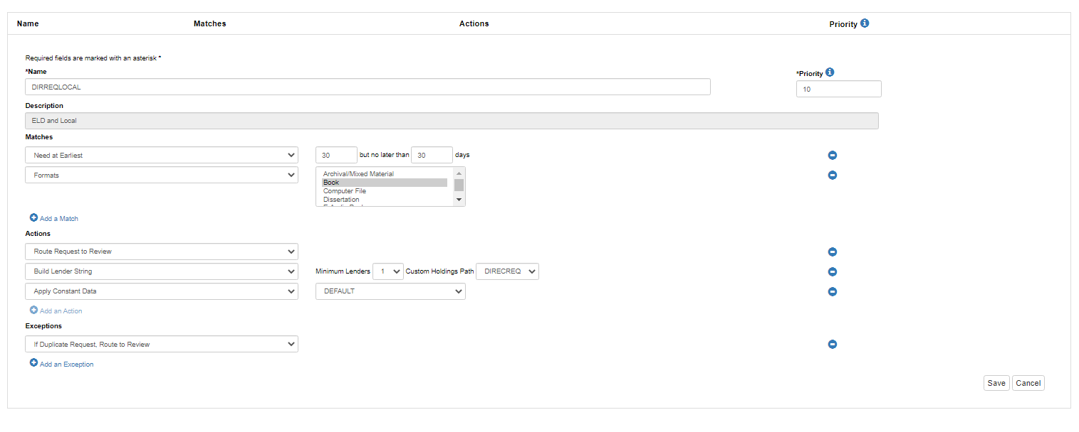
Automated Request Manager - ARM (formerly Direct Request)
SET IN PATHS
Notes:
Minimum Lenders- put as1- if there is one library that is available it will send auto send it.

Slide 17
Which Paths & Groups
Work for Your Library?

Slide 18
Here is criteria that works for Purchase College Library in New York.
Your libraries could and should be different from us!
Physical Items- Direct Requests, Books, & Scores:
IDS Project- Distance, Courier, & Time Zones
Metro- Libraries that do no charge
ALL SUNYs
We use this because sometimes the requests are passed on in Alma due to wrong record. Ex: eBook, Multiple catalog record, etc.
LVIS- Distance
Northeast states from NJ/PA to Maine
East Coast from Maine to Florida
Articles:
IDS Project- ALL
Metro- Metro- Libraries that do no charge
LVIS- ALL

Slide 19
*ENTERING SUPER OCD MODE*

Slide 20
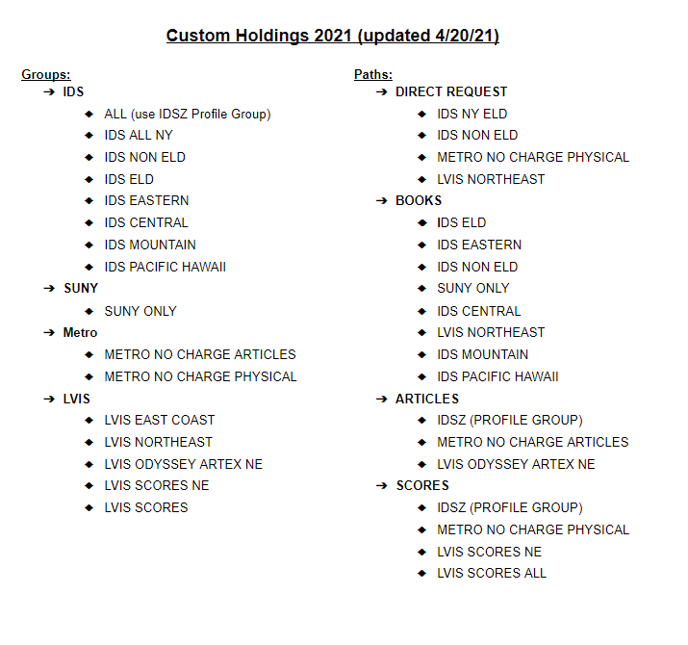
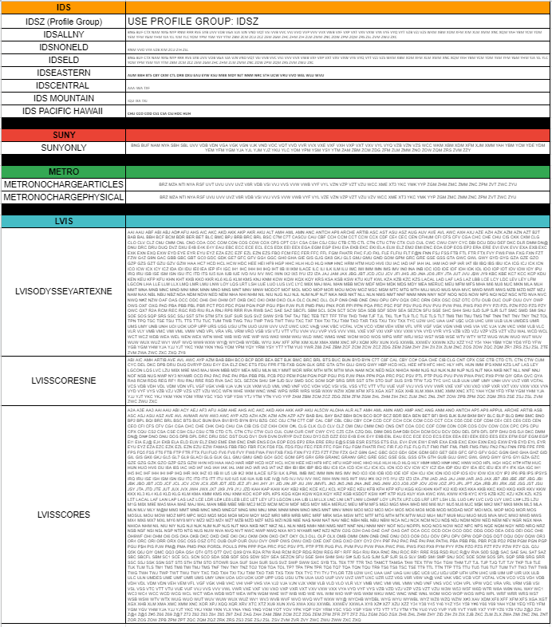
Word & Excel Documents
Notes:
On the left is my word doc that I have both the groups and paths
On the right is my excel with all of my symbols for my paths that can copy and paste right into my Custom Holdings Paths. Much easier to do this and have it all together then to flip back and fourth

Slide 21
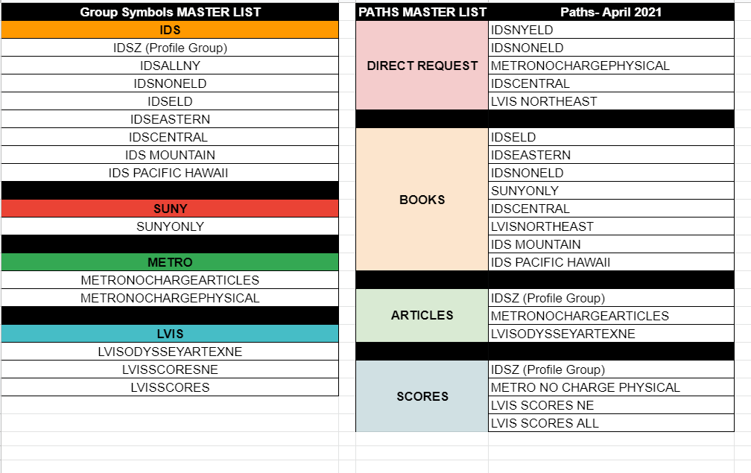
How do you organize Custom Holdings Groups & Paths in Excel
Notes:
On the left is my excel doc that I have both the groups and paths
On the right is my excel with all of my symbols for my paths that can copy and paste right into my Custom Holdings Paths. Much easier to do this and have it all together then to flip back and fourth

Slide 22
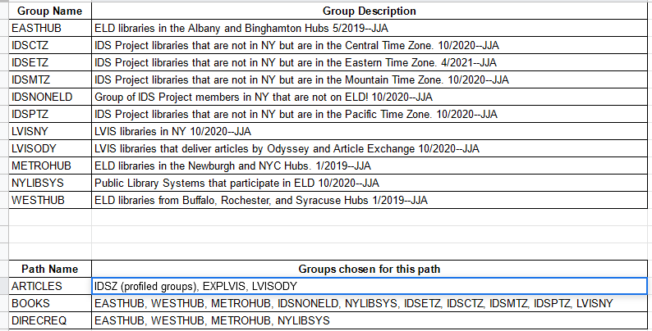
Another IDS Library in NY (Thanks Jen-HVCC!)
Notes:
Jen has shared her way of organizing her groups and paths.
She includes her descriptions that she uses in their Custom Groups Descriptions

Slide 23
Thank you!
Please feel free to contact me with any questions
or reach out to your IDS Mentor!
Kristen Heinrich
kristen.heinrich@purchase.edu

