Slide 1
Workflow Overview: Adding and Deleting IDS Project Members
Created by Jennifer Acker
Sr. Clerk - Resource Sharing - Hudson Valley Community College
IDS Project Manager - IDS Project
Notes:
Hello my name is Jennifer Acker and I am the Sr. Clerk for Resource Sharing at HVCC. I am also the IDS Project Manager.

Slide 2
What do I change and where?
These apply to both adding or removing IDS Project members!
ILLiad (affects Lending)
Group Maintenance
Billing - Exempt (if you charge)
OCLC Configuration (affects Borrowing)
Custom Holdings groups
Notes:
I think this is the million dollar question!!!
I wanted to have a slide with a brief answer but don’t worry we will take a closer look at each of these bullet points!

Slide 3
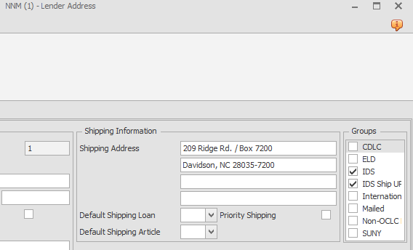
ILLiad - Group Maintenance
In a lenders address you will see a section called Groups. These groups will be different for each library. These groups are great when you want to run Web Reports in ILLiad!
**Note: If a library is leaving the IDS Project you will have to uncheck the appropriate groups.**
Atlas documentation: https://support.atlas-sys.com/hc/en-us/articles/360011912593-ILLiad-Groups-Maintenance
Notes:
You will see the Groups section when you look at a lender’s address. Groups will be different for each library and libraries can have check marks for more than one group.
As you can see some of the groups I have are for our local courier (ELD), International, SUNY, and IDS Ship UPS! I use groups so that I can pull specific data on a group using Web Reports. For example, I recelty added IDS Ship UPS. In the future I will pull lending data on this group to see how many loans we have done for this group. UPS is not a normal shipping method for us so I want to check on how many we have sent periodically.

Slide 4
ILLiad - Billing
Does your library bill other libraries using ILLiad?
Does your library not bill other libraries?
Image from Google: https://oaklandeye.com/billing-insurance/
Notes:
Some libraries do not bill any one or some libraries bill select libraries.

Slide 5
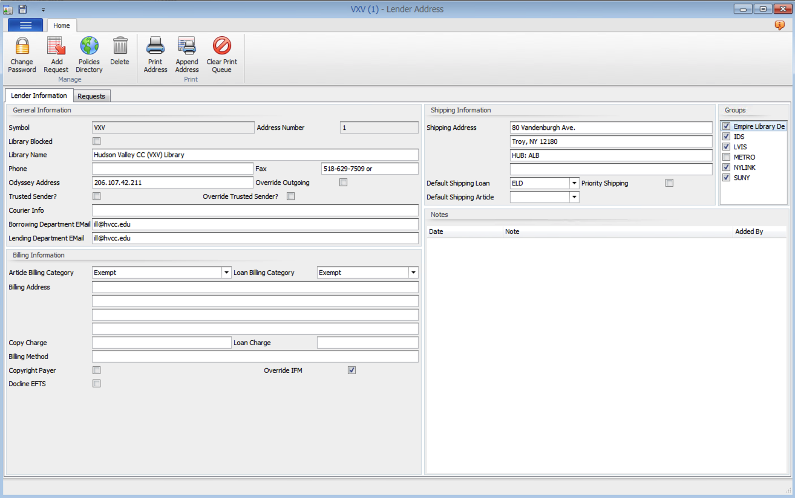
**Note: If a library leaves the IDS Project, you will need to decide if the library should still have Exempt billing status. **
If your library is currently charging the new IDS library then you will need to make them Exempt!!!
Notes:
If you are a library that bills then when a new library is announced or a library leaves you will have to look at the libraries billing category. If your library is billing them you will need to make them exempt.
When a library leaves the Project you will need to decide if the library should still have exempt billing status!

Slide 6
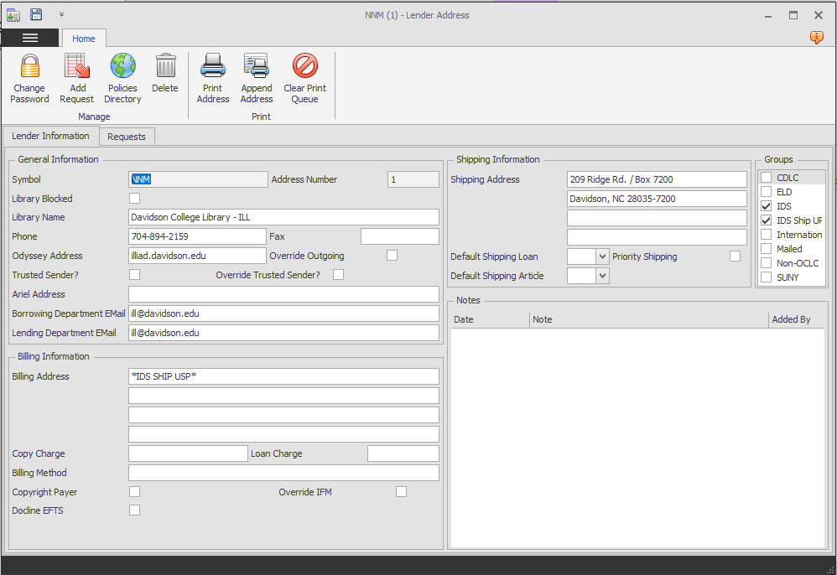
If your library doesn’t charge anyone you don’t have to do anything!!!

Slide 7
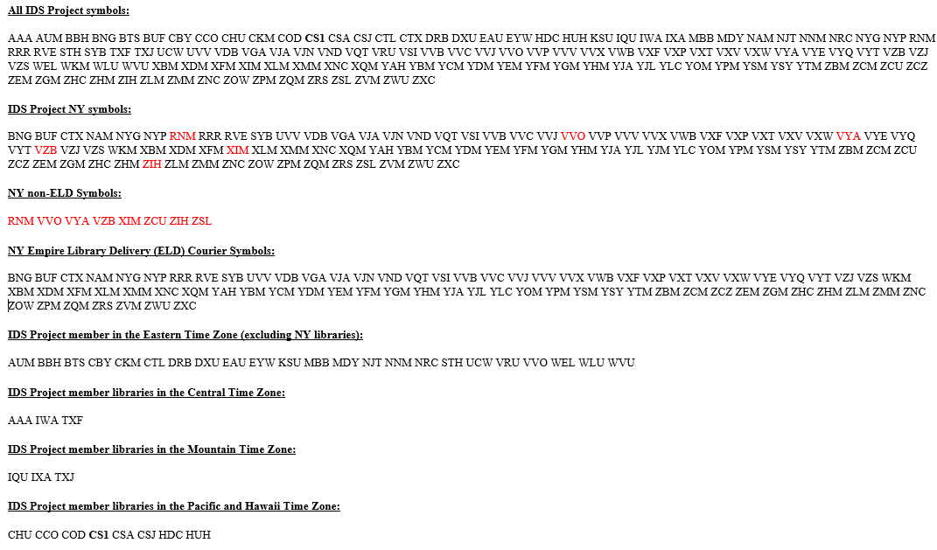
Emails from the IDS Listserv contain important member information
Please refer to the newest email that Mark Sullivan has sent out for the most current list of OCLC symbols! At this time the most current was sent on 11/30/2020.
Notes:
The email sent on 11/30 anounced 1 new member and the email on 10/30 anounced 5 new libraries. The email also included that IQU was listed under the Pacific time zone when it should be listed under the Mountain time zone. Did you see the emails where several New York community colleges left the Project?
The way the symbols now appear in the email is something we did to help members think about where our member libraries are by time zone. The list in this format came about because I was looking at creating IDS Project Custom Holdings Groups by time zone for my library. Custom Holding Groups and Paths are individaul to each library. We aren’t suggesting you change what you currently have but it is always a good practive to review your custom holding groups and paths peridocially. Usually this is a summer project for me!

Slide 8
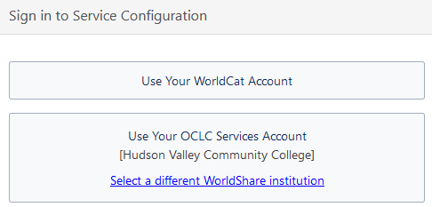
New Option on the System tab (starting with ILLiad 9.1)
From OCLC on the difference between logins:
The WorldCat Account uses your WorldCat.org account, if you have one. It also would need to be made an Authorized User under the WorldCat Registry section in order to make edits to a specific Service Configuration site.
The OCLC Services Account uses your WorldShare account, and is tied to the site that the WorldShare account is tied to. We often recommend using this login rather than the WorldCat Account if possible.
Notes:
Stating with ILLiad 9.1 you will see a new OCLC Resource Sharing Settings icon. This will take you to the sign-in for OCLC's Service Configuration. OCLC recommends libraries use the second option. This option is tied to a user's WorldShare account!
If you don't know your login information you could contact OCLC to get assistance.

Slide 9
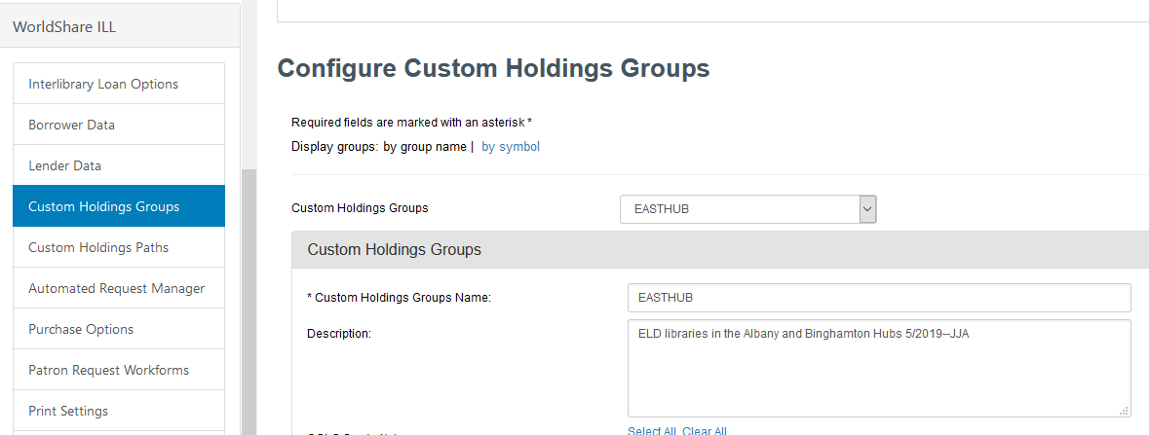
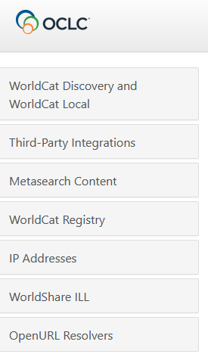
OCLC Configuration
Click the arrow to see the list of Groups!
Notes:
After you get logged into OCLC Configuration you will click on WorldShare ILL from the menu on the left-hand side. Then select Custom Holding Groups.
Click the arrow to see your comple list of Groups!

Slide 10
Which Groups should the symbol be added to
Since no library has the same Custom Holdings groups, we can’t tell you that! But we can tell you some things to think about when looking at your groups.
Do you have 1 IDS Project group? All new members would be added here!
Do you have special IDS Groups? They could be by State, Time Zone, or regional - Northeast, Southeast or East or West of the Mississippi.
Look at your description for each Group! If there isn’t one, add one. As a best practice, add your initials and a date.

Slide 11
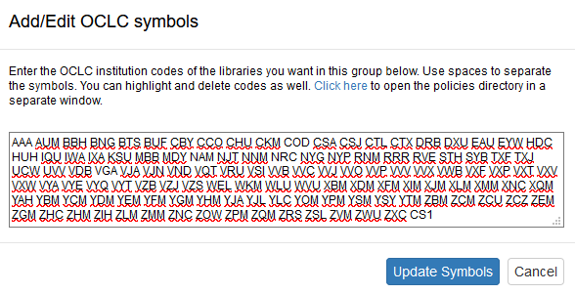
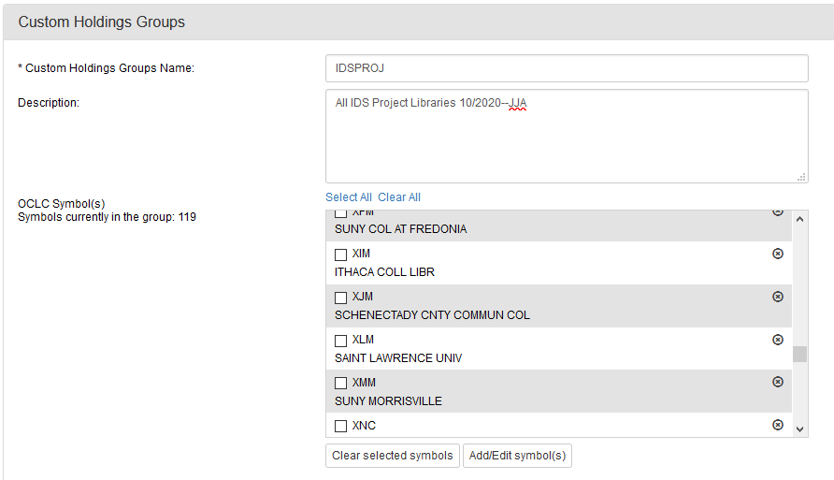
Add a symbol to a Group
Add your symbol(s) to then end of the list using only 1 space between each symbol.
Click Update Symbols
Don’t forget to click Save
Click Add/Edit symbol(s)

Slide 12
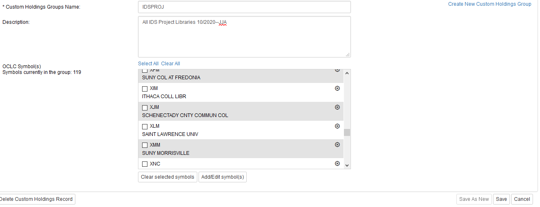
Remove a symbol from a Group
**Note: You would do the same assessment that you did to add a symbol when you need to remove a symbol.**
Don’t forget to click Save

Slide 13
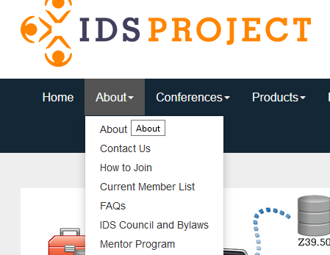
About on the IDS Project Webpage
Notes:
There are 2 very helpful webpages from under this menu.

Slide 14
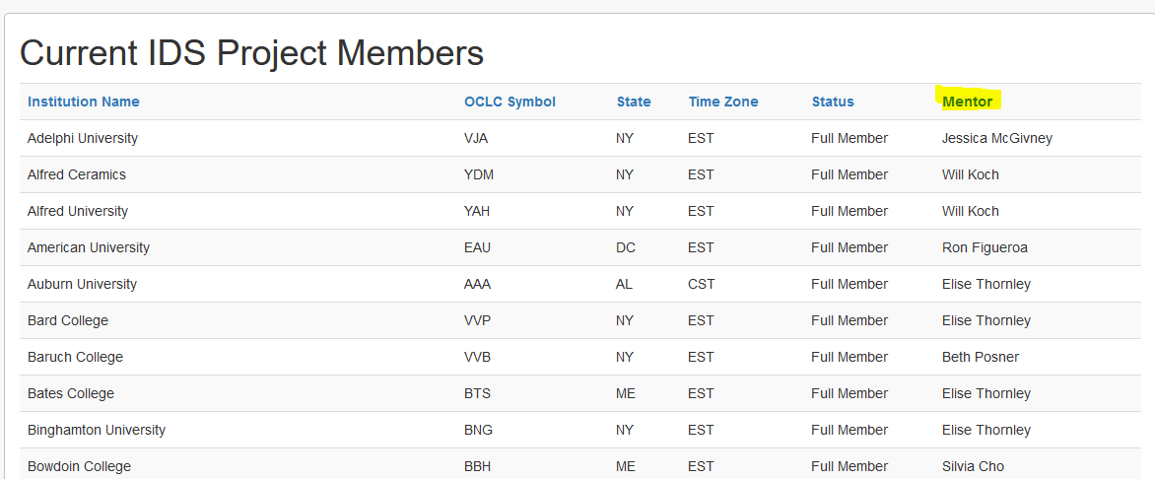
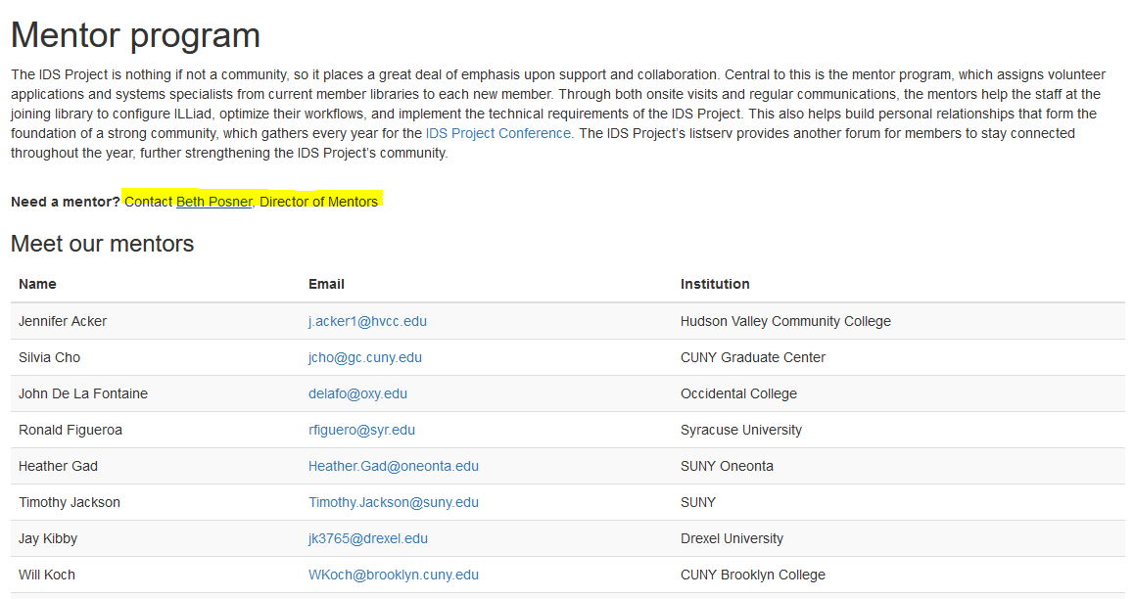
Two ways to find out who your mentor is
Current Member List Webpage
Email the Director of Mentors
https://idsproject.org/About/memberlist.aspx
https://idsproject.org/About/Mentors.aspx
Notes:
They are Current Member List and Mentor Program. These are public pages!
Current Member List: Find your library in the list and scan to the right to see your mentor name.
Mentor Program: Here you will find contact information for our mentors as well as an option to contact the Director of Mentors via email with questions.

Slide 15
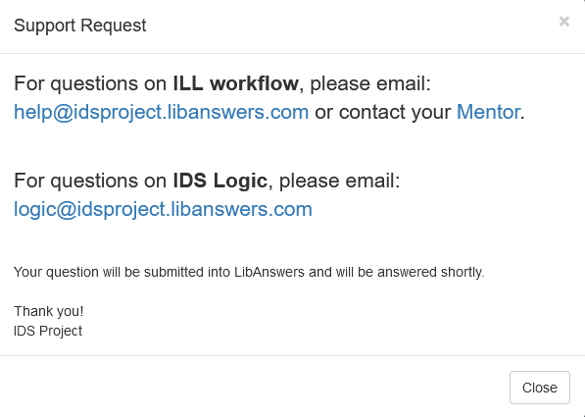
Submit Questions to LibAnswers
Notes:
There are 2 different emails! One for Workflow questions and one for Logic questions!

Slide 16
Questions? Thank you! Jennifer Acker j.acker1@hvcc.edu
Notes:
Feel free to unmute yourself. Are there any questions in chat? You can send me an email if you don’t want to ask something now or think of a question later!
Thank you!

