Slide 1
Getting It System Toolkit (GIST)
GIST Service & Workforce Impact
Tim Bowersox, Cyril Oberlander, Kate Pitcher, Mark Sullivan
IDS Conference, August 3, 2010

Slide 2
Agenda
Acquisitions, Collection Development & ILL
Setting the stage
GIST – Request Interface, Services and Workflow
Convergent workflow &/or units
Migration paths: where does the Library need to go next?

Slide 3
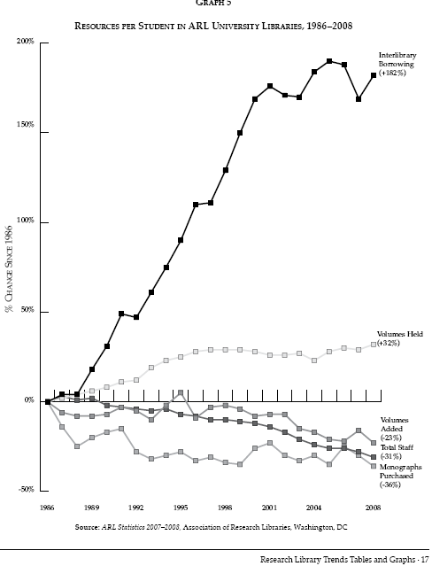
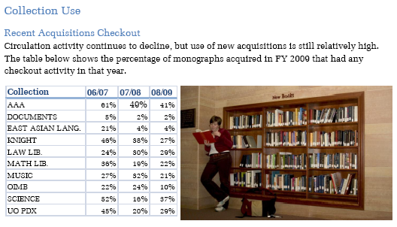
New books just in case
Main
Branch
Most libraries see less than 50% use of their new monographs
Notes:
The 2009 Library Annual report also the following information of interest – of the 16,761 new monographs purchased 08/09, with a monograph expenditures of roughly $1 M, the circulation % activity is well below 50%. P. 4, 17, 29.

Slide 4
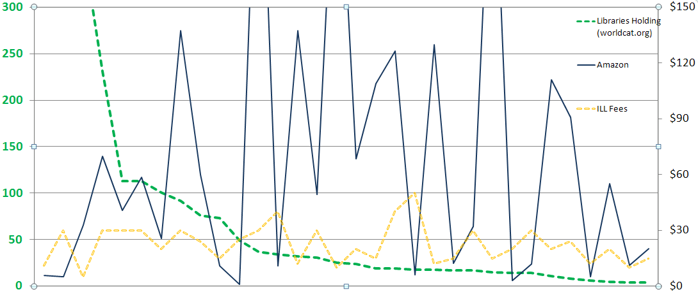
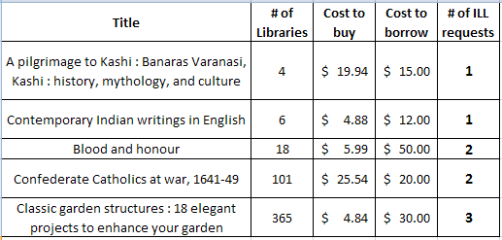
Strategies – Cost, Uniqueness, Use
Cost
# Libraries
Why Purchase on Demand / Just in Time Acquisition…
One study of Purchase on Demand books found that within 5 months
28.7% ILL Purchase on Demand books checked out again.
18% Regular Acquisition books were checked out once.
Ward, 2002
Notes:
From either an ILL borrowing or selection perspective, user initiated strategies can make a lot of sense. This graph is a look at Geneseo’s borrowing when we requested materials not held by SUNY and IDS libraries, and there were lending charges incurred for the request. The opportunity cost between borrow and buy, plus the collection diversification are key values useful for both ILL and collection development processes.
CLICK – here are some of the titles from the graphed sample. Pilgrimage & Garden examples.
CLICK – Lastly, if use is a measure of success in collection building, then Just in Time Acquisition has been shown to lead to subsequent use. How does that compare to many libraries selecting just in case that are fortunate if 50% of their new titles are ever checked out.

Slide 5
Models and Strategies
How much Just-in-Case (Librarian or Vendor) selection makes sense?
10% - 30% - 50% - 70% - 90% of monograph budget
How much Just-in-Time (User initiated) selection with data strategies i.e. cost to borrow, # holdings, etc. makes sense?
10% - 30% - 50% - 70% - 90% of monograph budget
Notes:
Do they know how much of their monograph budget is spent on this?

Slide 6
Models and Strategies
What strategies make sense?
User service focused | Collections focused | Financial focused | Other
User Initiated eBook POD ? | Cooperative /Coordinated Collection Development ? | Cooperative /Coordinated Collection Development ? | Technical Services Design: Gifts Weeding (5-10yrs) Digital Scholarship ?
Notes:
After slide – lead to next slide is – one strategy that is necessary is to have the various stakeholders working together…

Slide 7
We are a Divided house & Workflow
Acquisitions Librarian, Assoc. Director for Technical Services
ALA ALCTS
Chareston Conference
AcqNet
Library Acquisitions, Practice & Theory (later title: Library Collections, Acquisitions, & Technical Services)
Head of Interlibrary Loan
Access Services Librarian
Interlibrary Loan or Resource Sharing Librarian
ALA RUSA STARS & IFLA ILDS
Journal of Interlibrary Loan, Document Delivery & E-Reserve
Journal of Interlending & Document Supply
Journal of Access Services
Acquisition
ILL
Systems
Collection
Development
or
Subject Librarian
Systems Librarian
ALA LITA
Computers & Libraries
JASIST
Information Today
Library Journal
Science, Engineering, History, etc.
Librarian
ALA many separate divisions
American Libraries
Against the Grain
“for monographs, purchase may be a reasonable substitute for interlibrary loan.”
Holley, Robert, Kalyani Ankem, “The effect of the Internet on the out-of-print book market: Implications for libraries,” Library Collections, Acquisitions, & Technical Services, vol. 29, 2005, p. 118-139.
Notes:
Our house and family aren’t exactly on the same page, CLICK let’s look at the most obvious trend toward convergence with selection, just in time acquisitions, and purchase on demand…
Each stakeholder has very different views (ALA divisions, journal titles, etc.) of the elephant in the room, and each library type has a rather isolated view of the piece of the elephant they have. This is similar to Reference and Circulation.
The elephant is the relationship between collection, community, our identities and workflow…

Slide 8
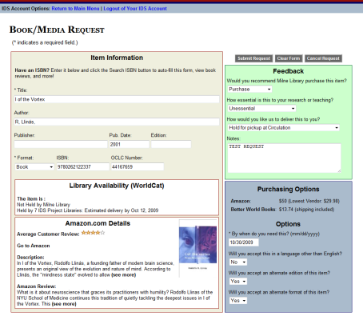
GIST for Web
GIST Request
Interlibrary Loan / IDS
Cancel or Unfilled
Filled
Borrow
Acquisitions
Filled
Buy
Cancel or Borrow
Requests are Transferable
Notes:
KATE
GIST requests can be either an ILL or Acquisitions request. For Geneseo, if the user recommends the library purchase the work, then the request is automatically routed into an acquisitions queue in ILLiad’s Document Delivery Module.

Slide 9
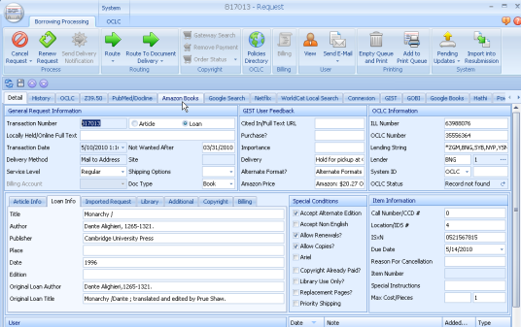
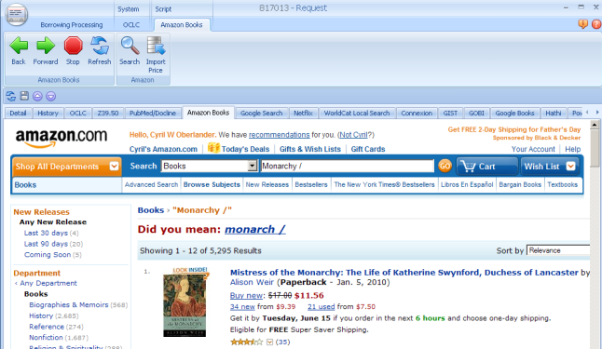
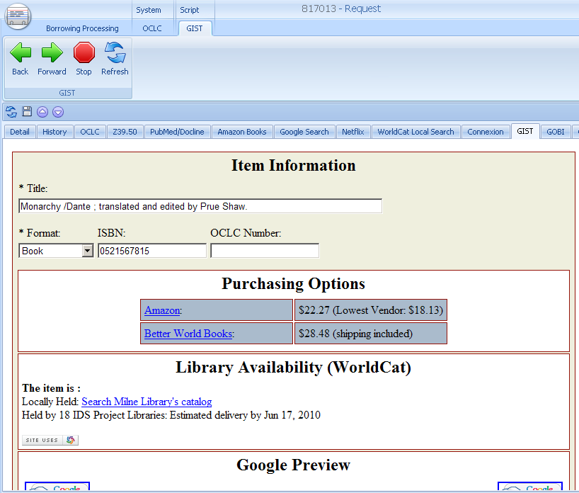
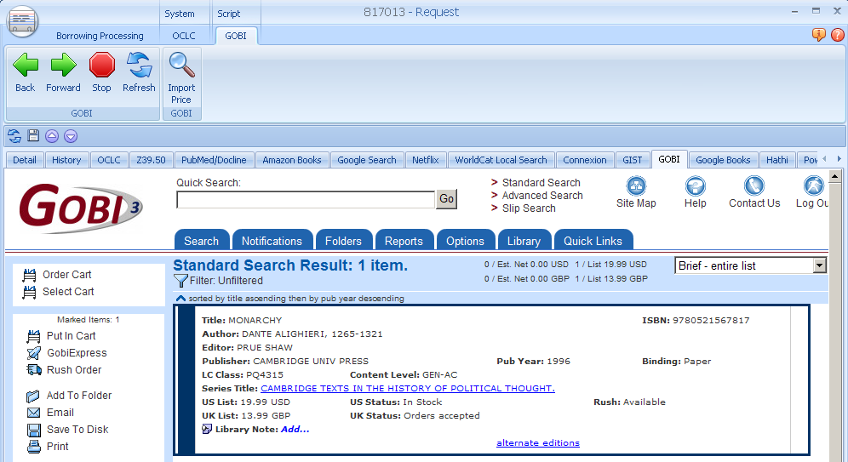
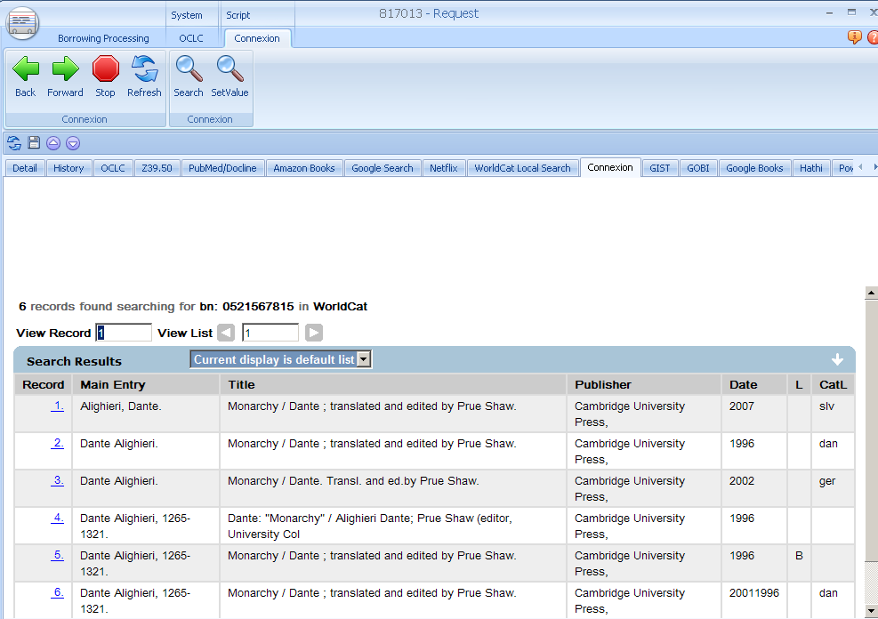
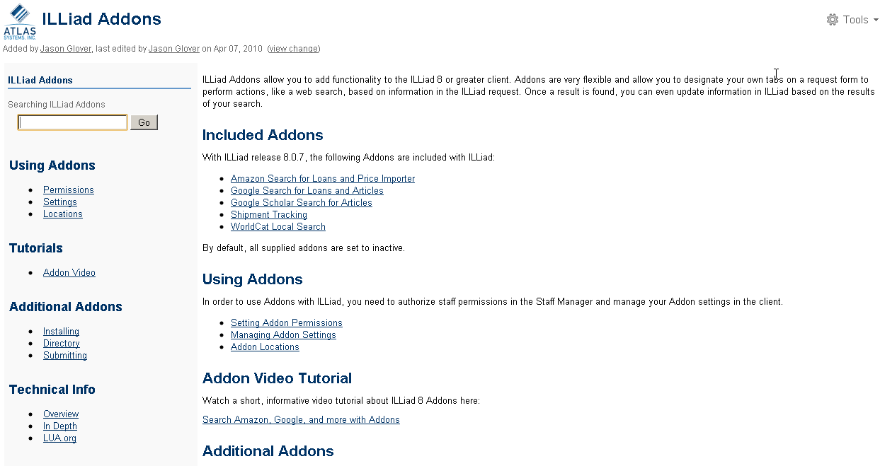
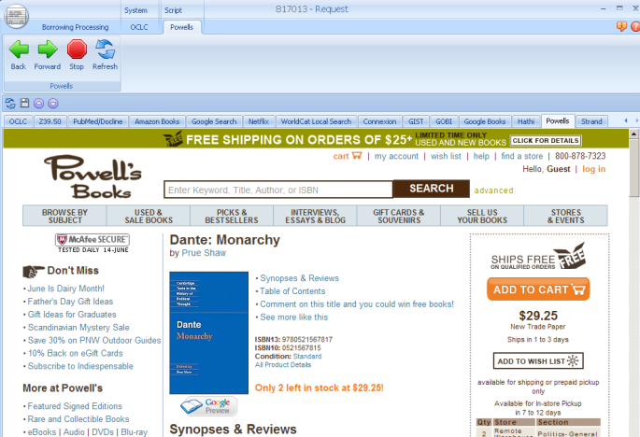
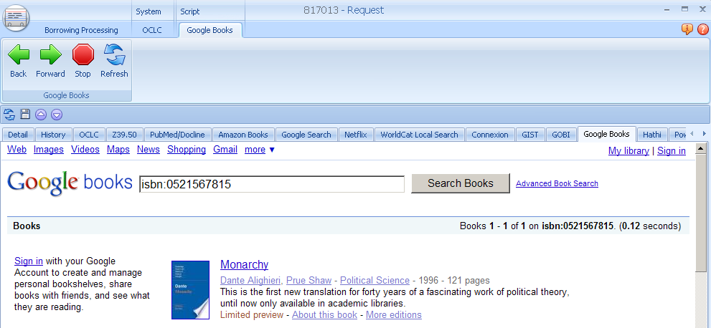
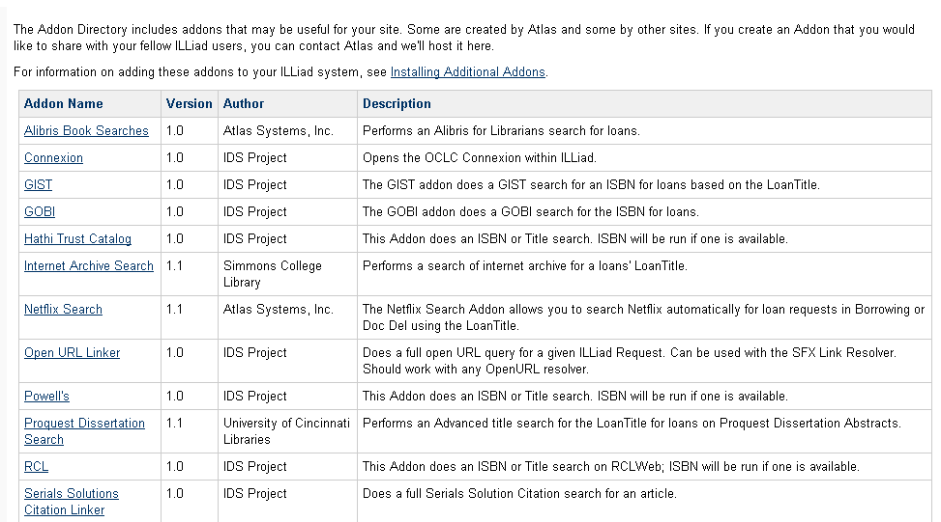
GIST for Web
ILLiad addons connect any web service
A tab away
ILLiad Addons https://prometheus.atlas-sys.com/display/ILLiadAddons/Addons+Directory
Notes:
Wonderful features, a tab away! Amazon, GIST, GOBI portal, Powells, OCLC Connexion, RCL Web and more! Any suggestions for new add-ons are encouraged

Slide 10
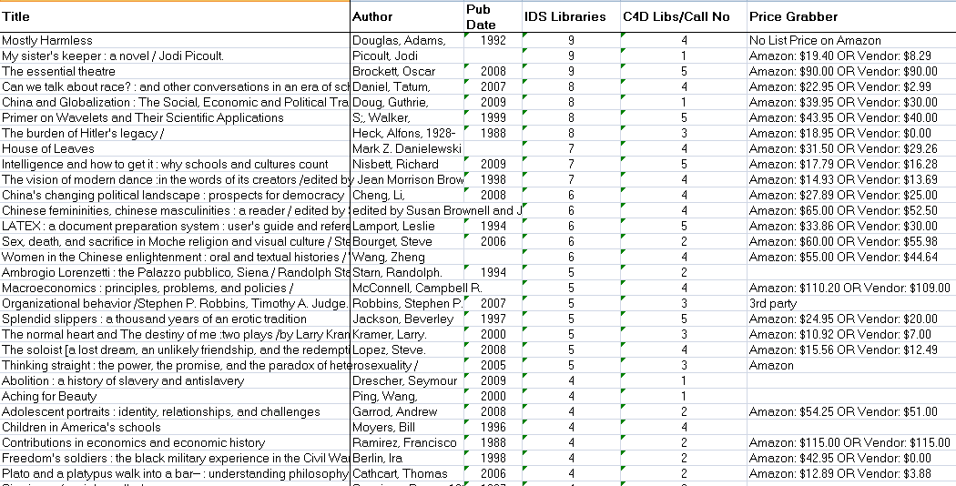
Achieving Collection Diversity
Recommended titles not purchased by SUNY Geneseo because too widely held
Strategies to discuss…
Automatically route ILL book requests for titles not currently held by your group 2 &/or 3 (e.g. NY3Rs &/or IDS Project or state)?
Automatically process ILL book requests through Direct Request using a path for free &/or inexpensive lenders, but evaluate purchase for any request with lender fees exceeding $10?
Evaluate purchasing from certain high-growth areas or new departments?
What conditions for review make sense, now that we can streamline and automate many of the steps?

Slide 11
Cooperative Collection development… 50 years in the making…
Hazen, Dan, “Cooperative Collection Development: Compelling Theory, Inconsequential Results?,” in Collection Management for the 21st Century: A handbook for librarians by G.E. Gorman & Ruth Miller, 1997.
Goals for Cooperative Collection Development
Broaden access
Contain cost
Improve coverage
Ensure the exotic
Conditions for success
Auspicious circumstances
Visionary and committed individuals
Supportive organizational structures
Appropriate staff participation
Bibliographic and physical accessibility to collections.
Others?
Add Simple Tools/Workflow,
Others?

Slide 12
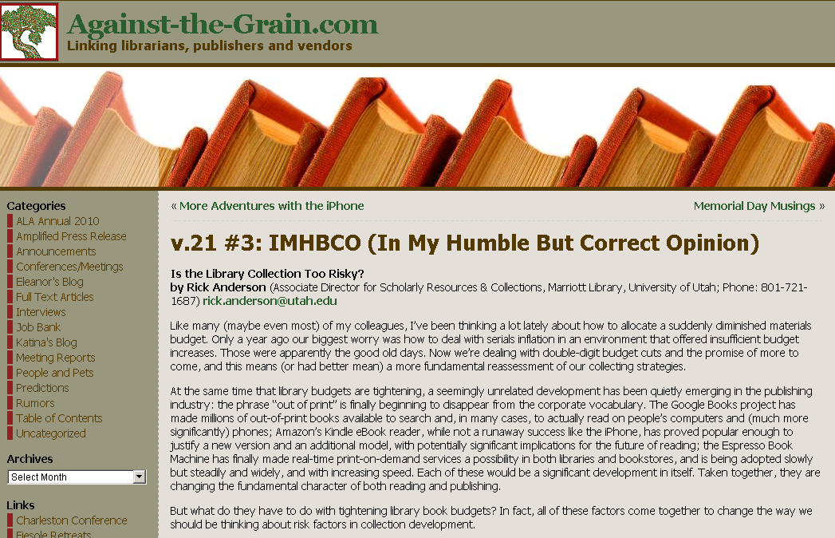

Local decision-making for
Cooperative Collections
or Collective Diversity
Collection Building
Ross Atkinson, “Six Key Challenges for the Future of Collection Development,” writes primarily of research libraries…
“Cooperation does not, for the most part, put a collection or library on the map… cooperation… will not happen by someone standing up and presenting a lot of PowerPoint slides that contain graphs and charts and dazzlingly innovative cooperative models…” it will entail…
Libraries “coalescing and operating as a group”
“to relinquish some leadership, to relinquish some distinctiveness”
“collective leadership to displace… the individual or institutional leadership”
Rick Anderson in “Is the Library Collection Too Risky”
“the risk inherent in buying the wrong book has increased (because each budget is now scarcer than it once was), while the risk inherent in failing to buy the right book has decreased (because it’s increasingly possible to buy only what is needed when it’s needed, and it is much easier to quickly and cheaply correct any failure to buy the right book).
Both of these developments support the same conclusion: that most research libraries should seriously reconsider their traditional strategy of meeting patrons’ needs by building large, inclusive, speculative collections that attempt to anticipate them.”
Wagner, Ralph D., History of the Farmington Plan, 2002.
Notes:
ARL libraries met during war to ensure preservation and access of foreign research materials by dividing up responsibility for acquiring research materials. Plan got its name from advisory committee met in Farmington, CT Ended in 1972.
Images: http://www.scarecrowpress.com/Catalog/SingleBook.shtml?command=Search&db=^DB/CATALOG.db&eqSKUdata=0810842599
http://www.against-the-grain.com/
Anderson, Rick IMHBCO v. 21 #3 “Is the Library Collection Too Risky” http://www.against-the-grain.com/2009/06/v-21-3-imhbco/
See also:
Robert Vosper – Farmington Plan Survey 1957-1961 see:
http://www.ideals.illinois.edu/bitstream/handle/2142/3828/gslisoccasionalpv00000i00077.pdf

Slide 13
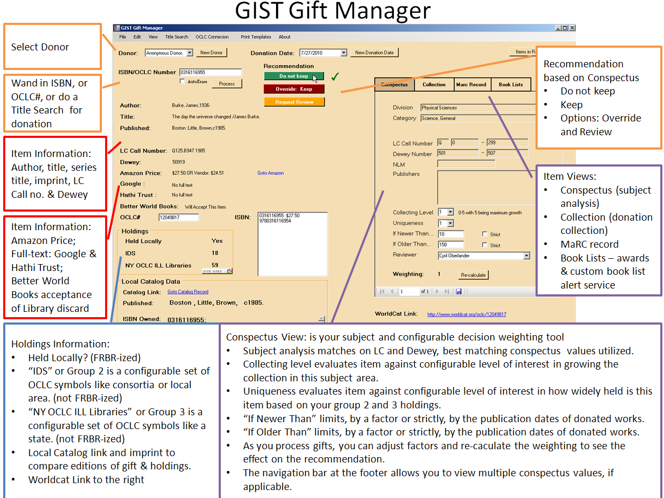
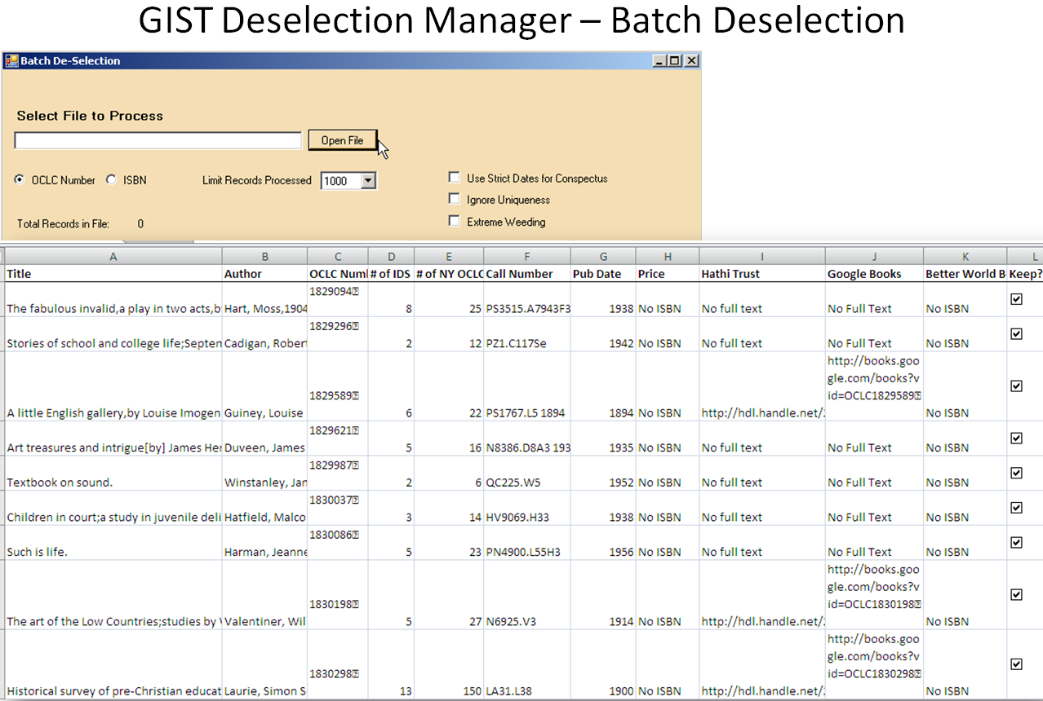
GIST Gift & Deselection manager
Evaluating weeding data is made easier – title by title or as a batch - GDM automatically creates a spreadsheet for evaluating tens of thousands of titles.
We found that over 13% of our 31K items we evaluated were available full-text in the Hathi Trust); GDM also works for evaluating journal titles across consortia.

Slide 14
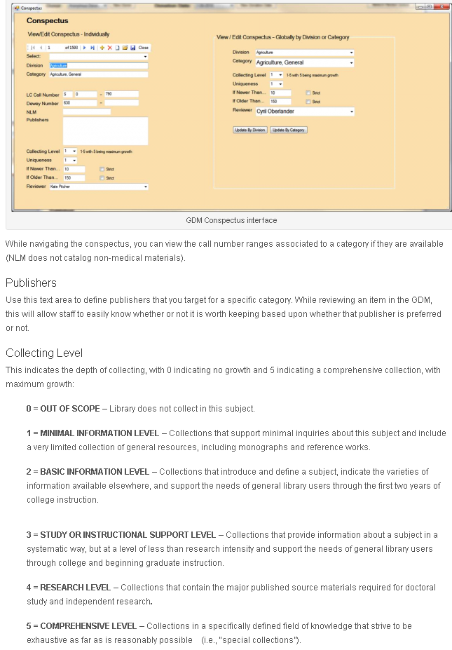
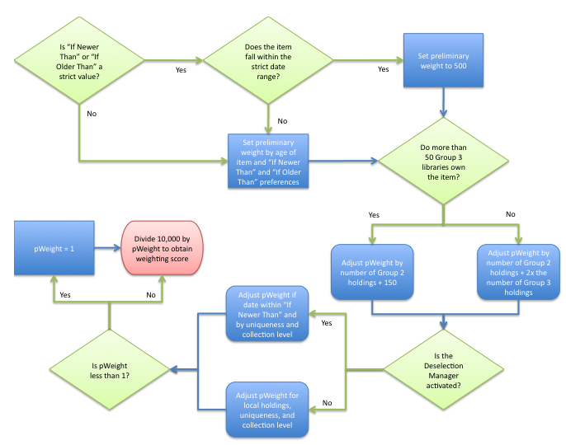
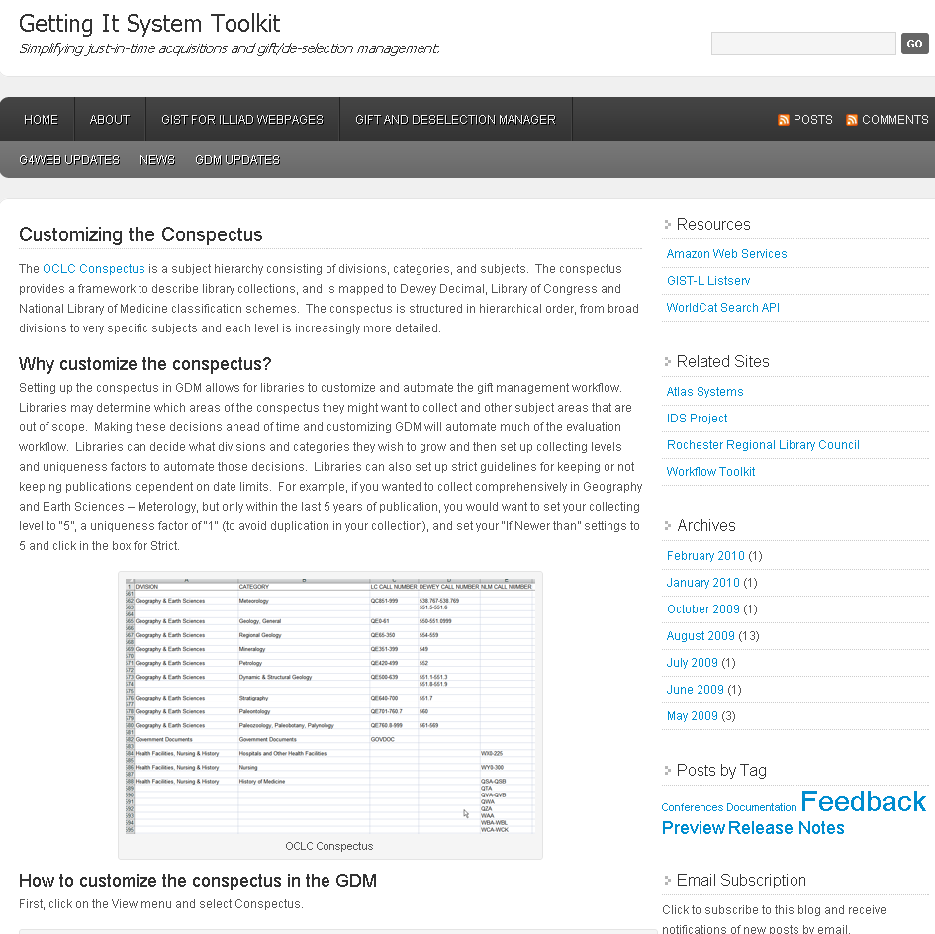
Conspectus
Notes:
http://gettingitsystemtoolkit.wordpress.com/gift-deselection-manager/customizing-the-conspectus/
The OCLC Conspectus is a subject hierarchy consisting of divisions, categories, and subjects. The conspectus provides a framework to describe library collections, and is mapped to Dewey Decimal, Library of Congress and National Library of Medicine classification schemes. The conspectus is structured in hierarchical order, from broad divisions to very specific subjects and each level is increasingly more detailed.
Why customize the conspectus?
Setting up the conspectus in GDM allows for libraries to customize and automate the gift management workflow. Libraries may determine which areas of the conspectus they might want to collect and other subject areas that are out of scope. Making these decisions ahead of time and customizing GDM will automate much of the evaluation workflow. Libraries can decide what divisions and categories they wish to grow and then set up collecting levels and uniqueness factors to automate those decisions. Libraries can also set up strict guidelines for keeping or not keeping publications dependent on date limits. For example, if you wanted to collect comprehensively in Geography and Earth Sciences – Meterology, but only within the last 5 years of publication, you would want to set your collecting level to “5”, a uniqueness factor of “1″ (to avoid duplication in your collection), and set your “If Newer than” settings to 5 and click in the box for Strict.
Weighting
A number of factors make up the Weight score which effectively determines whether or not GDM indicates a “Keep” or “Do Not Keep” recommendation. Holdings, publication dates, uniqueness and collecting level are factors that affect the final weighting of an item. The higher the weight score, the recommendation will be to Keep an item, due to these factors. A lower weight indicates an item of less desirability than the higher weighted item.
Weighting Logic
The first step of the weighting logic is to determine if either of the strict date restrictions apply. If NewerThanStrict is checked and the item is older than the limit or if OlderThanStrict is checked and the item is older than the limit, then the preliminary weight (pWeight) is automatically set to 500. Otherwise, the pWeight is based on the combination of the age of the item in relation to the NewerThan and OlderThan settings and the number of libraries in Group2 and Group3 that own the item.
Once pWeight has been established, the formula to modify it has to be determined. This formula is based upon whether Gift Manager or Deselection Manager is active, and, if the Gift Manager is active, then whether the item is held locally. Based on those results, pWeight is modified differently by the Unique and Collection Building numbers.
After the final pWeight is determined, a check is made to determine if pWeight is less than 1. If it is, then it is set to 1. The final WeightingScore is determined by dividing 10000 by pWeight.

Slide 15
Migrating Print to Electronic?
With 13 % of titles in storage available FULL-TEXT through Hathi Trust digital repository, similarly as the number of full-text increases with Google Books and other projects…
What is the impact on our print holdings and records for print holdings?
Questions
Do we deselect and convert our print record to an electronic holdings record?
Do we not catalog because GIST for web detects Hathi Trust & Google Books full-text holdings?
Do we catalog materials we don’t hold if GIST for web detects full-text holdings?
Notes:
Time it takes to convert records – is it worth retaining holdings numbers in statistics?
Hathi trust holdings over 10% Google Books API also available
31,436 total
2 titles = 0 holdings in IDS project libraries
Using data from GIST, only 2596 titles were kept in the collection; the remainder are being weeded
Selecting donations

Slide 16


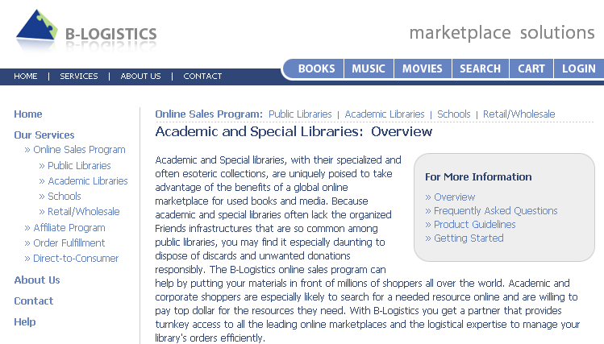
GIST Gift & Deselection manager
With…
Reduced monograph budgets (expected/guaranteed)
New tool to streamline gift and deselection processing
Does it make sense for libraries to focus Technical Services on…
Increasing gifts – through marketing & promotion, etc.
Increasing deselection – which using services like Better World Books library discards or others (Alibris, B-Logistics, etc.) creates some revenue for new books and can promote literacy campaigns.
Notes:
Images:
http://www.betterworldbooks.com/Info-Discards-Donations-Program-m-4.aspx
http://www.blogistics.com/rel/v2_home.php?storenr=339&deptnr=127

Slide 17
GIST Acquisitions manager
In Development – to be released August 2011
GIST Goals:
Optimize workflow by leveraging systems to do more work while reducing the time staff spends to make informed decisions and process materials.
GIST Acquisitions Manager
Further develop GIST for Web to incorporate budget information.
Develop acquisitions features, such as budget, fund, and invoice management features in an Acquisitions Manager component.

Slide 18
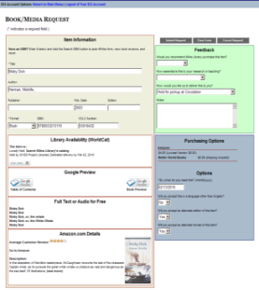
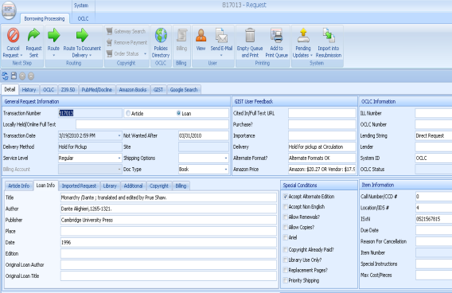
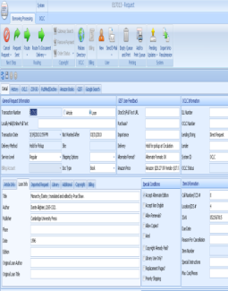
GIST Acquisitions Manager
Hold for Pickup
Mail to Address
Place on Reserve
Shelve it
Other?
Purchasing
Price Check
GIST Addon: Amazon, Alibris, BWB, GOBI, You select your vendor
Ordering Process
GIST Addon: Fund Manager Interface
Check current FUNDS (associated with username, department, and general purpose), import current FUNDS.
Apply FUNDS in real time.
Purchasing Process
Amazon Addon: (one example)
Import Order Total, Order Number, Estimated shipping date, Delivery URL
Print Procurement Form – institution specific (addon &/or report)
Holdings Process
OCLC Addon: Open OCLC Connexion – search, import LC#.
ILS Addon: Create Hold? (long-term TAG project)
Funds
Configure visibility as appropriate: On/Off,
Username & Funds,
Dept – General Fund,
Description: Radio button w/name & totals
Receiving Process
Depending on if library adds holdings at point of order…
Holdings Process
OCLC Addon: Open OCLC Connexion – search, import LC#.
ILS Addon: Create Hold?
Review Process
Email Routing
Send to Reviewer:
Link to GIST-Like Form to see CURRENT Budgets (FUNDS) and trigger Approve / Do Not Approve
Email reply triggers action via EmailImport
Notes:
Cyril

Slide 19
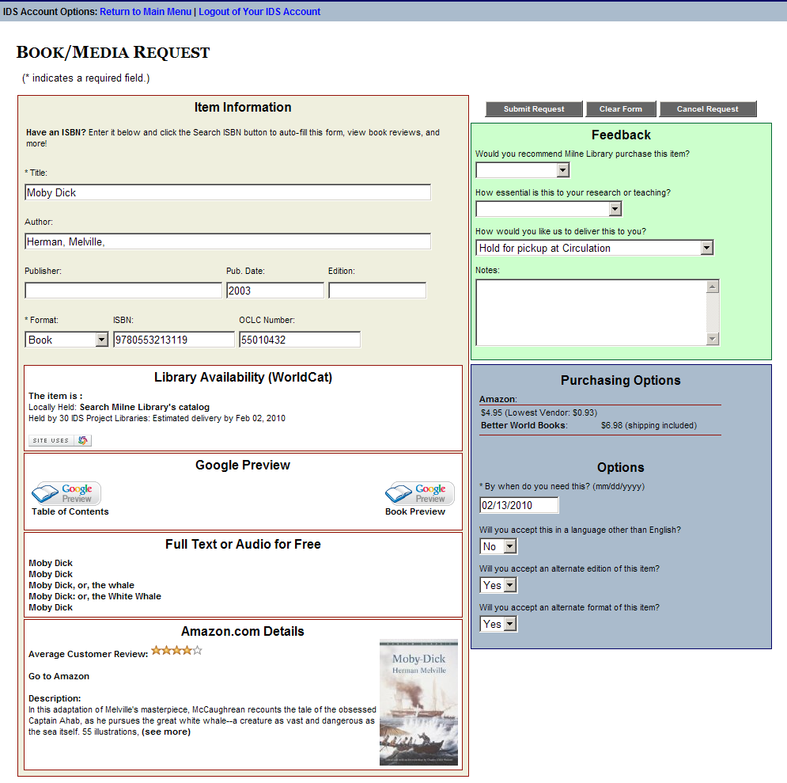
GIST User Interface Scenario:
Fund selection & insufficient funds
Purchasing transparency (on/off?)
Purchasing Options (Status & username specific) with Acquisitions Manager data: only faculty may see their department and if applicable username specific budgets; library staff in GIST addon see all budgets and can apply changes for import – see next slide.
Cost:
Amazon $4.95 (Lowest Vendor: $0.09)
Better World Books $6.49 (shipping included)
Budget: Select budget applied to this recommendation:
History General $553 remaining
Urban History Project Grant $58 remaining
Conditional business rule; if assigned budgets are depleted (or end of year) – system routing applies or librarian review web interface.
Insufficient funds - Recommend for next year or if additional funding is available.
Fiscal year ended - Recommend for next year’s budget.
Donate funds?

Slide 20
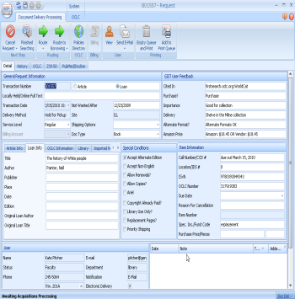
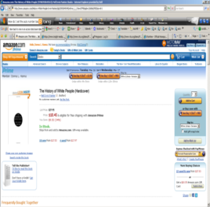
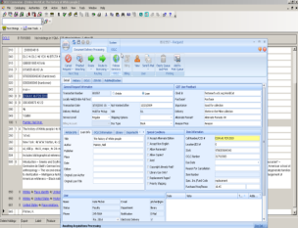
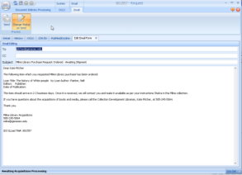
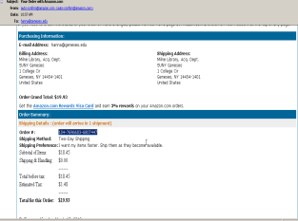
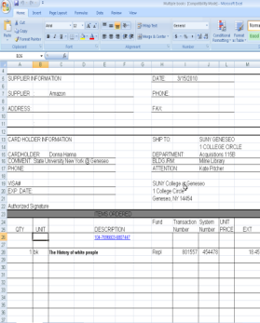
Basic Scenario of Purchasing Amazon order
User updated on purchasing
OCLC Addon: import record, attach symbol, and add call number after cataloging in OCLC. Import record in ILS?
Use GIST Addon to check funding; user designated and related funding options and budgets
Purchase from Amazon, import shipping fee (3rd party), Price, order #, YBP if purchased from GOBI, (shipping URL/Tracking & expected date nice to have).
Review Process
Email Routing or Web Interface
Send to Reviewer:
Link to GIST-Like Form to see CURRENT Budgets (FUNDS) and trigger Approve / Do Not Approve
Email reply triggers action via EmailImport
Customizable Print Forms
Print procurement or other forms using MS Access or Addon.

Slide 21
GIST Reviewer Web Interface Scenario:
(alternative to current use of email routing)
Email link to open OpenURL like reviewer form to Approve or Disapprove
Purchasing Options (Status & username specific) with Acquisitions Manager data: only faculty may see their department and if applicable username specific budgets; library staff in GIST addon see all budgets and can apply changes for import – see next slide.
Cost:
Amazon $4.95 (Lowest Vendor: $0.09)
Better World Books $6.49 (shipping included)
Budget: User selected budget applied to this recommendation:
User selected budget
History General $553 remaining
User associated budgets
Urban History Project Grant $58 remaining
Drop down list of other budgets appropriate to reviewer.
Conditional business rule; if assigned budgets are depleted (or end of year)
Insufficient funds - Recommend for next year or if additional funding is available.
Fiscal year ended - Recommend for next year’s budget
Recommended by:
First Last name
Approve
Approve & Select Fund
Deny & Convert to ILL

Slide 22
GIST Project Roadmap
GIST 2010-2011
GIST Acquisitions Manager
Develop efficient budget, fund, and expenditure system that is streamlined and integrates into ILLiad and GIST.
Continue to innovate staff and end-user interfaces to budgets, purchasing, and review workflow that incorporates web and complex addon developments.
GIST for Web
Document diverse strategies and workflow using GIST
Enhance GIST use of ILLiad fields and tables, and enhance use of ILLiad web pages.
GIST GIFT and Deselection Manager (GDM)
Post-release modifications as libraries begin using GDM.
Add statistics component and enhance batch processing.
Other?

Slide 23
GIST Project Roadmap
GIST 2011-2012
GIST Acquisitions Manager enhanced for pay-per-view for articles registry.
GIST for Web incorporate free and pay-per-view article resources, add format and edition FRBR recommender services, and enhance user experience with non-print resources.
GIST GDM add Circulation and TPAM2 data.
Other?

Slide 24
Acquisitions + Interlibrary Loan
Houle, Louis, “Convergence between interlibrary loan and acquisitions: can it be done?,” 8th Interlending & Document Supply International Conference, October 28-31, 2003. http://www.nla.gov/au/ilds/abstracts/convergencebetweeninterlibrary.htm
Selective criteria was used to convert ILL requests into purchase-on-demand, ILL librarian was essentially purchasing books and created a parallel acquisitions department.
Fisher, William, “Impact of organizational structure on acquisitions and collection development,” Library Collections, Acquisitions, & Technical Services, vol. 25, 2001, p. 409-419.
“Are organizational structures of libraries enhancing their ability to build and maintain collection (either through access or ownership) that respond to community needs, hindering this process, or neither helping or impeding this function?”
  39% library responses indicating need for organizational change;
  First reason, change reporting structure or upgrade position
  Secondly, change current reporting relationships to increase and/or improve communication and cooperation among various units.

Slide 25
Acquisitions + Interlibrary Loan
What makes sense?
Buy and borrow strategy convergence – yes / no
Workflow co-exist in ILLiad – yes / no
ILL and Acquisitions units merge – yes / no
Just what you need collections? – yes / no
Other ideas?
Borrow
Buy
Deliver
User Request
+
Library Service Strategy

Slide 26
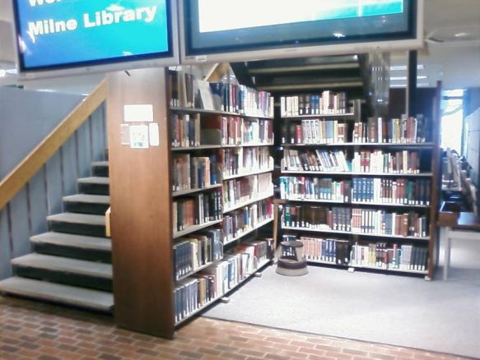
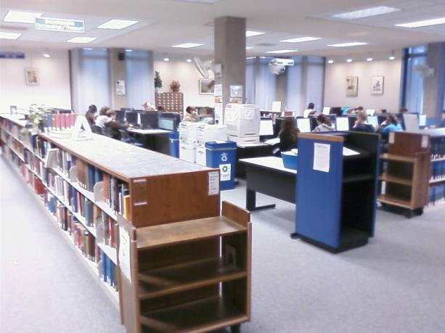
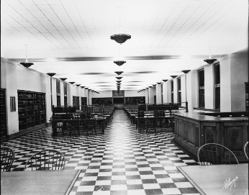
Change
What happened to Print Reference?
What does Print Reference mean today?
Notes:
Scholarship has changed, if you don’t already know, it is a hard sell to get students to use print reference materials, walking through Memorial Hall at Uva Library – watching almost no use of the print reference collection, and more frequent use of wikipedia in this hall.
Is this a problem for libraries?
Or is this a problem for discovering scholarship?
How do we work together to discover seminal works, and shorten the path to critical materials for analysis? Where do students find context?
Images: faculty.virginia.edu/villagespaces/essay/

Slide 27
Classic Reading
Concept & example
Harvard Classics
  51 volume anthology of classics – compiled and edited by Harvard University president Charles William Eliot. Started in 1909 as “Dr Eliot’s Five-Foot Shelf of Book” as key elements of liberal education.
  Divine Comedy vol. 20
Great Books of the Western World
  60 volumes of books on the Great Books list – essential primary sources of Western civilization as discussed by educators in 1920s-1930s. Divine Comedy vol. 21
Milne has about 16 printed versions of Divine Comedy, with a cumulative checkout of 29 uses for the last 7 years…
Notes:
Classics in a serial sense of the word, but really it was a very important concept worth understanding, because books were not widely distributed yet, making selection of classics easier for evaluation and dissemination made complete sense.
Scarcity actually made assigning canon relatively easy – if you were to look at the book collection at your home, and could only pick one to save from some future disaster, what title would it be; versus, if you looked across the expanse of over 50M books published… so let me focus our discussion on one particular title: Dante’s Divine Comedy

Slide 28
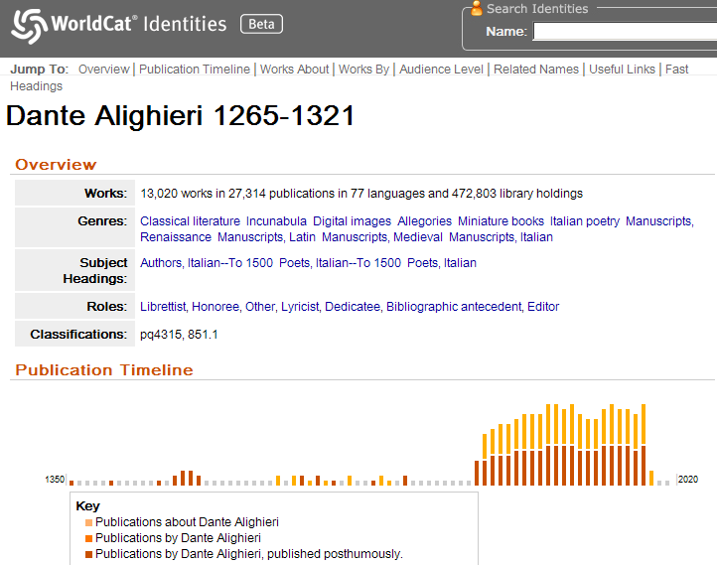
Reprint Galore
Notes:
It’s difficult to image, but there are so many works, and thanks to increased Reprinting of rare books, many works rarely accessible are now replicated for $12 to $43 dollars with growing print on demand businesses. Worldcat Identities is a way to see Dante from library collections. Note 13K works in 27K publications and 77 languages…
Images:
http://orlabs.oclc.org/identities/lccn-n78-95495

Slide 29
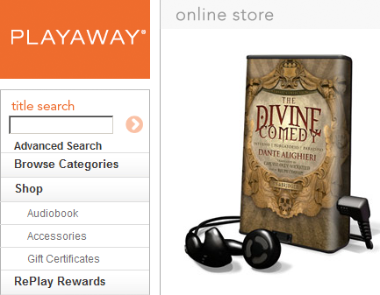
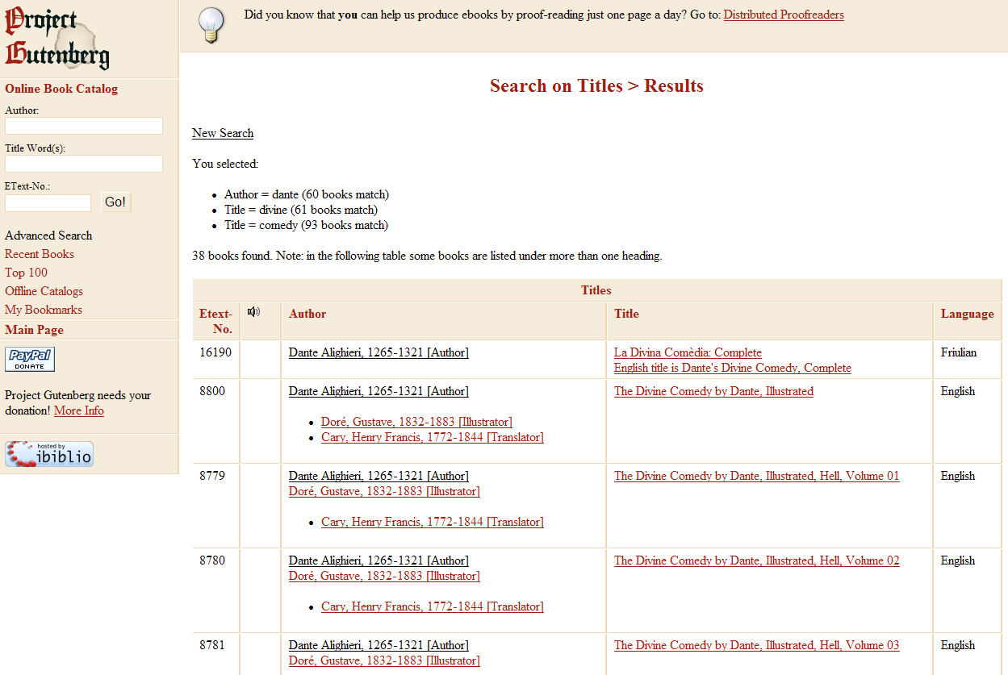
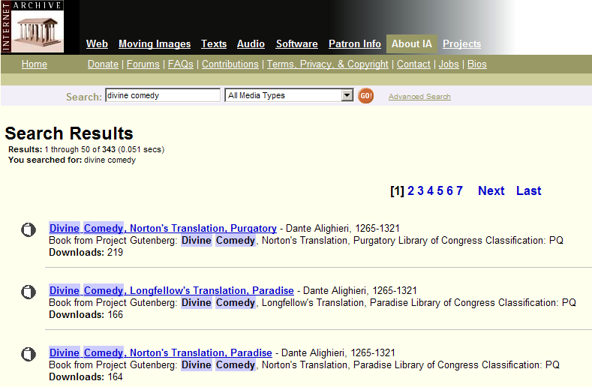
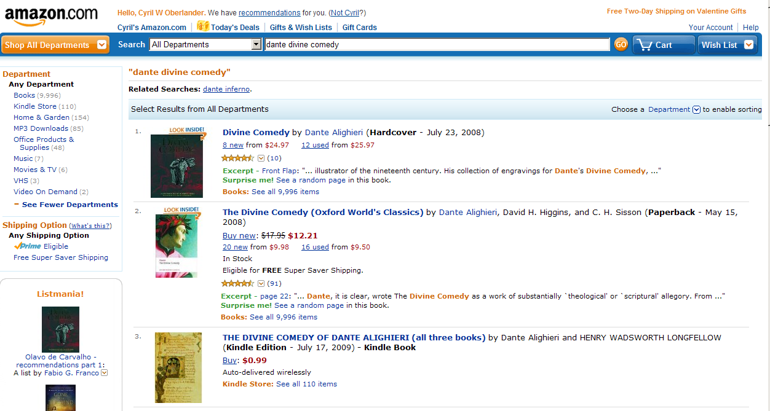
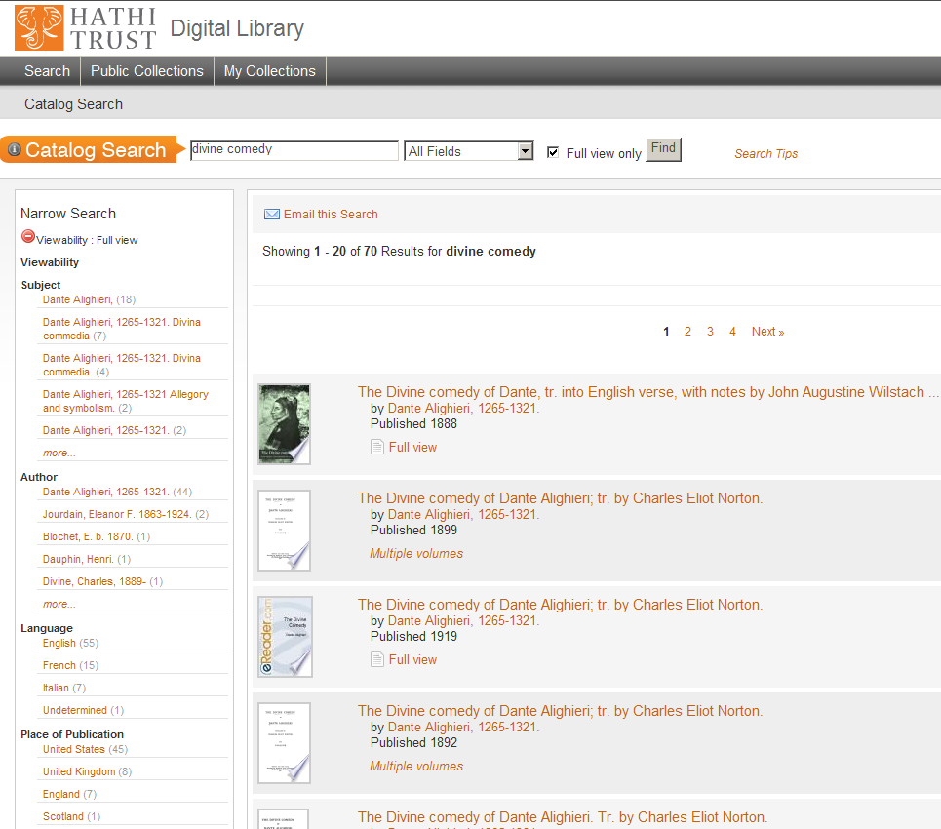
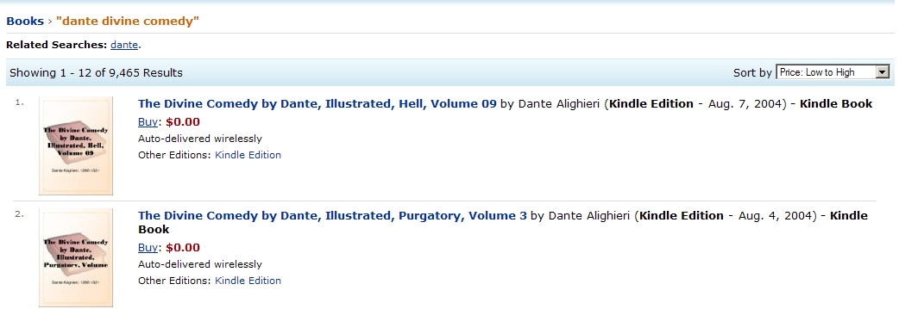
Divine Comedy
Notes:
But why checkout Divine Comedy when you can download various versions…
Images: Free sources:
38 full text titles in http://www.gutenberg.org
246 full text and other media in http://www.archive.org/
82 full text in http://catalog.hathitrust.org/
Reality is, you may want to pay for a type of version of Divine Comedy, say $85 for an audio book version with 14 hours of Divine Comedy
In Amazon, there are almost 10K books, several videos, MP3, etc.; widely ranging in price, including penny books – which are often library discards, and even free books for the Kindle.
Fee based sources : http://audiobook.playawaydigital.com/titles/divine-comedy
www.amazon.com

Slide 30
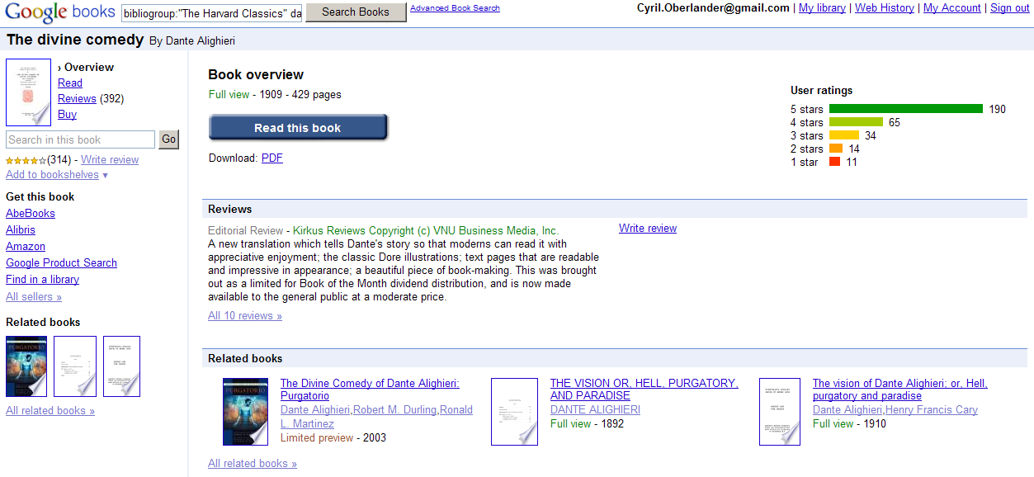
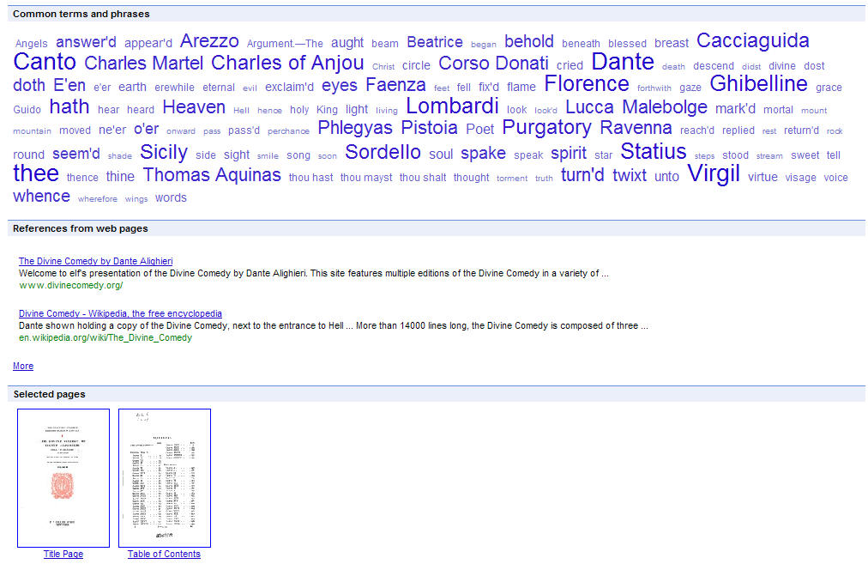
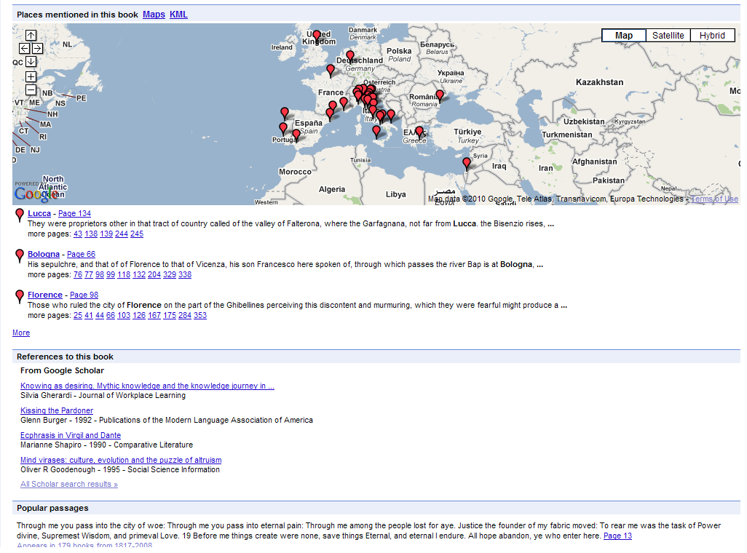
Google books
Notes:
We mentioned Google Books, and there are many full text view copies of Divine Comedy there to find…
Download a copy or search within the work
Use tag clouds to find keywords as they are frequently used, other versions, or
A geographic tour of the work
Images: Overview
http://books.google.com/books?id=bWOONT95MlIC&pg=PP7#v=onepage&q=&f=false

Slide 31
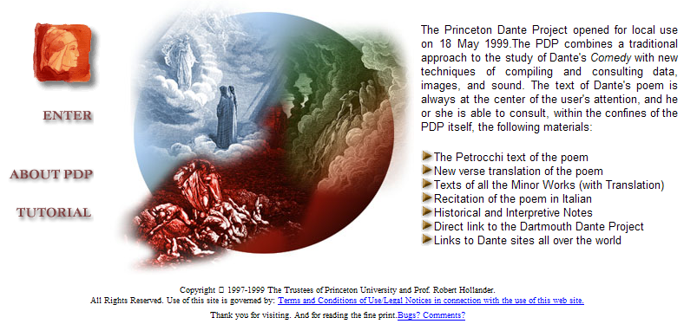
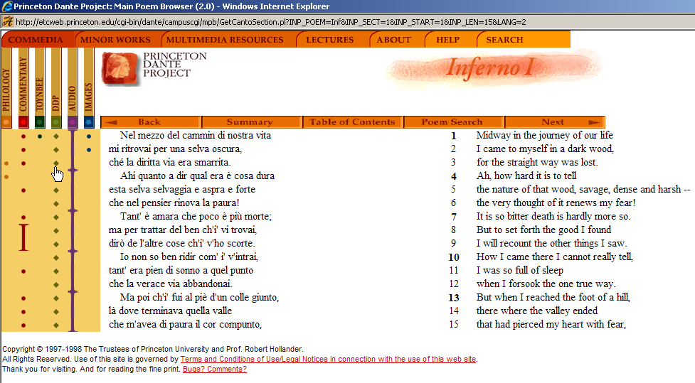
Digital Humanities & Dante
Notes:
You can find Divine Comedy here too – this is an example of a digital humanities project run out of Princeton.
Increasingly digital humanities is superimposing works in new ways that are exciting for researchers, teaching and learning. Other digital humanities projects superimpose author notes and revisions onto the published texts, letters between the author and friends and reviewers.
http://etcweb.princeton.edu/dante/index.html
Nines

Slide 32
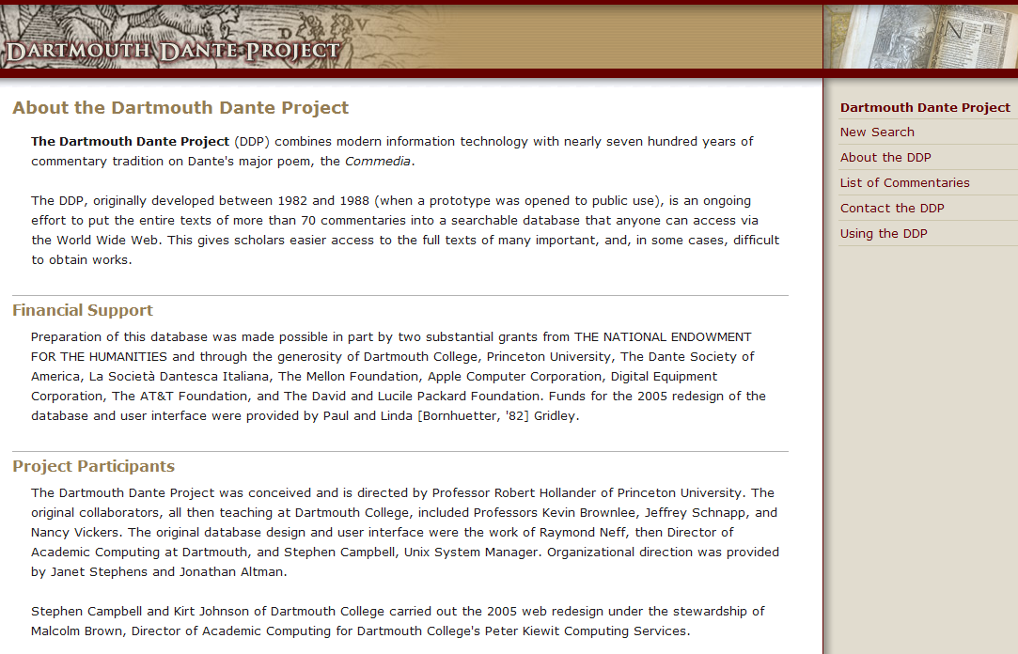
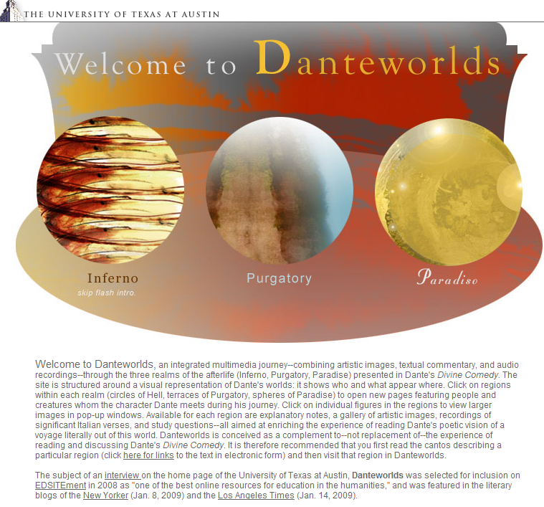
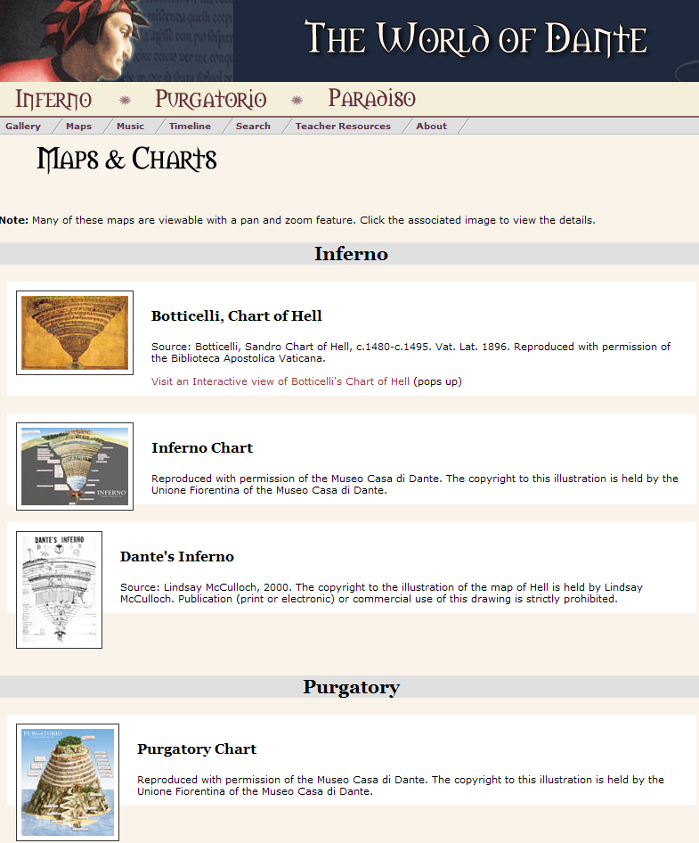

Digital Humanities & Dante
Notes:
http://dante.dartmouth.edu/about.php
http://www.worldofdante.org/about.html
http://danteworlds.laits.utexas.edu/
There are so many digital Dante projects, and perhaps that explains one of the challenges ahead for digital scholarship. At a recent presentation by a Mellon representative at the Charleston Conference, the plethora of disparate digital humanities projects was mentioned as a scalability problem. Honestly, it’s a cooperative and attention problem too. Diagram on whiteboard.

Slide 33
Organization Changes & Staff Implications
Digital Scholarship – Librarians & Library IT integral to platform & project
Metadata & Cataloging Librarians
  Data Synchronization & Crosswalk
  TEI and other digital scholarship standards
  Analysis of collection and user data, vendor resources, etc. (deselection, title and aggregated databases).
Technical Services
  Research Consultations
  Project Management (scholarship, collection maintenance, etc.)
  Gift Management & Marketing (community engagement strategies)
  Data Analysis & data curation
Other

Slide 34
Organization Changes & Staff Implications
Faculty liaison roles
  Current title awareness services using subject guides If user selection is key to collection building, then marketing excellent new works in potentially for the collection becomes key.
  Scholarly Communication Consultation
  Research Project and Scholarship Consultant
  Data analysis
Other?

Slide 35
Resources of Interest
Cooperative Collection Development & Collection Development
Atkinson, Ross, “Six Key Challenges for the Future of Collection Development,” Library Resources & Technical Services, vol. 50 (4), October 2006, p. 244-251.
Hazen, Dan, “Cooperative Collection Development: Compelling Theory, Inconsequential Results?,” in Collection Management for the 21st Century: A handbook for librarians by G.E. Gorman & Ruth Miller, 1997. See also Richard Wood’s chapter “The Axioms, Barriers, and Components of Cooperative Collection Development.”
Levine-Clark, Michael, “An analysis of used-book availability on the Internet,” Library Collections, Acquisitions, & Technical Services, vol. 28, 2004, p. 283-297.
Pitcher, Kate, Tim Bowersox, Cyril Oberlander, Mark Sullivan, “Point-of-Need Collection Development: The Getting It System Toolkit (GIST) and a New System for Acquisitions and Interlibrary Loan Integrated Workflow and Collection Development,” Collection Management, vol. 35 (3 & 4), July 2010, p. 222-236.
http://pdfserve.informaworld.com/642489__923174819.pdf
Wagner, Ralph D., History of the Farmington Plan, 2002.

Slide 36
Resources of Interest
Organization in Transition (Acquisitions, Cataloging, Collection Development, ILL, Tech Services)
Cook, El, Farthing, PA., “Technical services perspective of implementing an organizational review while simultaneously installing an integrated library system,” Library acquisitions: practice and theory, vol. 19, 1995, p. 445-461.
Fisher, William, “Impact of organizational structure on acquisitions and collection development,” Library Collections, Acquisitions, & Technical Services, vol. 25, 2001, p. 409-419.
Houle, Louis, “Convergence between interlibrary loan and acquisitions: can it be done?,” 8th Interlending & Document Supply International Conference, October 28-31, 2003. http://www.nla.gov/au/ilds/abstracts/convergencebetweeninterlibrary.htm
Kenyon College & Denison University, Plan for Library Technical Services Work Redesign, October 14, 2004 – regional technical services. http://collaborations.denison.edu/ohio5/libres/lwrtf/alcts_presentation.pdf
Larsen, Patricia M., “The Climate of Change: Library Organizational Structures, 1985-1990,” Reference librarian, vol. 34, 1991, p. 79-93.
Robinson, William, “Academic Library Collection Development and Management Positions: Announcements in College & Research Libraries News from 1980 through 1991,” Library resources & technical services, vol. 37 (2), April 1993, p. 134-146.

