Slide 1
ILLiad and Alma and Primo! Oh my!
AKA “Alma/ILLiad Integration”
Kourtney Blackburn - St. John Fisher College | Ben Hogben - Ithaca College | Christine Sisak - Nazareth College
Notes:
All

Slide 2
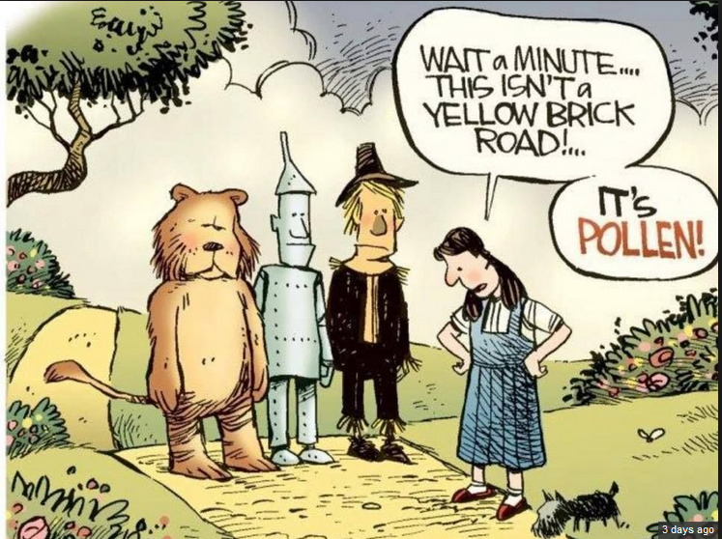
Notes:
Kourtney

Slide 3
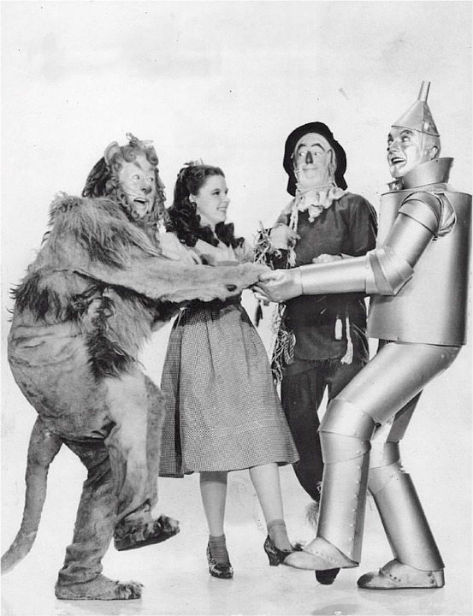
3 different institutions, 3 different set-ups
Ithaca: Alma_NCIP Client addon for borrowing, separate addon for lending, and server addon for borrowing renewals
Naz: Alma_NCIP Client addon with borrowing and lending config
Fisher: Alma_NCIP Client addon with borrowing commented out in config file
Notes:
Kourtney/Everybody
We each have 3 different set-ups ( or at least 2 ?) with different reasons as to why we went about them the way we did. We’ve been working on this together a lot, especially since we went live at roughly the same time last year.
We will explain throughout presentation as to why we made the choices we did while we talk about the set-up and workflows associated with the addons.

Slide 4
Agenda
Part One: Addons & Logic
Part Two: Integrating into Workflows
Part Three: Pitfalls, Tips and Tricks
Part Four: Future of Alma & ILLiad & Tipasa
Part Five: ROTA Partners
Notes:
Kourtney
Here’s the agenda we’re going to fly through this morning: talking about addons, workflows, some things to be aware of, mainly.
Just know, your patience and skills will be tested with this Integration and Addons! Hang in there! You can do it!

Slide 5
Part One: Addons & Logic
Alma/ILLiad/Primo Addons
Where & which ones
Set-up in Alma
Resource Sharing Partner
TOUs
Item Policy
Location
Set-up in ILLiad
Problems
IDS Logic Set-up
Barcode import
Notes:
Kourtney
So, first off, we’re going to talk about Addons, some set-up in Alma & Logic Set-up
Another huge point to NOTE - the documentation is scattered, partially because there isn’t one person or entity responsible for the integration, and what works at one institution, may not work at yours!
We’ll show you what we’ve done… These may work for your library… or they may not and you’ll find yourself cruising down the red brick road!

Slide 6
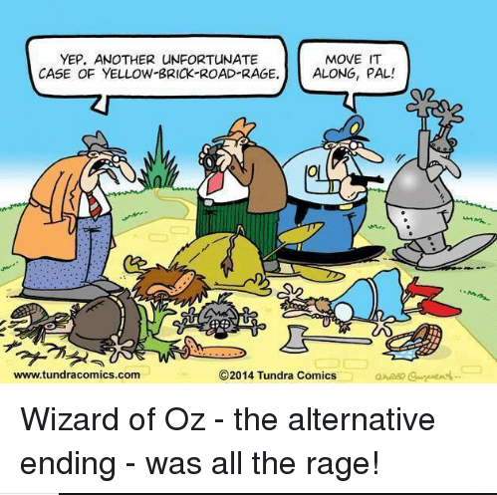
Where & Which Ones?
Helpful Tip!
Install one Addon at a time and get it working correctly before installing the next!!
Where
ILLiad Addon Directory
https://prometheus.atlas-sys.com/display/ILLiadAddons/ILLiad+Addon+Directory
Which Ones?
For Alma Functionality
ILLiad Alma NCIP Client Addon
ILLiad NCIP Lending Only Addon
ILLiad Alma NCIP Borrowing Renewal
Other
For Primo Searching
ILLiad Primo New UI Addon
OpenURL addon
Notes:
(Chris)
Addons are found on the ILLiad Website or by googling ILLiad Addon Directory
The Addons to use are the following:
For Alma Functionality -
ILLiad Alma NCIP Client Addon - this Client Addon is if you plan on integrating both borrowing and lending workflows through Alma.
ILLiad NCIP Lending Only Addon - this is if you plan on tracking only Lending through Alma
ILLiad Alma NCIP Borrowing Renewal - this handy Server side Addon can be used to automate the borrowing renewal process
Other - (Troubles Ben ran into?) Splitting the Alma NCIP to make both parts work!
For Primo Searching
ILLiad Primo New UI Addon - This allows you to search your database from within ILLiad
OpenURL Addon - for additional searching strategies.

Slide 7
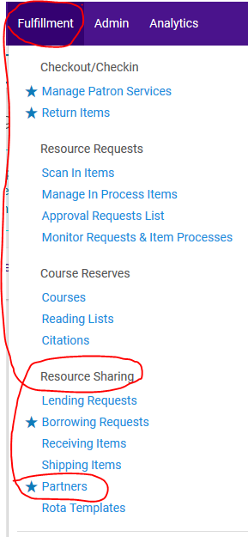
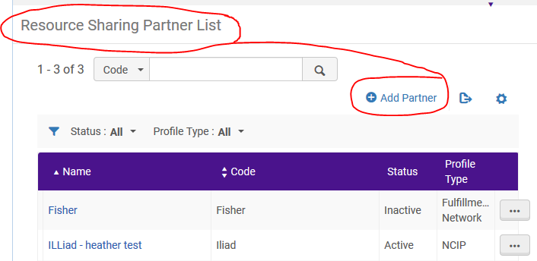
Resource Sharing Partner
Set up in Alma
Notes:
The following slides show setting up your Alma to allow for ILLiad to talk to it. Again! This will differ slightly from institution to institution...
In Alma, you will:
Go under Fulfillment|Resource Sharing|Partners
And Add Partner

Slide 8
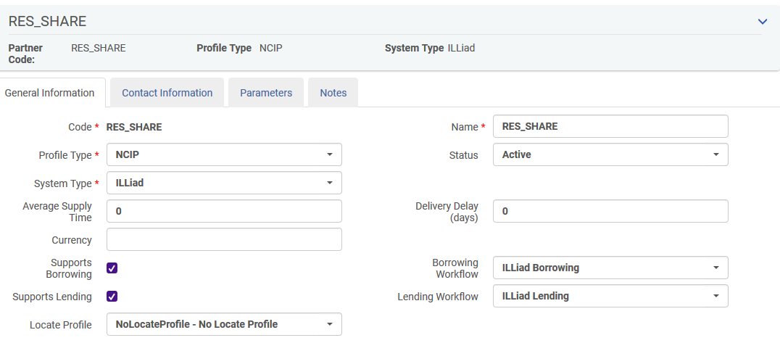
General Information Tab
Alma Set Up
Notes:
Important fields are:
Profile Type = NCIP
System Type = ILLiad
Name = whatever you want, but you have to match these in Addons
Borrowing Workflow and Lending Workflows need to be set up and selected

Slide 9
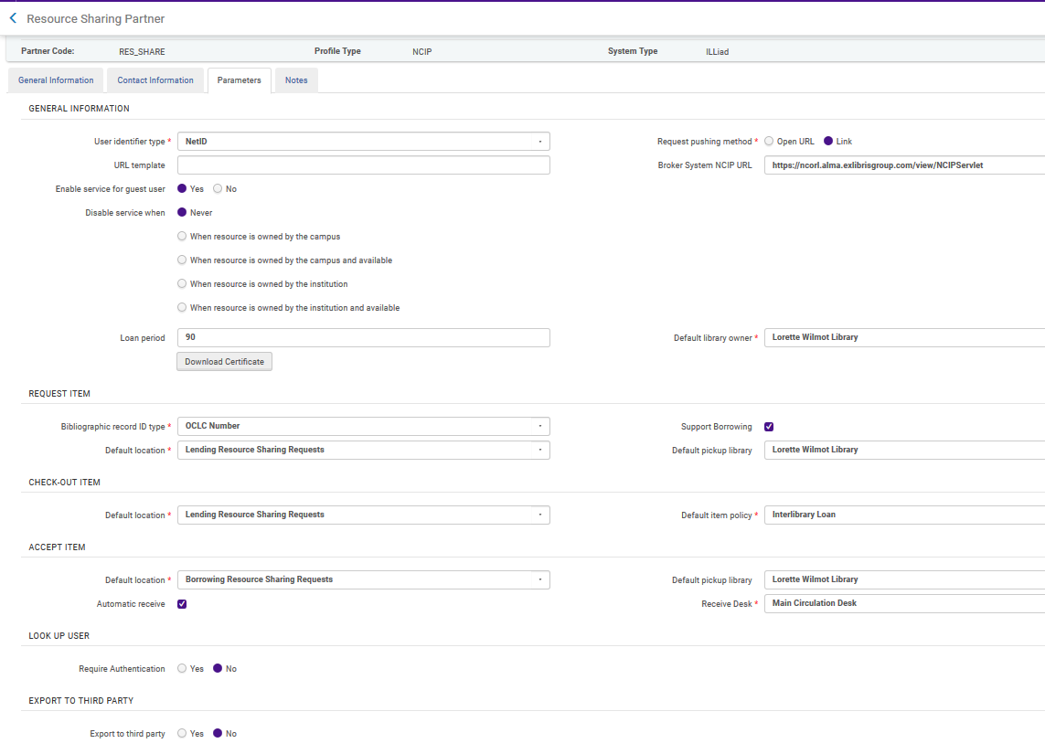
Set-up in Alma - Parameters Tab
Parameters Tab
Notes:
Continuing on : Important fields to Note:
What are you going to use for your User Identifier Type?
Naz uses NetID
Fisher uses University ID
Ithaca uses University ID
Differences for SJFC: University ID is identifier type, enable service for guest user is no, supports borrowing is unchecked

Slide 10
Terms of Use Management
Alma Set Up
Notes:
You’ll need to set up Terms of Use for both Borrowing and Lending Resource Sharing

Slide 11
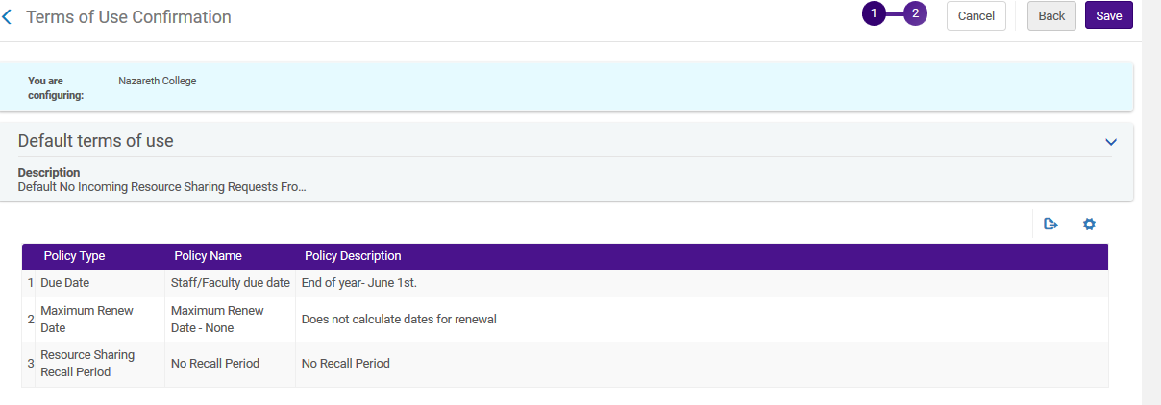
Terms of Use Management (LENDING)
Alma Set Up
Notes:
This is Nazareth’s set-up.
Setting a Due Date policy - although the Due date you assign the item in ILLiad will be the due date translated over into Alma.
Setting a Renew Date - though, you can assign whatever renewal date you want.

Slide 12
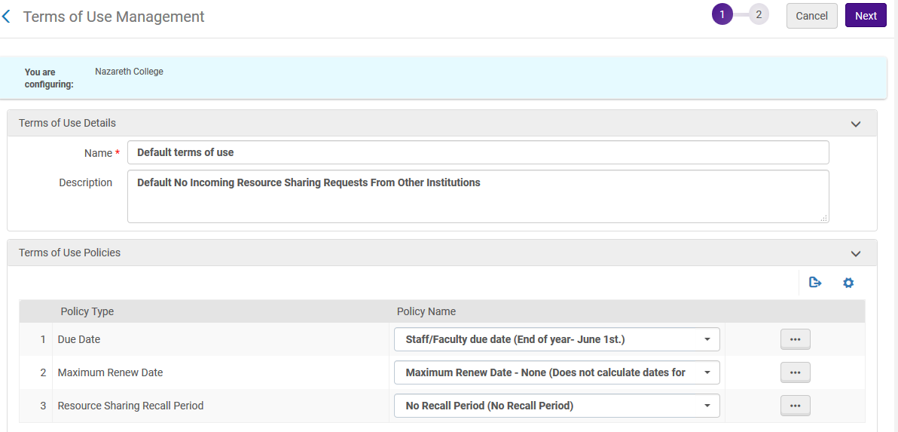
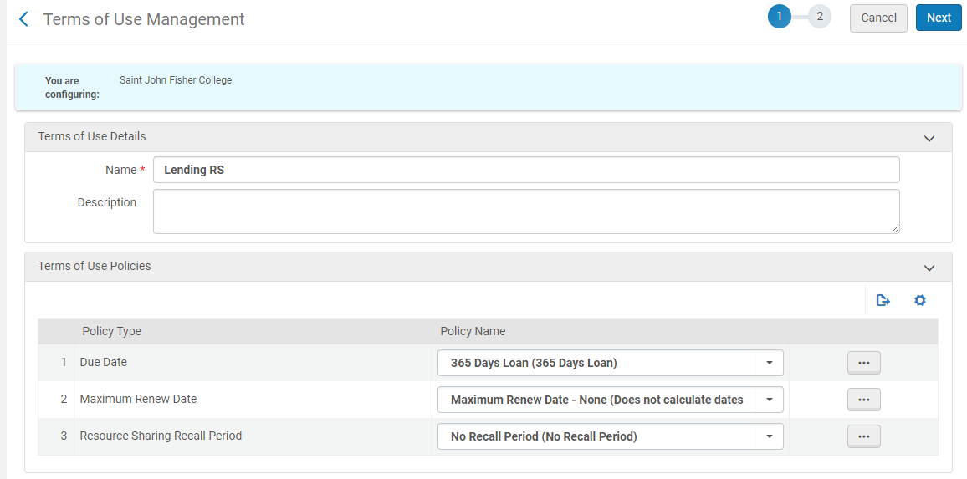
Terms of Use Management (LENDING)
Alma Set Up
St. John Fisher College
Nazareth College
Notes:
Again, more Lending TOUs in detail - All three libraries’ set-ups are near identical.
Here is an example - Nazareth’s on the left - Fisher’s on the right.

Slide 13
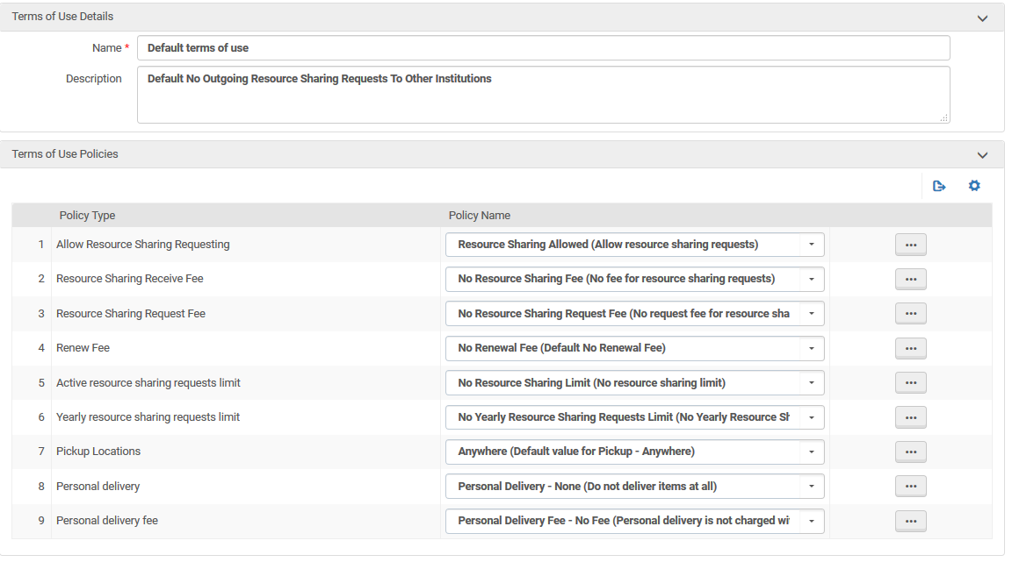
Terms of Use Management (BORROWING)
Alma Set Up
Notes:
Naz Example for the Borrowing TOUs
SJFC is same but we are not using this functionality

Slide 14
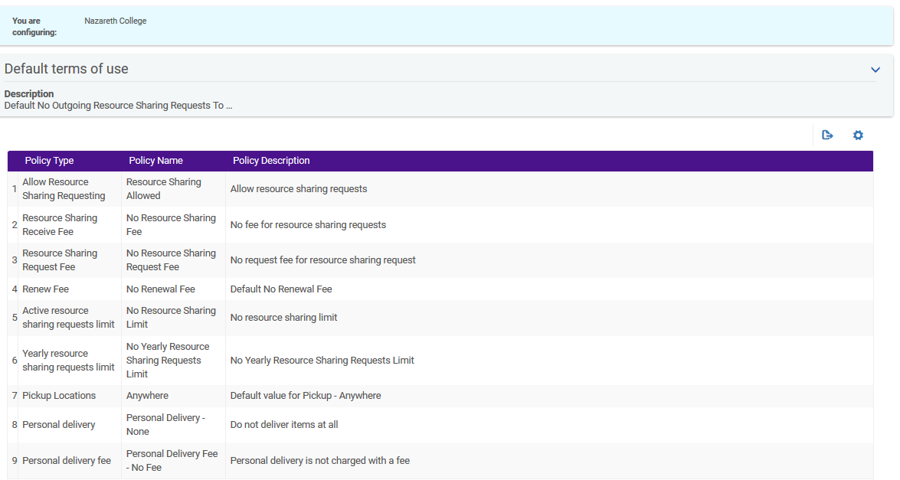
Terms of Use Management (BORROWING continued)
Alma Set Up
Notes:
Naz Example.

Slide 15
Activate in ILLiad and check settings
ILLiad Alma NCIP ...Other
Notes:
Ben - This is where things can get tricky.
You need to have:
the correct NCIP Responder URL
Your Unique Agency value
And the Profile Name - In Ithaca’s example it was named Illiad

Slide 16
Configuring the Addon:
Notes:
Chris/Ben - You will need a field designated in ILLiad where your item barcode will go.
Ours at Nazareth is the ReferenceNumber field. This gets filled in when IDS Logic looks up the Call number, location and accessibility.
Illiad pushes this up to Alma so that Alma checks out that barcode to LENDING.
And now you’re going to test, test, test to see if you can actually get ILLiad to push data up to Alma.

Slide 17
ILLiad Alma NCIP Set up Tips!
NOTE!!
Configurations that work for one institution may not work for another….
Work on only one Addon at a time! Get it working. Go to the next!
Notes:
Kourtney
This is a probably good point to stop and say that when you go to set up any of the addons, WORK ON ONLY ONE AT A TIME! It is a bit daunting and you may have trouble getting an addon to work for you well, even if it worked for your neighbor down the road. Ithaca and Fisher both could not get separate parts of the NCIP addon to work, as you saw earlier in our current configurations.

Slide 18
We Installed the Add-on, Now What?
Check for success or error messages
If you see a success message, then it’s time to celebrate!
NCIP Response for BorrowingAcceptItem received successfully (Woohoo!)
If you see an error message, then it’s time to </ns1:Problem></ns1:Decipher the error></ns1:NCIPMessage>
The error message may be helpful, or not.
Again, settings that work for one institution may not work for another.
You can also check the ILLiad log if set to Debug
<?xml version="1.0" encoding="UTF-8" standalone="yes"?><ns1:NCIPMessage xmlns:ns1="http://www.niso.org/2008/ncip" ns1:version="http://www.niso.org/schemas/ncip/v2_0/imp1/xsd/ncip_v2_0.xsd"><ns1:AcceptItemResponse><ns1:Problem><ns1:ProblemType>Temporary Processing Failure </ns1:ProblemType><ns1:ProblemDetail>AlmaAcceptItemService failed</ns1:ProblemDetail></ns1:Problem></ns1:AcceptItemResponse></ns1:NCIPMessage>
Notes:
Ben-
Fisher tried again and again to get the lending only addon to work, but eventually had to comment out the borrowing section of the Alma NCIP addon in config Debug log was not helpful for us. In the long run, this could be a good thing, as we don’t have to deal with installing another/different addon or uninstalling the one we currently have, should our needs and priorities change

Slide 19
What Can Go Wrong?
No Connectivity between the two systems
NCIP Errors
What they mean
How to resolve
Remember, one institution’s configurations may not work for another’s.
While it is possible to write to the authors of the addons…..
Solution: Network, if possible with other institutions
“You are going to use up all of your D-90 help vouchers” - Juno, the caseworker
(Oh, sorry, wrong movie….)
A guide for (and by) the perplexed) https://tinyurl.com/yap7l28a
Notes:
Chris/Ben - Kurt Munson snapshot
No connectivity - where do you turn? Not Alma, not ILLiad…
Lapis David Cohen
Van Pelt Library Interlibrary Loan
PAU - University of Pennsylvania

Slide 20
ILLiad Alma NCIP Borrowing Renewal
1. Download the Alma renewal add-ons from https://prometheus.atlas-sys.com/display/ILLiadAddons/ILLiad+Alma+NCIP+Borrowing+Renewal – this includes a config and Lua file
2. Open the config file and edit the following settings to match yours
a. <Setting name="NCIP_Responder_URL" value="https://na02.alma.exlibrisgroup.com/view/NCIPServlet" type="string">
b. <Setting name="renewItem_from_uniqueAgency_value" value=”01ITHACACOL_INST" type="string">
c. <Setting name="ApplicationProfileType" value="illiad" type="string">
3. Install the add-on, on the ILLiad server through the Customization Manager; set Active to Yes.
4. The user match point is the critical piece. For us it is Username in the Lua file:
a. local user = GetFieldValue("Transaction", "Username"); check Institution ID in the Alma Resource Sharing Partner parameters.
c. Note: if the add-on fails and it gives an error message, the error message may not accurately tell you what the problem is. For instance, our error message was Unknown Item, however, it was not matching the patron; it had nothing to do with the item.
5. To test, renew an item in ILLiad and then move the request to Awaiting Alma Renewal Updating queue. It should be picked up by Alma in a matter of minutes.
6. The due date in Alma may not match the due date in ILLiad based on your Alma calendar and patron account expiration date.
Notes:
Ben - this is a step by step process - the patron match point is critical

Slide 21
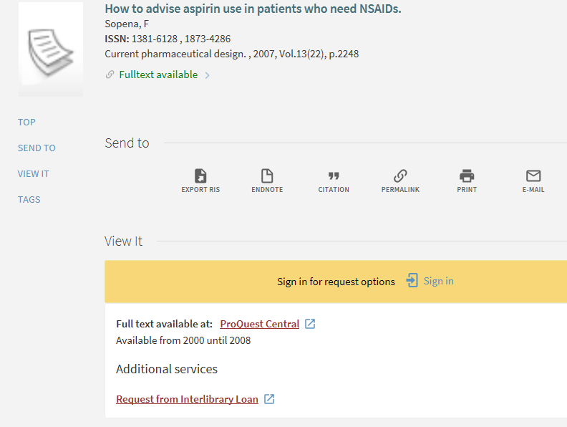
ILLiad Primo OpenURL Addon
Notes:
Kourtney
ILLiad Primo OpenURL Addon for article searching - one of the easier ones. Just fill in the Values for the OpenURLBaseArticle and Book. Select “Yes” to Activate and BOOM it should work. Here’s what the resulting Primo screen looks like in our ILLiad.

Slide 22
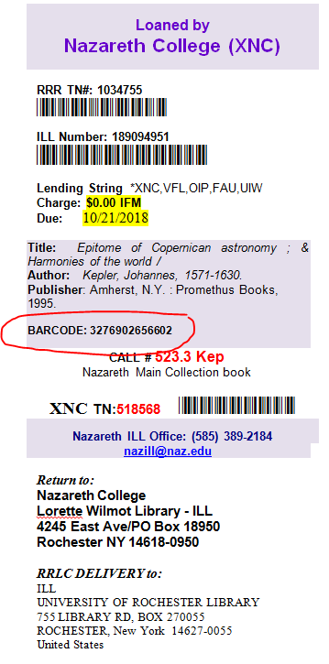
Logic Set-up
The Barcode Import - ask the IDS Logic folks!
Import barcode into your designated Addon field and be sure to add it to your pull slips!
Notes:
Chris? Kourtney?
For lending, there’s one part of the addon you’ll want IDS Logic folks to configure, which is easy.
The Logic Set-Up is easy -
Ask the folks at IDS to include a pull on your barcode and insert it into the ILLiad field you’ve specified in your ILLiad ALMA NCIP Addon config file..
Be sure to include this field on your paperwork.
And NOTE - It will only pull in one barcode - so, you’ll have to address multiple volume sets - which we have coming up!

Slide 23
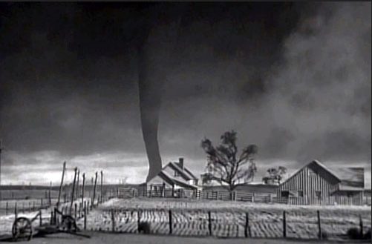
Part Two: Integrating into Workflows
Paradox of notices
Lending
Borrowing
To Check out or not
Overdues (where and how)
Notes:
Kourtney

Slide 24
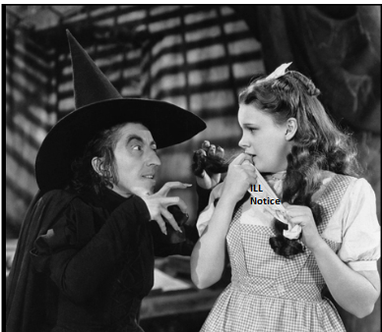
Paradox of Notices
If using the borrowing addon:
Alma will send notices to the patron any time that the due date is changed with the ILL item
The due date in ILLiad and the due date in Alma will likely not be the same, due to the patron record expiration date in Alma, and the calendar
Consider stopping the ILLiad overdue/renewal notices, to avoid patron confusion
Considerations with Alma notices:
Ease of configuration
XML
Number of notices
Notices are for both ILL & Circ items
Must be on same page!
Notes:
Ben/Kourtney -
Ease of configuration for Alma notices - not as much flexibility because of XML
No way to configure stipulations unless Circ wants to have that info in their regular notices as well.
Really need to streamline your texts between Circ and ILL; everybody needs to be on the same page if you use Alma notices.
This was a large reason as to why SJFC chose not to go with the borrowing portion of the addon.

Slide 25
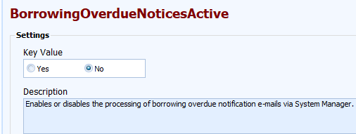
Disable ILLiad Notices in the Customization Manager
Notes:
Kourtney

Slide 26
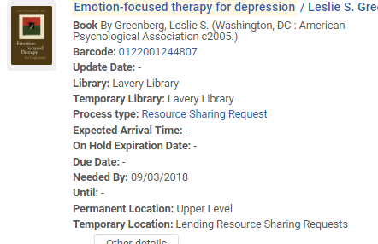
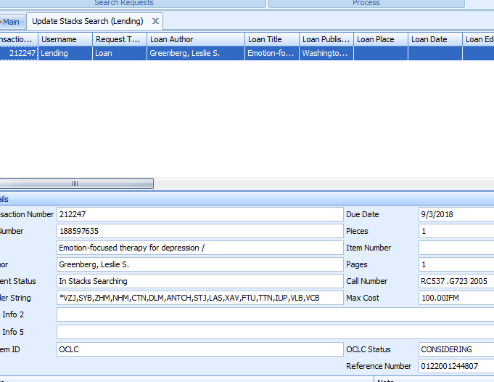
B) Lending: Update Stacks Search Results
Display changes in Alma:
Display changes in Primo:
Notes:
Kourtney
Process as normal until you update stacks search results
IDS automatically pulls barcode into Reference Number field (if you’re doing this)
Include barcode printed on pull slip template
ILL due date is pulled into Alma
ILL status is “Request Shipped” like normal
Temporary location in Alma of Lending Resource Sharing Requests
Not really checked out/counting as a circ because it moves into a temp location
Could prove tricky for weeding
Can track still track resource sharing requests in Alma Analytics
Depending on your config, it will display in primo that the item is unavailable and the status will update to say “On ILL process until due date”

Slide 27
Marking a loaned item “Lost” (or not)
Items are not checked out to a patron account
Items lost by a borrowing library can be marked as “lost” in Resource Sharing, but not Primo
Alternatively: you can mark to “missing” in Primo
Will item change to “lost” based on Overdue & Lost Loan Profile configuration?
TBD...in X days!
Notes:
Kourtney

Slide 28
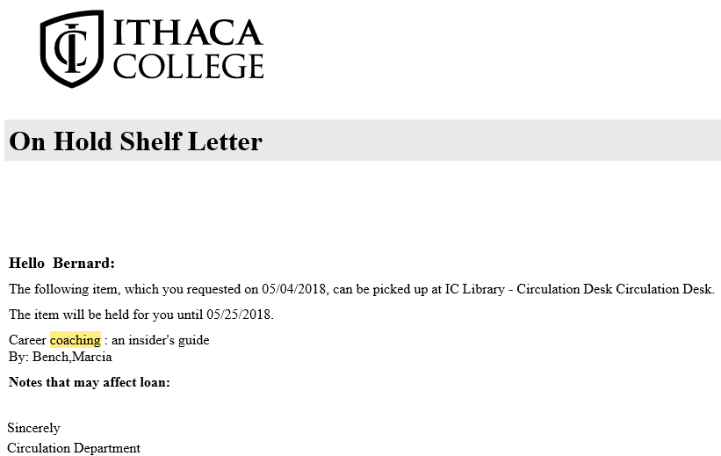
C) Borrowing
-Once items are received in ILLiad, Alma creates a brief bib record and places the item on “Hold”
-The patron is then notified via an Alma notice (no longer a need for the ILLiad notice)
Notes:
Ben -

Slide 29
Borrowing Continued:
If you need processing time to get items on the shelf before patrons are notified, select a desk other than Circulation in Alma : Resource Sharing -> Resource Sharing Partners -> Parameters
Then, scan the items in Alma when they are ready for the “Hold” shelf.
Notes:
Ben-

Slide 30
Borrowing, Continued
-Renewals are all or nothing with Alma, which means that all ILL items appear to be renewable, even though they may not be
-Renewals require staff intervention on the Alma and ILLiad side
-Items are “Returned” in Alma, which can be set to “In Transit” in ILLiad (just in case it was a Library use only item and needed to go back on the shelf)
-They can then be “Checked in” by Library staff in ILLiad when ready to be returned
Notes:
Ben-

Slide 31
Borrowing Renewals
If using the borrowing addon, all items will display as renewable in the patron’s Primo account
When a patron renews in their Primo account, it then changes the status of the request, in Alma -> Resource Sharing -> Borrowing Requests, to “Mediated Patron Renewal”
Staff then have to enter the renewal in ILLiad
Once the renewal is granted, or denied, the request and due date need to be updated in Alma
The patron will then receive an Alma notice with the new due date, or denied renewal
However…. When an item is renewed in ILLiad and updated, in Alma, Alma, looks at the patron record expiration date and the system calendar, and modifies the due date base on that criteria.
This means that the due date in ILLiad and due date in Alma may not match.
You may want to consider hiding the due date in ILLiad with the following message:
Due Date: Sign-in to your Library Account at https://yourlibrary.edu/
Notes:
Ben- With Alma, renewals are all or nothing. This means that ALL ILL items will show up as renewable, even if they are not.

Slide 32
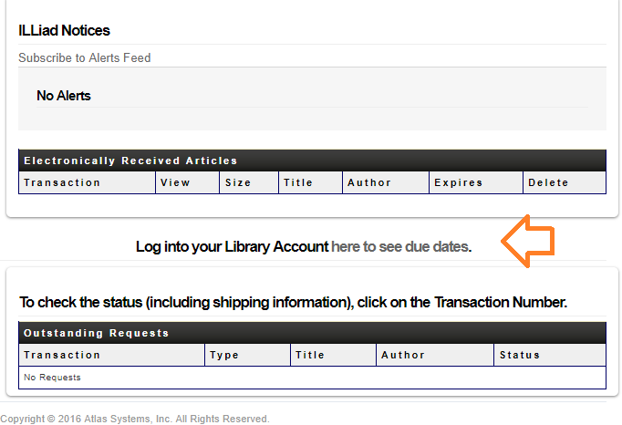
Borrowing, Epilogue
-Since ILLiad and Alma may not agree on the due date, due to the patron expiration date and system calendar, you may want to consider removing the due dates in ILLiad and direct the patron to their Primo account
Notes:
Ben-

Slide 33
Here is How it is Done:
<!--tr>
<h4>Click on the Transaction Number to Renew, or <i>Request Again</i> if not renewable.</h4>
<div class="default-table">
<#TABLE name="ViewRenewCheckedOutItems" headerText="Checked Out Items" noDataAction="ShowMessageRow" noDataMessage="No Items">
<#TABLE name="ViewCheckedOutItems" headerText="Checked Out Items" noDataAction="ShowMessageRow" noDataMessage="No Items">
</div>
</tr-->
<h3 style="text-align:center">Log into your Library Account <a href="https://ithaca-primo.hosted.exlibrisgroup.com/primo-explore/account?vid=01ITHACACOL_V1&section=overview&lang=en_US" target="_blank">here to see due dates</a>.</h3>
The table is hidden, and a link to Primo is added
Notes:
Ben-

Slide 34
Borrowing - To check out or not check out
Upon printing your book labels/bands do you route to:
Customer Notified via E-Mail?
Checked Out to Customer
Problems for both:
Leaving in Customer Notified via E-Mail
Customer wants a renewal
They can’t do it in ILLiad
Stats incorrect - Not Picked Up status upon check in
Routing to Checked Out to Customer (before going on Hold Shelf)
Customer calls to inquire about what they have out - it might be still on the hold shelf
Customer claims never picked it up, but it’s Checked Out to them - Is it?
They call and want everything renewed - but it’s still on the hold shelf
Stats incorrect - some items were never picked up.
Notes:
Chris

Slide 35
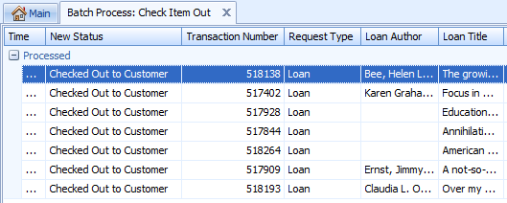
D) Borrowing - To check out or not check out
Messy Solution:
After Check-In, let ILLiad status go to Customer Notified via Email.
In Alma, run a daily report listing everything in the Loaned Item to Patron with date ‘x’
Then manually check out in ILLiad
Notes:
Chris

Slide 36
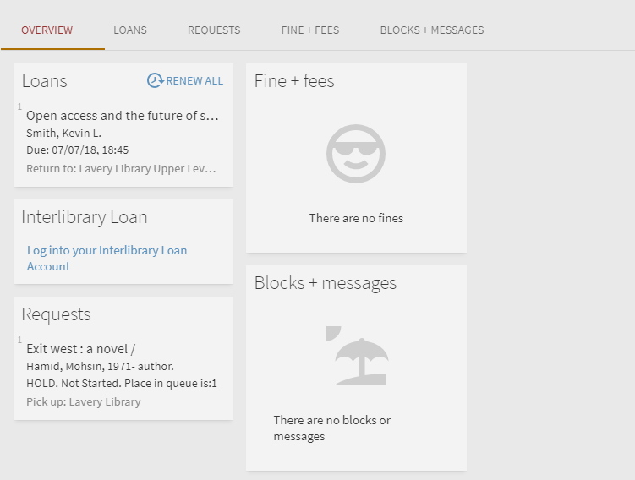
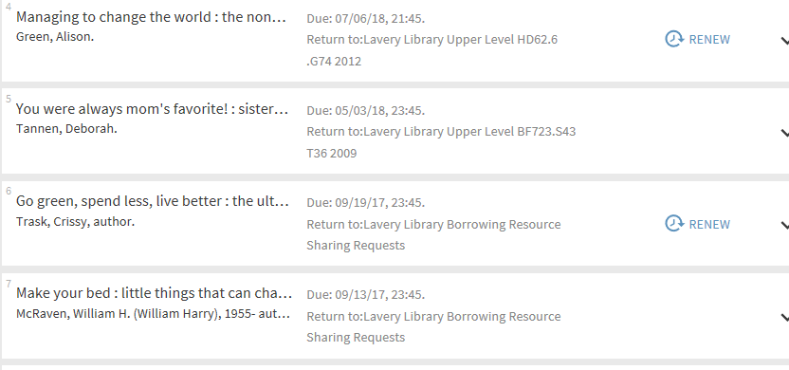
Borrowing Renewals: Patron Primo Account (Example 1)
Notes:
Kourtney
If you use the borrowing addon, your patrons will have regular library materials and your ILL materials in their Primo accounts, with options to renew. Once a patron clicks on “Renew” here, they get a message, the default saying “The renew request will be handled by the appropriate library staff”. This means that you will need to manage ILL borrowing renewals in Alma.
@ Fisher- In addition to the paradox of notices we described earlier, the fact that our emails already say “please respond to this email to renew”, and the balance of managing staff time and patron benefit led us to not use the borrowing addon, and instead opted for a link to the ILL account in the Primo account (see animation).

Slide 37
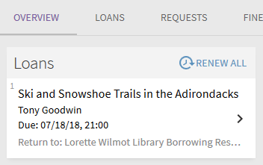
Borrowing Renewals: Patron Primo Account (Example 2)
Benefits of allowing patrons to renew through their account:
Not blocked in ILLiad if item is overdue by x day(s)
Second renewals possible without having to call, stop in or email ILL staff
Downside:
More staff workflow involvement in Alma
Notes:
(Chris) This is Nazareth’s example of Allowing patrons to renew their item from Primo.
The Benefits are:
Not blocked in ILLiad if item is overdue by x day(s)
Second renewals possible without having to call, stop in or email ILL staff
The Downside is:
More staff time

Slide 38
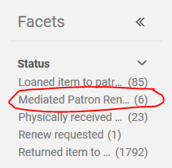
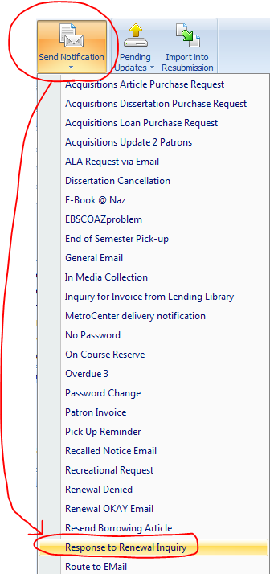
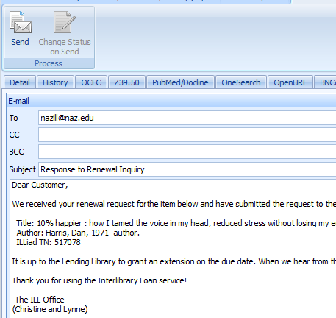
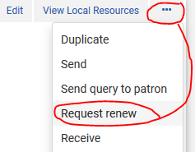
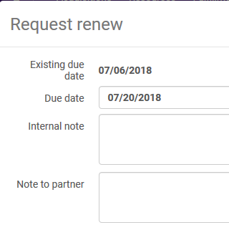
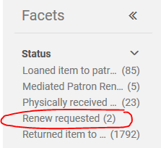
Borrowing Renewals: Staff View
And then wait for a response...
Notes:
(Chris)
So, if they renew it through Primo here is the workflow.

Slide 39
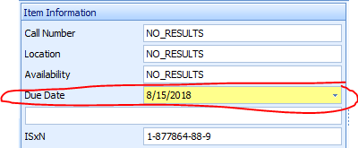
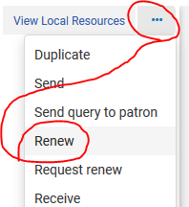
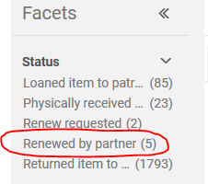
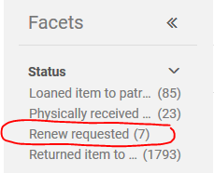
Borrowing Renewals: Staff View
If you’re lucky, you get the Addon working… or else...
NOTE: If they renewed through ILLiad, you’ll need to look these up in Alma manually. They won’t be in the Renew Requested facet.
Notes:
(Chris)
Renewed workflow - Done

Slide 40
E) Overdues (Where and How)
Notices Decision…
Are you going to have ILLiad send out customized ones? Or go with Alma’s?
Naz Decision to send both:
We want the items back
No fines for Naz items...
ILLiad allows us to customize the 3rd email with stronger language than our circ policy
Did I mention we want the items back?
Ithaca Decision to send Alma only:
Eventually ILLiad will go away.
Notes:
(Chris slide)
Ithaca - overdues off in ILLiad
Naz - overdues on in both.

Slide 41
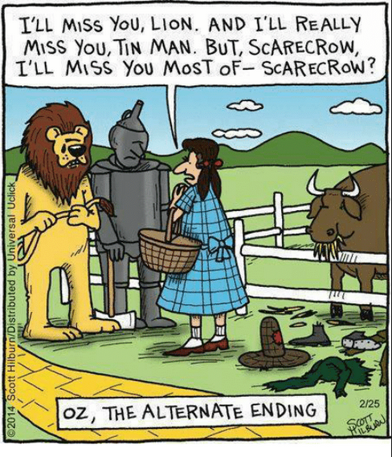
Part Three: Pitfalls, Tips and Tricks
No Borrowing or Lending categories in Alma!
Multi-volume
Borrowing
Lending
Multiple Copy (Barcode to print slip)
Renewals
Alma requests & hold shelf woes
Pre-addon requests

Slide 42
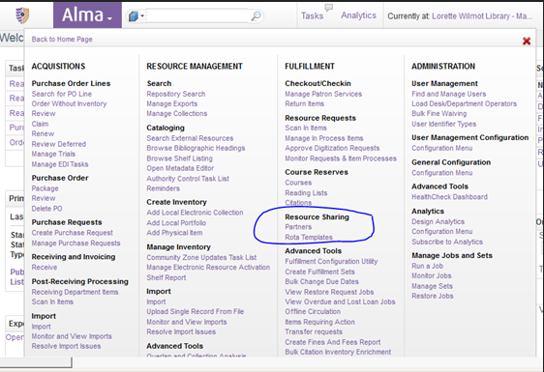
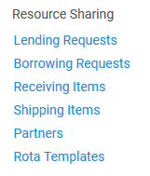
No Borrowing or Lending Categories in Alma
Solution:
Added a Library scoped Fulfillment Services Manager role.
Look up staff member
Get into their User Details
Under General Information locate their User Roles (scroll down)
Activate Fulfillment Services Manager and scope to your Library (not Institution name)
Notes:
(Chris Slide)
We initially had problems where your Alma wasn’t displaying under Resource Sharing, the categories of Lending, Borrowing, Receiving and Shipping.
To add these in, you need to add a Library Scop under the Fulfillment Services Manager role.

Slide 43
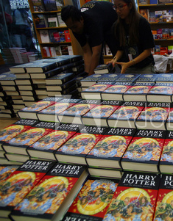
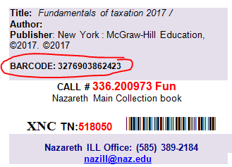
Multi-Copy Set
Alma will check-out the barcode you give it and NOT the copy someone pulls from the shelf!
SOLUTION:
Notes:
(Chris Slide)
Multi-copy Sets can be a problem in Alma.
Say you have five copies of a popular book. You give Alma the barcode for Copy 2 but your student pulls Copy 4 and updates it in ILLiad to ship it out.
Alma updates Copy 2 to Lending Resource Sharing Requests. Copy 4 still reads available - even though it’s on its way to another library.
SOLUTION: Put the barcode or barcodes on the Lending Pull Slips. Staff match on barcodes then.

Slide 44
Multi-Volume Set - Lending
PROBLEM: Alma does not recognize more than one barcode for updating
Notes:
(Chris slide)
Alma does not recognize more than one barcode for updating!
Therefore - for fetching purposes, I paste both barcodes into the Reference Number field, which will print onto the pull slips.
When the student updates, it errors. Easiest way Naz has found to handle it, is to temporarily move both barcodes to another field for updating each barcode individually through the Mark Found update process.
Once all barcodes are updated to shipped in ILLiad (and thus also in Alma), I put all barcodes BACK into the barcode field to eventually ERROR out when the item is returned. That way I can check them all back into Alma.
Just be aware:
If you have a space behind or in front of the barcode - you will get an error.
ILLiad will probably throw you an update Error Flag - just clear it.
ILLiad may also toss the re-updated request into Secondary Print Queue - so just route it back to Item Shipped or Request Finished (if you are completing the lending process), or - if you don’t use the Secondary print queue - write a routing rule.

Slide 45
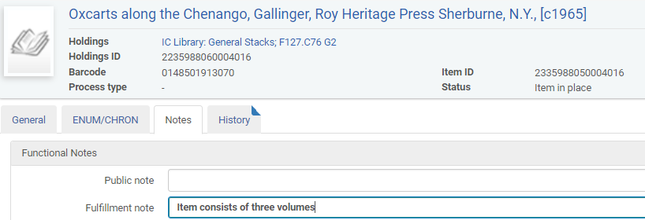
Multi-Volume Set - Borrowing
Notes:
(Chris Slide)
On the flip side - you need to note multiple volumes when loaning out to your own patrons!
Be sure to add in a Fulfillment Note noting how many volumes - so that your circulation people will know what to check for.

Slide 46
Lending Renewals: Overdues
Overdue items have a “restore” request on them in Alma
Find item, cancel restore request
Renew in ILLiad
Renew in Alma under Fulfillment > Lending
No renew options? You MUST have your borrowing workflow profile configured in Alma!
Notes:
Kourtney
Something that we just recently experienced at Ithaca and Fisher is how to handle a renewal for an lending item that is overdue in Alma. When an item is overdue in Alma, it will have a “restore” request on them in Alma. You have to find the item in the lending section of Alma and cancel the request before you renew it in Alma. This is actually a good thing because you may want to ensure there aren’t requests for this item from your own patrons as well as this restore request. If there werer more than 1, you would see that listed.
Ithaca was able to get this working, but at Fisher, we couldn’t, and here’s why: IF YOU CHOOSE TO NOT USE THE BORROWING ADDON: MUST have your borrowing workflow profile configured in Alma for renew options to appear. Fisher was just updating due back date but this was not displaying in Primo.

Slide 47
Lending, Primo Requests, & Hold Shelf Woes
Local patron places an Primo request on an item out via ILL
Item is eventually returned with NCIP addon
Item moves to “available” in Alma regardless of request by local patron
Patron is told to come pick up item
Circ staff are never notified via email or “Pick from Shelf” in Alma, so the book gets reshelved.
Possible, sticky solution: staff “scan in items” without registering in-house use in Alma to see next steps
Notes:
Kourtney
Another tricky spot in lending is when your own patrons place Primo hold requests on items out via ILL. Here is how this scenario looks:
Why is this problematic?
Circ staff have no way to know that a patron requested an item, it goes back on the shelf.
Having students or staff scan in items again to see there is a request is extra work, defeating part of the purpose of the addon
The next steps screen of “scan in items” is not big and it doesn’t necessarily clue someone in if they’re scanning multiple items at once
We have a ticket in to Alma support for this.

Slide 48
Pre-addon lending requests: things to consider
How do you handle currently shipped lending requests once returned?
If you use an ILL Patron account to check out lending requests in your ILS
If you have one staff member using addon for testing and documentation before rolling out to other staff members (putting on server)
Error message will display in ILLiad: route to request finished
Notes:
Kourtney
Regarding workflow, something to consider is how you will handle the requests that you currently have in the “Item Shipped” status that have not been touched by the lending addon.

Slide 49
Pre-addon requests: borrowing
For borrowing, some items will be checked out in Alma, and some won’t.
Either:
Check all current items out in Alma by re-receiving with the addon (patrons will receive a notice when this happens; it may be a good idea to notify them ahead of time), you will also see connection errors
Or
“Return” all items in Alma regardless of if they were checked out in Alma or not, and update in ILLiad as needed
You may want to use the “Mark in transit” function to ensure that items are properly returned in ILLiad, as needed
Notes:
Consider change up in book band colors for pre-Alma Addon vs. Alma Addon working. (Screen shot)

Slide 50
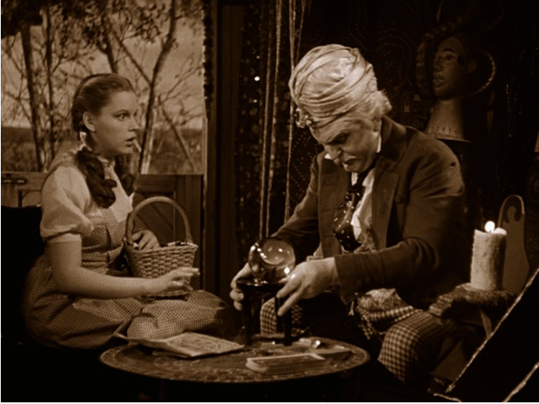
Part Four: Future of Alma & ILLiad & Tipasa
Notes:
IDS interested in working on APIs
OCLC interested in developing APIs in Tipasa to function with Alma and other integrated systems.
Taken right from the Tipasa Newsletter - July 2018:
WMS libraries using Tipasa already take advantage of its user portal, notification service, streamlined staff processing, advanced configurations, and integrations with Circulation and RapidILL. We’ve just expanded integration with WorldShare Circulation and added integration with WorldShare Acquisitions. With this new functionality, you’ll be able to streamline purchase requests that originate from ILL and connect patron ILL activity in circulation, providing additional workflow efficiencies for both borrowing and lending libraries.
The NCIP connections built with this functionality allow us to begin working on other ILS integrations. Ex Libris Alma is in testing now with scheduled availability in February 2019.

Slide 51
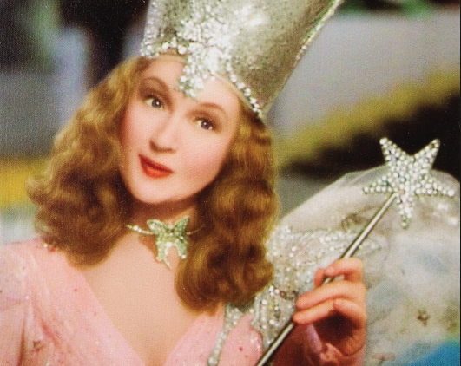
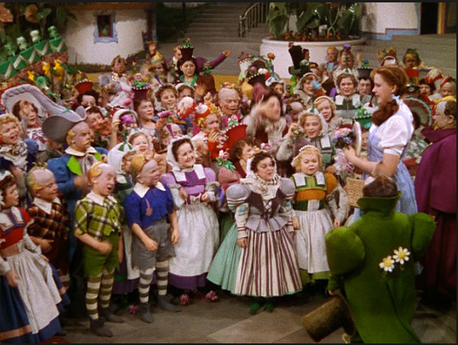
Part Five: ROTA Partners
Notes:
SUNY interest in this as well as private library interest.

Slide 52
Questions….
Please feel free to contact us during lunch, in the halls, at dinner, via emails!
Kourtney Blackburn: kblackburn@sjfc.edu
Ben Hogben: bhogben@ithaca.edu
Christine Sisak: csisak5@naz.edu
Notes:
SUNY interest in this as well as private library interest.

