Slide 1
OER: A Model for Building a Relationship Between Faculty and Librarians
Larry Chase and Gregg Kiehl
ljc@tc3.edu – KiehlG@tompkinscortland.edu
IDS Project
Conference 2018
Utica, New York
Notes:
Since this is the last convening of the OER Degree Initiative Grantees, we are giving grantees an opportunity to update your colleague on your success and challenges during the initiative.
On the cover slide, include your institution name, logo, OER team members and number of OER Degree in Process (or completed).

Slide 2
The Tompkins Cortland plan for OER
sustainability has three components:
Organizational planning
Marketing
Making materials available

Slide 3
Organizational planning
Define OER (our OER Task Group)
Designate a coordinator & support advocates (Library)
Recruit faculty advocates
Support from administration and others (Library)
Promote OER on campus (Library)
Develop a sustainability model (Library)

Slide 4
Formed an OER Task Group
Task Group Goals
Standardize a SUNY definition of OER
Engage the SUNY community and other OER experts to determine elements for a successful OER implementation
Create tools to scale and sustain campus OER efforts
Benchmark and share best practices between campuses
Subgroups formed:
Faculty
Support (Library)

Slide 5
Tony DeFranco
Director of Technology Support

Slide 6
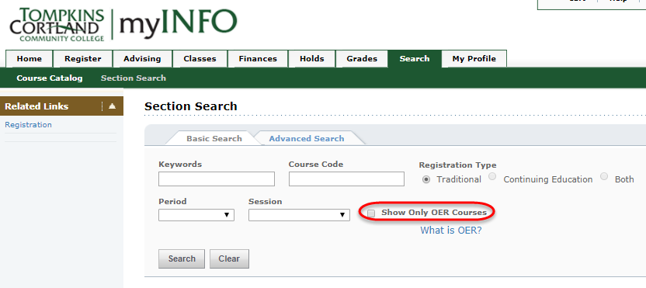
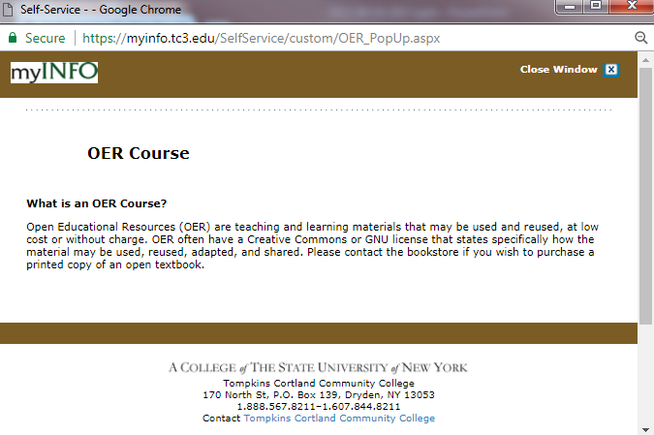
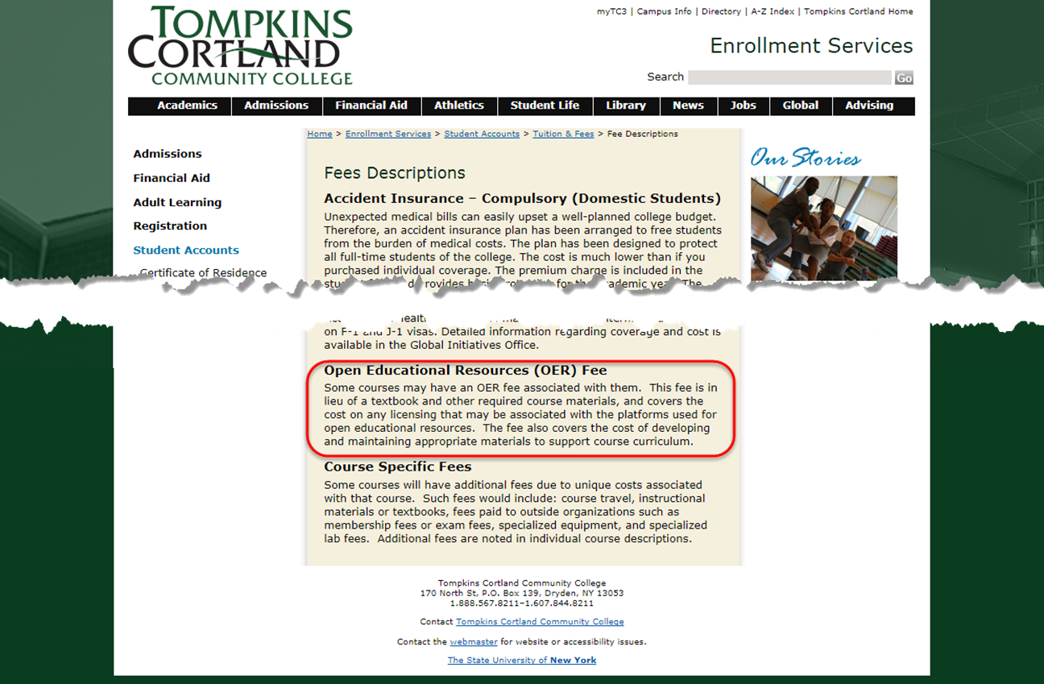
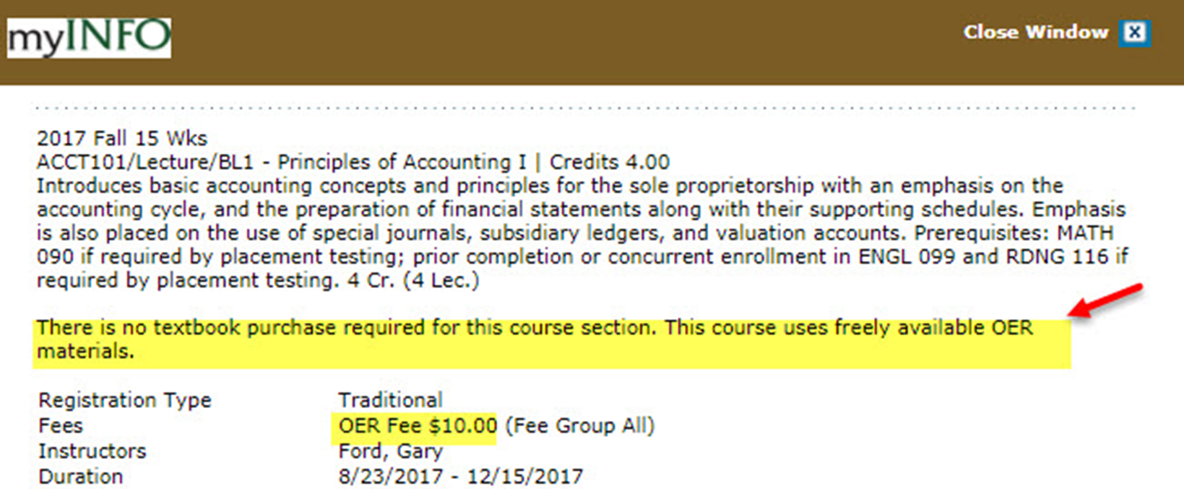
Marketing efforts

Slide 7
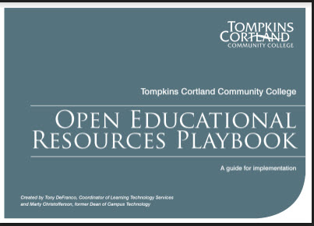
Promoting and Scaling OER
Developed OER Playbook
Hosted OER Colloquium for SUNY
Promotional videos
Presenting to SUNY Campuses and Groups like IDS

Slide 8
Why use OER?
Saves money for students
Grants access to more quality choices (Social responsibility – provides education for all)
Helps preparation for course and retention of knowledge after course (Library)
More clarity and/or certainty regarding reuse of materials (Library)
Enhances a college’s reputation as well as that of the teacher or researcher
Raises standard of educational resources by gathering more contributors

Slide 9
Success/Accomplishments
Completed OER degree (Business Administration AAS & AS)
$600k since degree initiative began in 2016
$1.5 million total thus far
92 sections/40 courses
Culture shift
Improved success and retention
Paving the way for new OER programs
***** Governor has pledged $8,000,000 for OER development.
Notes:
This slide is where you can flaunt all of the success and accomplishments that you and your team experienced during the Initiative. You can list courses completed, any news recognition, institutional changes that have occurred, etc.
Faculty from participating departments enthusiastically embraced the project
Brought about more attention on campus of OER. Faculty not involved with the grant express interest in OER because they heard about it from others on campus.
We’ve experienced an overall cultural change - OER is now who we are as a College
students talk about how they like OER (for savings) and talk to their instructors about it
Faculty now approach administration about getting involved, rather than the other way around
OER sections prominently displayed in SIS course catalog – faculty very much want their courses included in the list
4. In many courses we’ve seen significant improvements in student success and retention compared to previous semesters when OER was not used
5. We are now just a few courses away from offering other programs completely using OER

Slide 10
Library’s Role
Research
Archiving
Printing

Slide 11
OER Library Support for Faculty
Value add services
https://tc3.libguides.com/OER

Slide 12
OER Explained

Slide 13
OER Explained continued

Slide 14
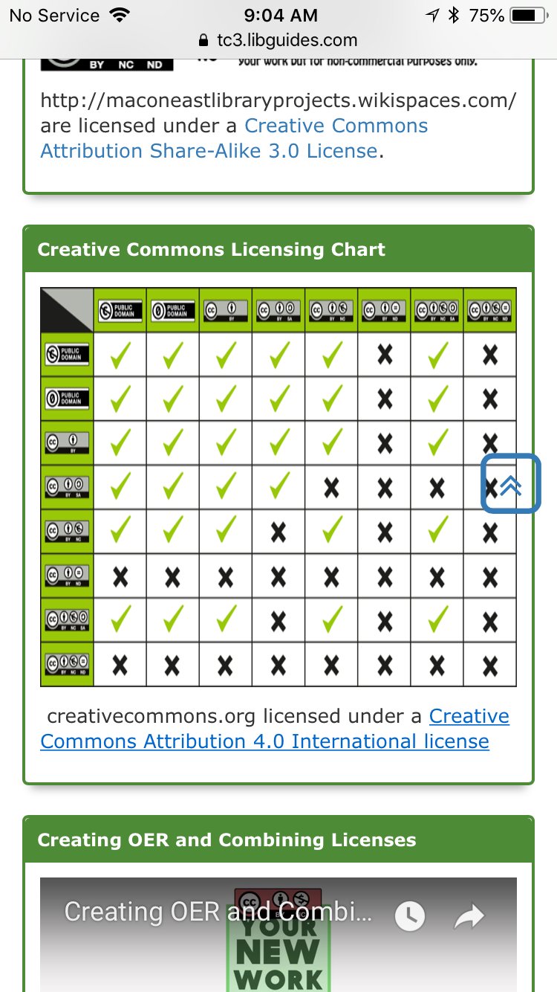
Understanding Licensing

Slide 15
Research the obvious connection

Slide 16
Adoption & Creation

Slide 17
Finding Aids

Slide 18
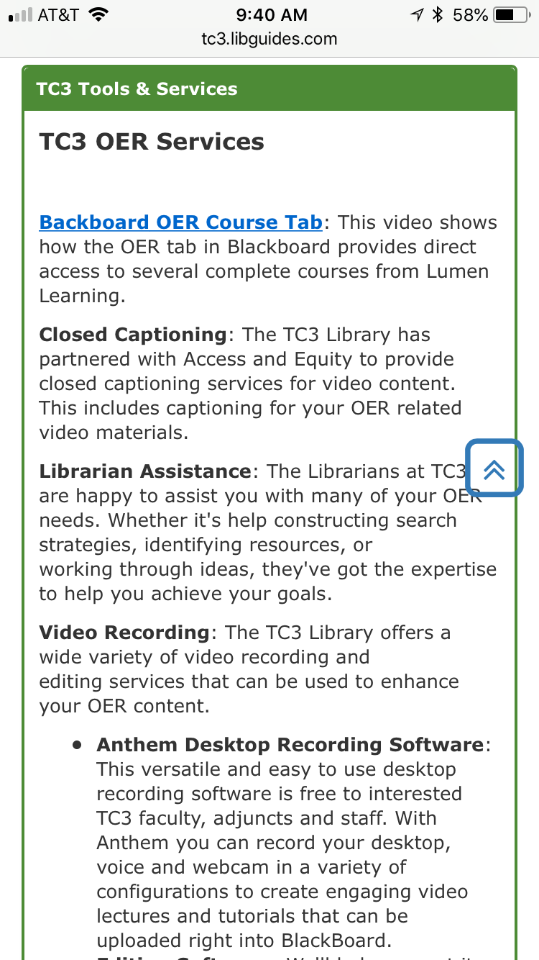
Value Add Services

Slide 19
Streamlined Communication

