Slide 1
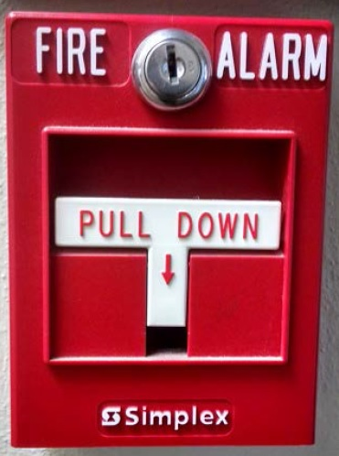
Putting Out Fires Without Water
IDS Conference
Friday July 27, 2018
Notes:
Think about an organization that failed. Why did it fail? What was missing? What was congruent or incongruent?

Slide 2
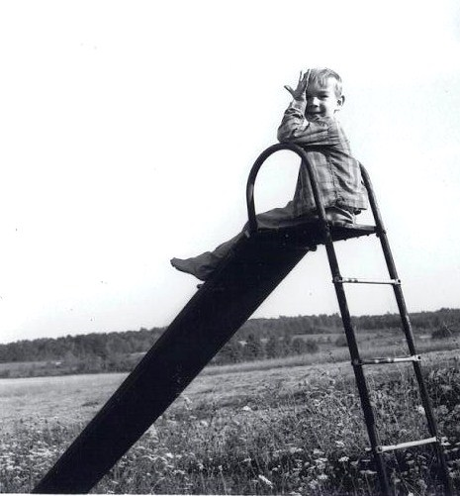
Childhood games often included rules and roles. What happened when those rules and roles were not followed?

Slide 3
Our discussions today will include:
Agreements between staff and departments involved with a project
Communication within teams
The components of change
Team differences
Personality styles
Managing conflict
Recognizing stress

Slide 4
Working Agreement
Team members agree on how/when/where to meet, discuss and make decisions for the project. The working agreement is defined, decided and agreed upon by all members of the team.
The team must also determine the plan of action if the working agreement is not followed. Perhaps it needs to be modified.

Slide 5
Memorandum of understanding
A nonbinding written document that states the responsibilities of each party to an agreement, before the official contract is drafted..
https://legaldictionary.net/memorandum-of-understanding/

Slide 6
communication
How will updates be sent to staff?
How will team members communicate during the project?
How often will updates be sent out?
How far in advance do we need to let users know of the change?
How can our users contact us with questions in the meantime?

Slide 7
Internal communication tools
Basecamp
Course management software
SharePoint (MS Teams)
Wiki
Wordpress

Slide 8
Communicating within teams
“My co-worker said that I don’t listen when he’s talking. At least, I think that is what he said. I was distracted at the time he said it.”

Slide 9
Is the team inclusive?
Who does the team represent? Staff? Users? Librarians? Students?

Slide 10
Communication Tool
Be present – ensure that you ‘re in attendance to the important meetings that involve you.
Be prepared – Knowing who will be in attendance, what will be discussed, and what is the expected outcome for each meeting….
Don’t be afraid to chime in (aka interrupt) – Don’t be afraid to voice your opinion second or third time.
Be confident, not defensive, with your input – being confident enough to “lean in” at meetings and speak up….
Give credit where credit is due to colleagues.
https://www.payscale.com/career-news/2016/09/5-ways-make-sure-women-heard-meetings

Slide 11
Facts versus fiction
Which one of these statements is a fact, and which is a fiction?
We are migrating to a new library system this summer.
Because we are migrating to a new library system, it will most likely mean position eliminations.

Slide 12
The Four rooms of change
Contentment My current situation is comfortable. No need for change. | Renewal Creative change. Strong sense of accomplishment and community.
Denial May be defensive to the current ways of doing things. | Confusion Something feels wrong. Not sure what to do next. Missing information may be constructed, whether or not based on fact.
Adapted from http://www.claesjanssen.com/four-rooms/matrix/index.shtml

Slide 13
What are the Components of a Team?
The more similar the types on a team, the more readily the team members will understand each other.
The more dissimilar the types on a team, the slower the understanding.
Groups with high similarity will reach decisions more quickly but are more likely to make errors due to inadequate representation of all view points.
Groups with members of many different types will reach decisions more slowly but may reach better decisions because more viewpoints are covered.
McCaulley (1975), Introduction to Types and Teams
Notes:
This leads us to MBTI.

Slide 14
Triage and communicate
Consider creating a timeline for important tasks.
The timeline can be based on hours, days or weeks.
If deadlines cannot be met within an expected deadline, who needs to be notified? What can be done in the meantime?

Slide 15
Personalities and teams
“When disagreements or conflicts emerge, encourage team members to step back and ask themselves if type differences are playing a role.” Briggs-Myers, I, Mary H. Mccaulley, et al. : CPP : 2009: MBTI Manual

Slide 16
Personalities and teams
The MBTI is a survey that helps to determine one’s preferences for receiving and processing information, which leads to communication styles and making decisions.

Slide 17
Personality types
Share information and discuss ideas (Extrovert)
Or
Reflect, process and then discuss (Introvert)
Identify facts and realities (Sensing)
Or
Generate possibilities (Intuition)
Analyze likely outcomes (Thinking)
Or
Evaluate by values and social capital (Feeling)
Create a plan (Judging)
Or
Be spontaneous (Perceiving)

Slide 18
Personalities and teams
What happens when:
The person who focuses on details, doesn’t have enough details?
The person who relies on possibilities and intuition now has to make decisions using details and facts?
The person who is an introvert now has to give a presentation in front of a large group?
Someone who relies on timelines is working with someone who is spontaneous and doesn’t adhere to timelines?

Slide 19
Building Teams
Attack the problem, not the person
Give everyone the opportunity to state his or her opinion
Remember that opinions differ; there may be several perspectives on the same situation
Talk solely about your own beliefs and experiences—avoid blanket statements such as “Everyone feels that …”; instead, try “I feel that …”
Elizabeth Hirsh, Katherine W. Hirsh, and Sandra Krebs Hirsh, MBTI® Teambuilding Program, 3rd ed. Copyright 2009 by CPP, Inc. All rights reserved. Permission is hereby granted to reproduce this document for workshop use. Duplication for any other use, including resale, is a violation of copyright law. MBTI and Introduction to Type are trademarks or registered trademarks of the MBTI Trust, Inc., in the United States and other countries.
Notes:
We tried that once and it didn’t work.

Slide 20
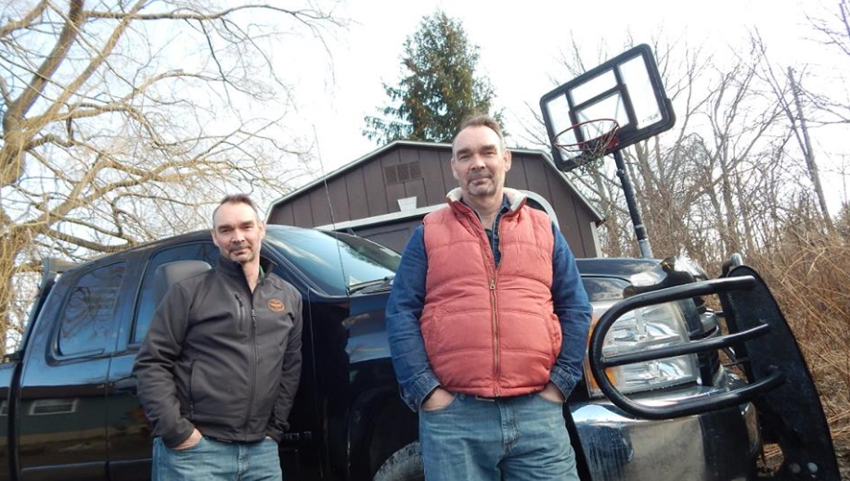
When types are exaggerated
That doesn’t sound like them at all.
Where did that come from?

Slide 21
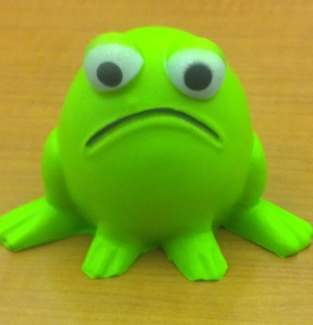
Working on teams and stress
“The stresses of everyday life have different effects on different types and that some types are more naturally reactive to stress than others.”
Briggs-Myers, I, Mary H. Mccaulley, et al. : CPP : 2009: MBTI Manual

Slide 22
network
Are there other libraries that have already implemented/migrated to a new system?

Slide 23
Team problem solving
When solving problems within a team, is it due to a lack of a:
Awareness
Behavior/attitude
Skill
Tool

Slide 24
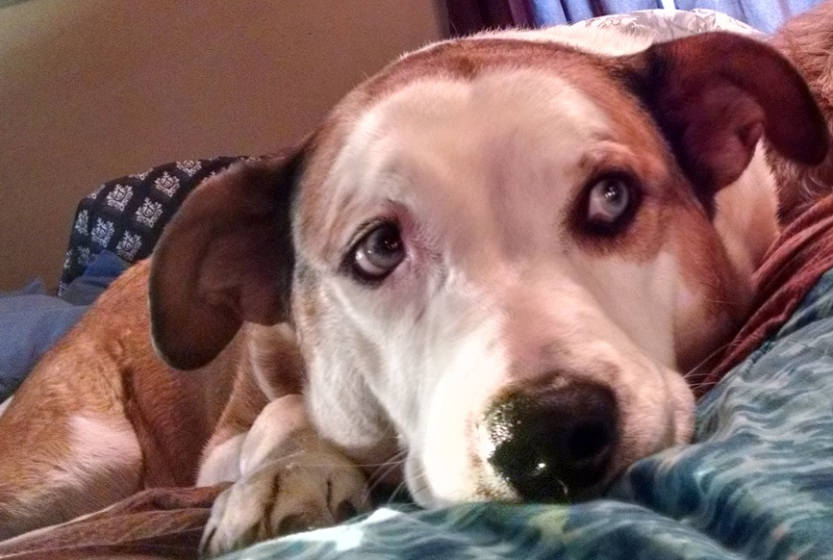
Questions only

Slide 25
Consider stress relief activities
Decorate cupcakes
Go for a walk around campus
Graffiti wall
Painting class
Therapy dogs

Slide 26
Wrap up
Teams involve many different personalities
With those personalities comes the different communication styles
If information is missing, it might be constructed “Fact versus fiction”
Working on teams can be stressful – recognize stress and give some attention to de-stressing
When feeling overwhelmed, it’s important to triage and then communicate.

Slide 27
Thank you for attending today!
Do you have questions?
Do you have answers?
bhogben@Ithaca.edu

