Slide 1
The Library didn't explode.
One year after an Alma migration

Slide 2
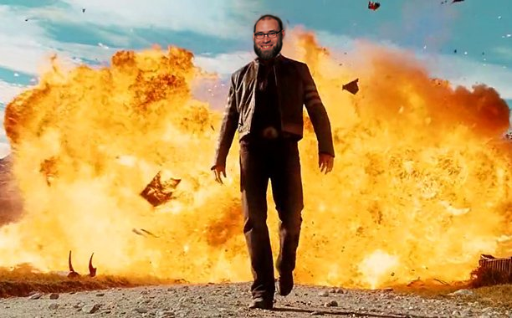
“Why did we do this?”
You can’t walk away from this one.
Notes:
Image adapted from X-Men Origins: Wolverine

Slide 3
Managing your migration

Slide 4
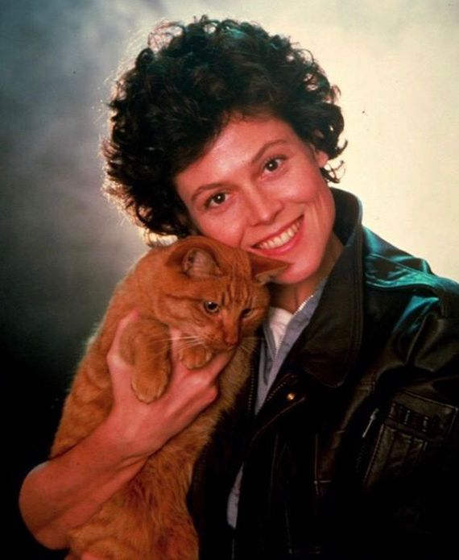
Your support network
Library staff and administration
IT
Colleagues in your institution and beyond : IDS!
Family and friends
Ex Libris Support
Notes:
Promotional image from Alien

Slide 5
Get all hands on deck
Focused teams are needed for project meetings … but everyone is part of this
Include input from all departments (don’t forget Instruction!)
Designated liaisons between project leads and departments
Keep communication flowing
Notes:
Image adapted from X-Men: Apocalypse poster

Slide 6
The big stuff
Don’t sweat the config spreadsheets
Use your implementation coordinator
Read and act on feedback from test data loads
Document preexisting workflows
Figure out nice-to-haves vs. essentials
Take training seriously
Notes:
I say don’t sweat the config spreadsheets -- but you should spend some time on them. Just know that they’re not going to lock you into one configuration, and they limit you in a lot of ways that may not match your institution.
Image adapted from The Princess Bride

Slide 7
Leverage available tools
Project management tools: Asana, Basecamp, Keep, Trello
Keep track of progress, deadlines, and assignees
Dig into Salesforce Support Cases, Alma-L/Primo-L, and Knowledge Center
Notes:
Image adapted from Kill Bill, Vol. I

Slide 8
Protect yourselves

Slide 9
Back up all the data
Save everything from your old system
Copy the database if you have database-level access
Pull every report
Export all the MARC
….and save it all to two places. JIC.
Notes:
If you have your old data, you can pull it apart to answer questions and correct foibles.
Image from Hackers

Slide 10
Get your hands dirty
Don’t be afraid, but take precautions
Learn to configure all you can
Use your test environment
Take screenshots and document current state and changes
Notes:
Image from Mad Max: Fury Road

Slide 11
Manage expectations
Let your user base know change is coming ...and more change will come after that
Expect growing pains
Respond to feedback before and after
Notes:
Image adapted from Shawn of the Dead

Slide 12
Freeze and Cutover

Slide 13
Offline time...
Plan staff projects
2 weeks tech services freeze
2-3 days checkout freeze
Training
Digitization projects
Offline circulation
Notes:
Image adapted from The Day After Tomorrow poster.

Slide 14
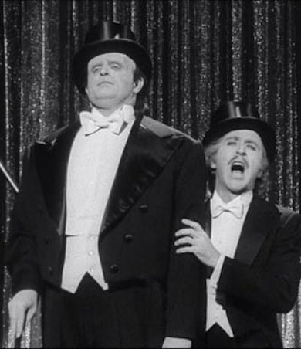
Go-Live!
Overlap services, or hard switch?
If possible, schedule some back-end overlap: you probably forgot something!
Test all the things
Communicate with users: the feedback cycle starts now
Notes:
Image adapted from Young Frankenstein

Slide 15
After Migration

Slide 16
Celebrate!
You made it! Cue the group hugs!
And the continuing meetings… but seriously, throw a party, you went through a lot
Notes:
Image from My Little Pony: Friendship is Magic

Slide 17
You can fix it
Alma can change before AND after go-live
You’re not stuck -- now it’s yours
Touch base with all staff: where are pain points occurring?
Work with product support
Suggest improvements through Idea Exchange, NERS, and lists
Notes:
Image adapted from Atlantis: The Lost Empire

Slide 18
Let’s Get In There!
Notes:
Time to jump into Alma, kids. Questions and distractions welcome.
sjfc.alma.exlibrisgroup.com

Slide 19
Links
Ex Libris Knowledge Center: https://knowledge.exlibrisgroup.com
St. John Fisher Primo: https://sjfc-primo.hosted.exlibrisgroup.com/primo-explore/search?vid=01SJFC_INST
Pictures of Kittens: https://www.google.com/search?q=pictures+of+kittens&tbm=isch
Notes:
Alma: https://sjfc.alma.exlibrisgroup.com/mng/login
Primo Back Office: https://sjfc-primo.hosted.exlibrisgroup.com:1443/primo_publishing/admin/acegilogin.jsp
Salesforce: https://exlibrisgroup.my.salesforce.com/home/home.jsp?sdtd=1

Slide 20
Thanks
The library staff at Fisher and Nazareth
Our mentors at IDS, Roberts, Ithaca, Northwestern, Tennessee, and UConn
Our library director and campus community
Our Alma implementation coordinator, Marina, and her support team
Notes:
Alma: https://sjfc.alma.exlibrisgroup.com/mng/login
Primo Back Office: https://sjfc-primo.hosted.exlibrisgroup.com:1443/primo_publishing/admin/acegilogin.jsp
Salesforce: https://exlibrisgroup.my.salesforce.com/home/home.jsp?sdtd=1

