Slide 1
IDS • 26 July 2018
Tipasa API Update
John Trares
Senior Product Operations Manager
Resource Sharing
traresj@oclc.org
Notes:
My name is John Trares and I’ve been working with ILLiad since 2006 .. And I’m still learning new material every time I dig deeper into the components.
I manage the hosting service at OCLC and I also work with the WorldShare ILL developers when we release new ILL APIs

Slide 2
API …
What is an API?
Notes:
Let’s do another quick show of hands: how many of you are really comfortable with what an API is?
Well, the good news is that it's not super important for you, as ILL librarians, to understand all the technical details about APIs. But, you too should be excited about the forthcoming Tipasa API, and my main goal today is to help you understand why.

Slide 3
API …
Application Programming Interface
An API is a service's interface that accepts a request from another service/system and returns a response.
Notes:
Here’s the definition that I came up with ..

Slide 4
Image (CC BY-SA 2.0)
Notes:
The Tipasa APIs will be a tool set. This tool set will allow developers to build custom applications that interact with Tipasa and enhance the ILL experience for both patrons and staff. The API is an important part of making Tipasa as customizable and interoperable with other systems as you need it to be.
We're committed not only to creating this toolkit, but to providing facilities to share the resulting applications with the Tipasa Community. This, we believe, is what we really need to spur community innovation in the ILL space.
Now, perhaps some of you are thinking, my library doesn’t have developers, or at least very many of them. So why do I care about the Tipasa API? Well, our community-based approach will also allow institutions of ALL sizes to take advantage of the Tipasa API, and now I’ll say a little more about how.

Slide 5
Image (CC BY-SA 4.0)
Notes:
Let’s start with the big libraries. Libraries with development staff, which tend of course to be larger institutions, will be able to take advantage of the API directly and write code that integrates with Tipasa.
These libraries will want to look to the OCLC Developer Network to find API documentation and technical updates, as well as our GitHub page for code libraries, examples, and starter projects.

Slide 6
Image (CC BY-SA 3.0)
Notes:
All libraries, on the other hand, even smaller ones with limited or no development staff, will be able to take advantage of applications shared with the community, and perhaps contribute to community coding projects as well.
The Tipasa Community Center will be a great place to learn about how libraries are taking advantage of these tools and integrating them into their workflows.
To promote interoperability, we also have plans to make the API available to OCLC commercial partners so that they can integrate their software with Tipasa and create more tools for libraries of all sizes to make use of.

Slide 7
Travel system example
Takes your travel requirements (car, hotel, plane)
Conveys it to rental agency, hotel, airline
Returns with your confirmation number, pricing, additional details

Slide 8
Travel system example
Takes your travel requirements (car, hotel, plane) request
Conveys it to rental agency, hotel, airline the external system(s)
Returns with your confirmation number, pricing, additional details response(s)
Notes:
Request
External system(s)
Response(s)

Slide 9
Travel system example
Response:
Car Rental at: Columbus US (CMH)
Pick-up at: 173 W 5TH AVE COLUMBUS, OH, 43212 US
Pick Up: 08:30 AM Wed Jul 25
Number of Cars:1
Return: 12:00 PM Sat Jul 28
Returning to:173 W 5TH AVE COLUMBUS, OH, 43212 US
Confirmation: 202431246COUN
Status: Confirmed
Rental Details: Compact / Car / Automatic transmission / Air conditioning
Notes:
Compact

Slide 10
Travel system example
Unexpected results
Error handling
Recovery
Acceptence
Notes:
Not a compact

Slide 11
Current WorldShare ILL API usage
OCLC provides two separate Resource Sharing APIs
Problems:
  Built on HTTP/SOAP (Simple Object Access Protocol) protocol
    “The verbosity of the protocol, slow parsing speed of XML, and lack of a standardized interaction model led to the domination in the field by services using the HTTP protocol more directly. See, for example, REST.”
  Enhancements hard to provide since the entire API needs updated for new features
  Current APIs don’t map well to the internal WorldShare ILL / Tipasa components
We will:
  Move to the HTTP/REST (Representational State Transfer) protocol
  Provide access to the same internal components used by WorldShare ILL and Tipasa
  Provide a community-based development model to engage less technical institutions

Slide 12


Tipasa AP Task Force .. started
Notes:
We started with an open discussion about the Tipasa API and the call for participation in the Task Force at the IDS Conference in July, 2017.
We had our first meeting in September and continued meeting monthly. Our charge was to define use cases for the Tipasa API and how the ILL community will work together to collaborate on and share applications using the API.

Slide 13
Task Force – Community Members
Lauren Ajamie, University of Notre Dame
Tyler Ashcroft, Brigham Young University
Eric Bivona, Dartmouth College
Timothy Jackson, University at Albany, SUNY
Ralph Johnson, University of Michigan
Shannon Pritting, SUNY Polytechnic Institute
Mark Sullivan, IDS Project
Notes:
First, here are the community members of the Tipasa API Task Force, two of whom, Shannon and Tim, you'll be hearing from them shortly. I'm personally very thankful for all the thought and dedication that the Task Force members have contributed towards this effort, so let's have a round of applause for them.
There’s a lot of expertise in this group customizing ILL workflows and tools, particularly ILLiad, so we couldn't have asked for a better group to guide the development of the Tipasa API.

Slide 14
Task Force – OCLC Staff
Donald Bohn, Software Architect
Karen Coombs, Senior Product Analyst
Jennifer Corsi, Senior Product Manager
Tony O’Brien, Senior Technical Manager
Hank Sway, Product Analyst
John Trares, Senior Product Operations Manager
Notes:
We also had a lot of participation in this group from the OCLC side, from both our product management and technology teams.

Slide 15
User Stories
Build custom applications that can:
  Create Tipasa requests
  Read Tipasa request data
  Update Tipasa request data
  Search Tipasa requests
  … and more!
Notes:
Based on our conversations about these problems, we then formulated user stories about what developers want to do with the Tipasa API. This included building applications that are capable of creating new Tipasa requests, reading, updating, and searching request information, and more!
Our next step after solidifying these problem statements and user stories was to focus on how to make the API as developer-friendly as possible.

Slide 16
API Problem / Solution Pairs
Notes:
Here are sample real, in process and future problem / solution pairs for OCLC APIs

Slide 17
Pull lists
Problem
Need each way to get a real time list of materials to be retrieved from offsite storage on a mobile device

Slide 18
Pull lists
Problem
Need each way to get a real time list of materials to be retrieved from offsite storage on a mobile device
Solution
OCLC Digby App - Uses WMS Circulation API see a list of items to be pulled and mark each item as “pulled”

Slide 19

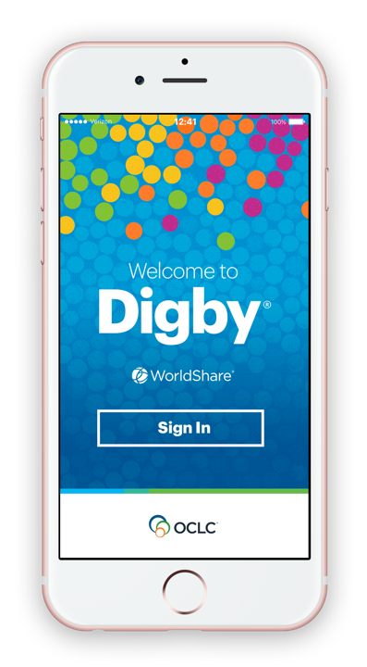

Confidential. Not for distribution.
Notes:
A key enhancement that we introduced in the last year was Digby, a mobile app.
The Digby app, which is available with a WMS subscription, has helped libraries' student workers, volunteers, and staff manage common library tasks like handling pull lists and reshelving more efficiently—saving time and reducing reliance on paper slips.

Slide 20
Self Service Account Creation
Problem
Need to allow patrons to create accounts for themselves

Slide 21
Self Service Account Creation
Problem
Need to allow patrons to create accounts for themselves
Solution
Use WorldShare Identity Management API to allow patrons to enter basic data and get a basic account

Slide 22
Submit a request to Tipasa/WorldShare ILL
Problem
Need to submit a request from a custom patron portal
Notes:
For example, the API could be used in building a custom patron to submit Tipasa requests.

Slide 23
Submit a request to Tipasa/WorldShare ILL
Problem
Need to submit a request from a custom patron portal
Solution
Use Tipasa API to create an request within Tipasa/WorldShare ILL

Slide 24
Tipasa API
Read / write access to Tipasa data:
  Requests
    Create, Get, Update (full, partial), List/Search
  Queues
    Get, List/Search
  Request Events
    Get, List/Search
Patron-facing tools

Slide 25
What’s next?
Tipasa API Advisory Group
URL Specifications
Item Request XML Schema
Sample Item Request XML Document
Error Messages
Persona Creation

Slide 26
How to Get Updates
Developers:
  OCLC Developer Network (news, documentation)
    https://www.oclc.org/developer/home.en.html
  GitHub (starter code, code libraries)
    https://github.com/oclc-developer-network
Librarians:
  Tipasa Community Center (discuss APIs, community applications in practice)
  ILLiad to Tipasa Community Center
    http://oc.lc/community
Notes:
We’ll be sharing more information about the Tipasa API on the OCLC Developer Network website, and posting starter code your developers can use in their own applications on our GitHub page. We also plan to promote discussions about how libraries are using the API and community-built applications via the Community Center.

Slide 27
Collaborate. Build. Share.
The Developer Network helps you learn, experiment, and collaborate to put OCLC Web services to work.
OCLC’s Developer Network
Explore and access all APIs, including WMS APIs, to enhance library workflows and services
Tools, documentation, and resources for all skill levels
Live support available via
email and phone
Notes:
The Developer Network is a global community of developers who innovate, collaborate and use APIs through the OCLC WorldShare Platform to enhance library workflows.

Slide 28
OCLC
Community Center
15,700+ members
5,000+ institutions
260 new postings a month
Join the community at oc.lc/community
Notes:
The OCLC Community Center is the place for making community connections, sharing best practices, staying up to date on product releases and contributing ideas.

Slide 29
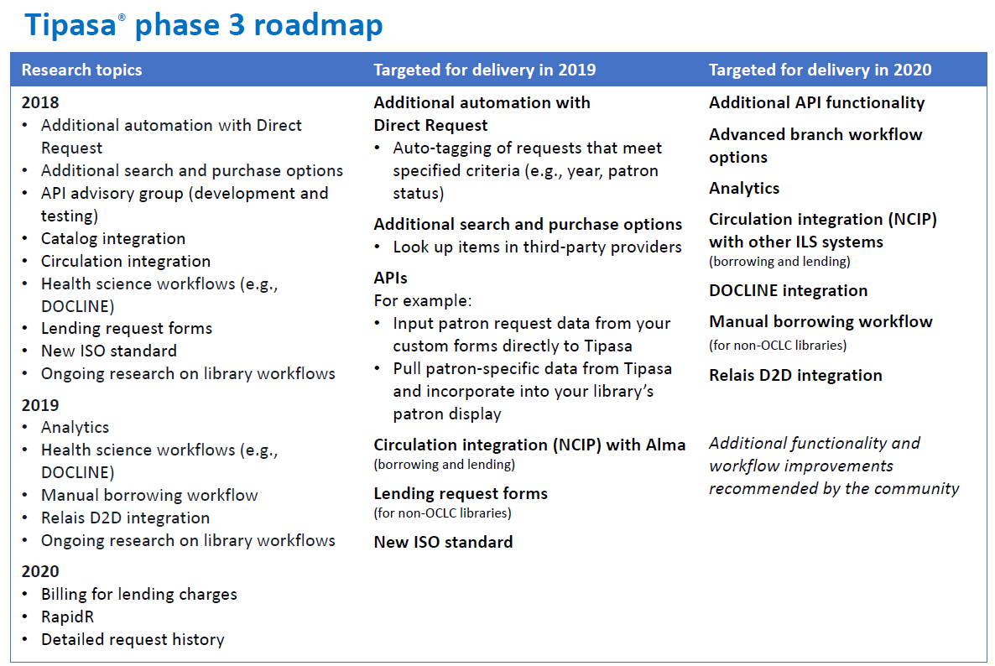
oc.lc/illiadtotipasa
Notes:
APIs are currently on the Tipasa phase 3 roadmap. Updates will be posted here when available.

Slide 30

Notes:
A Tipasa API update will be on the calendar.

Slide 31

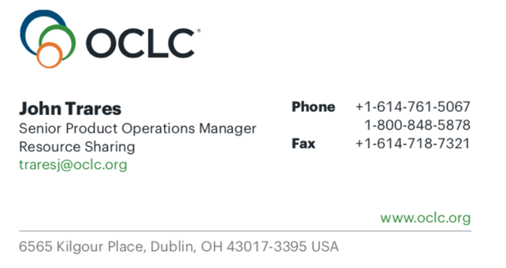
Questions?, Thoughts? Suggestions?
Notes:
Thank you for attending today’s presentation.

