Slide 2
Article Galaxy Scholar
Removing Barriers to Access.

Slide 3

2006: Reprints Desk founded, launch doc-del service for corporate libraries
2008: Earned #1 ranking in doc-del vendor scorecard
2011: First test at providing doc-del to academic libraries fails

Slide 4

2011-2012
Back to the drawing board
2013
Re-launched A-Z Academic DocDel Collection
2015-2019
ILLiad workflow integration with A-Z Collection
ACADEMIC VS COMMERCIAL DOCDEL COPYRIGHT ROYALTY COMPARISON
A-Z Academic
DocDel Collection
Reprints Desk’s
Commercial
Document Delivery
$23.50
$32.00

Slide 5
The Article Galaxy Scholar Collection
Articles from over 40,000 journals (we think that’s around 40 million articles)
NO embargoes
Chapters from nearly half a million books
Order with a DOI or complete citation and most of this content can be delivered via email in native PDF format within minutes.
Many titles are discounted below paywall prices

Slide 6

COLLECTION & PUBLISHERS
ARTICLE GALAXY SCHOLAR COLLECTION FEATURES:
Support & delivery for journal articles & book chapters in native
PDF format
including all major publishers & many niche titles too
chapters and papers from nearly half a million books in original PDF format
Average delivery time
via Article Galaxy’s
ultra-rapid delivery
engine
24/7
40,000+
½ million
<30 MINS
SOME OF OUR PUBLISHERS

Slide 7


Slide 8
how to access…
The Article Galaxy Scholar Collection
EBSCO Full Text Finder
Tipasa
Via ILL workflow tools like RapidILL, ILLIad, and IDS project
Via the Lean Library browser extension
Point your OpenURL link resolver to ReprintsDesk.com
…and coming soon via the Article Galaxy Scholar platform

Slide 9

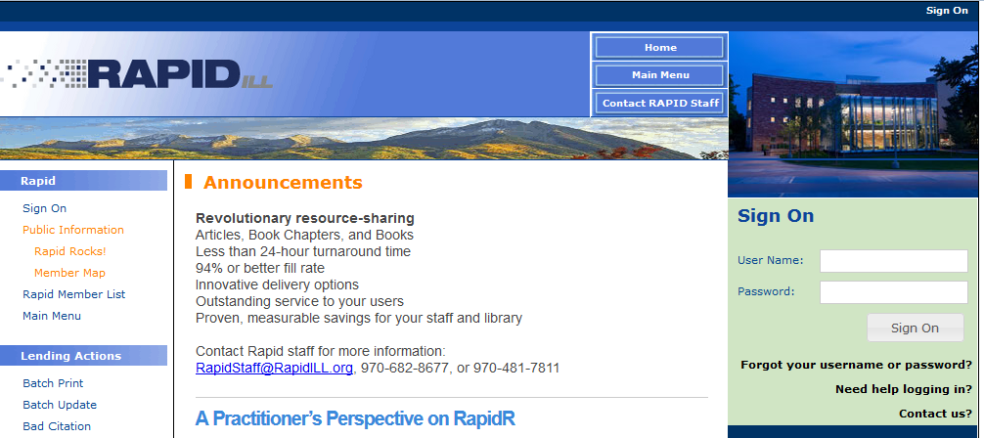
Rapid ILL – Integration

Slide 10
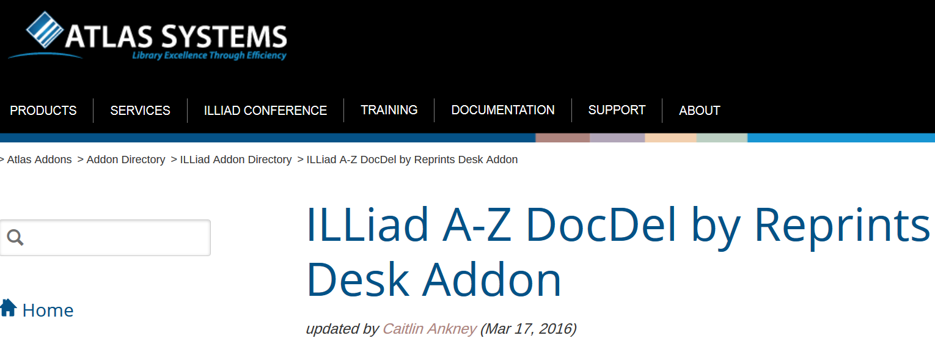
ILLiad Addon w/ Odyssey

Slide 11

Article Gateway Integration
Rule of 5 routing – Best vendor based on pricing
Automated routing rules can be put in place
      Specific Titles to be automatically ordered
      Specific Price thresholds to be automatically ordered

Slide 12
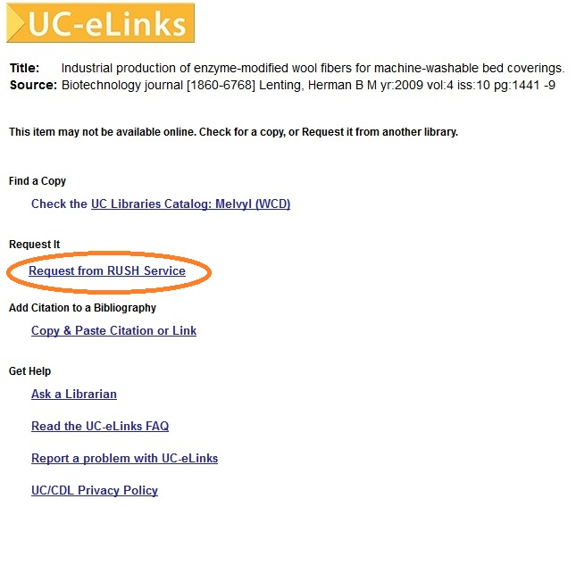
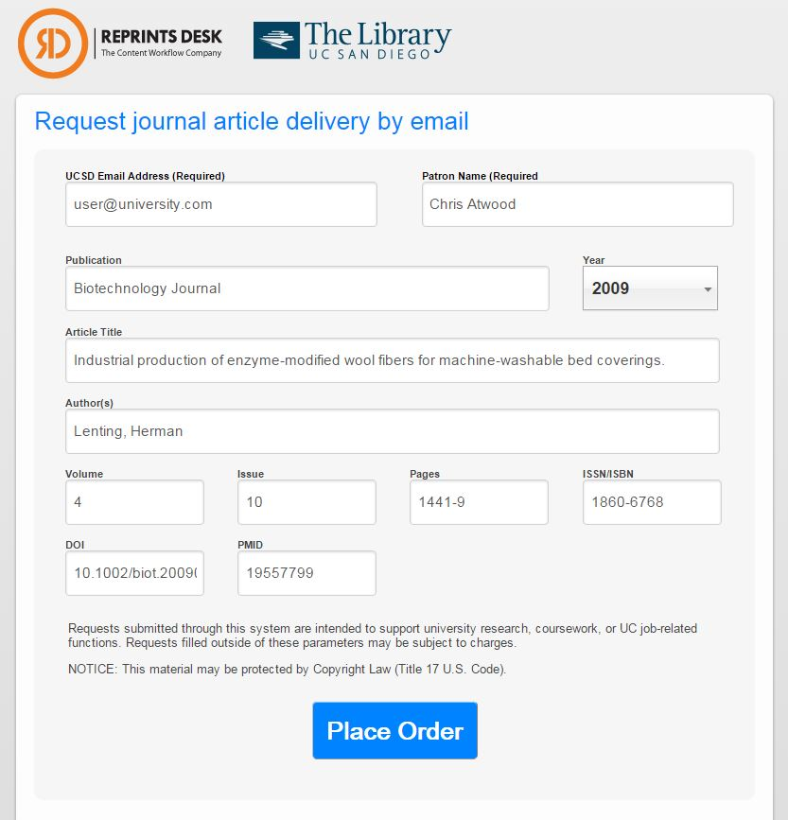
Unmediated Ordering

Slide 13
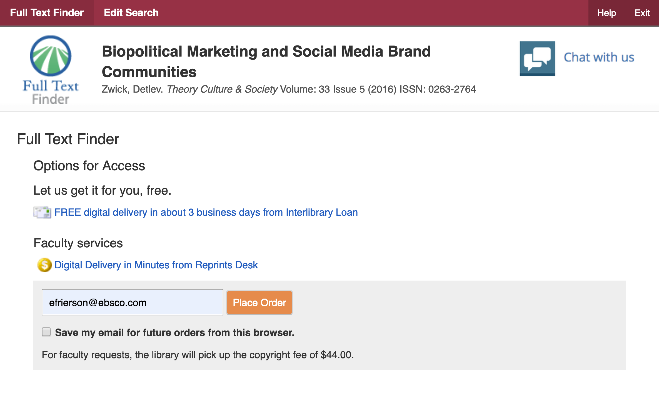
Via EBSCO

Slide 14
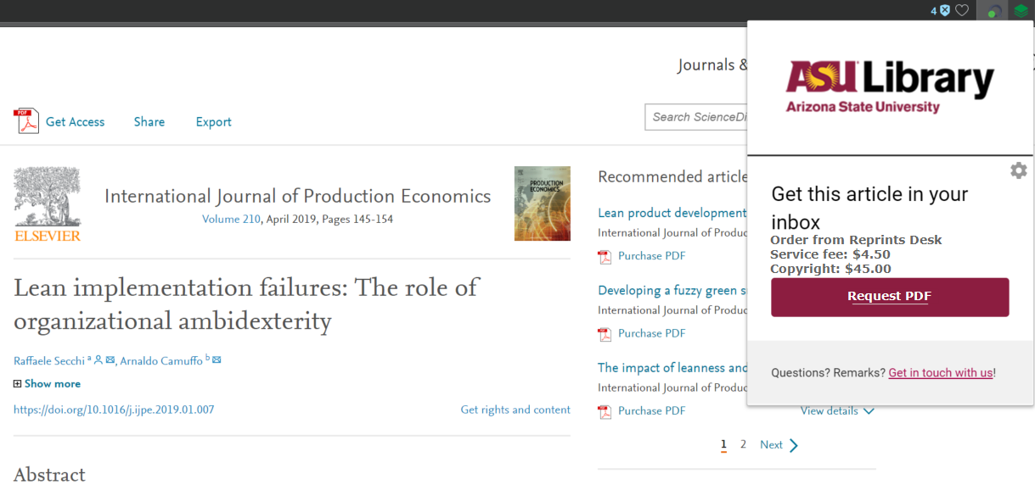
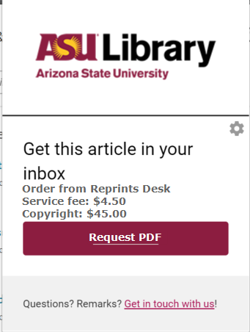
Lean Library
A browser plug-in which can be rolled out to specific user groups and can recommend access options for those users

Slide 15
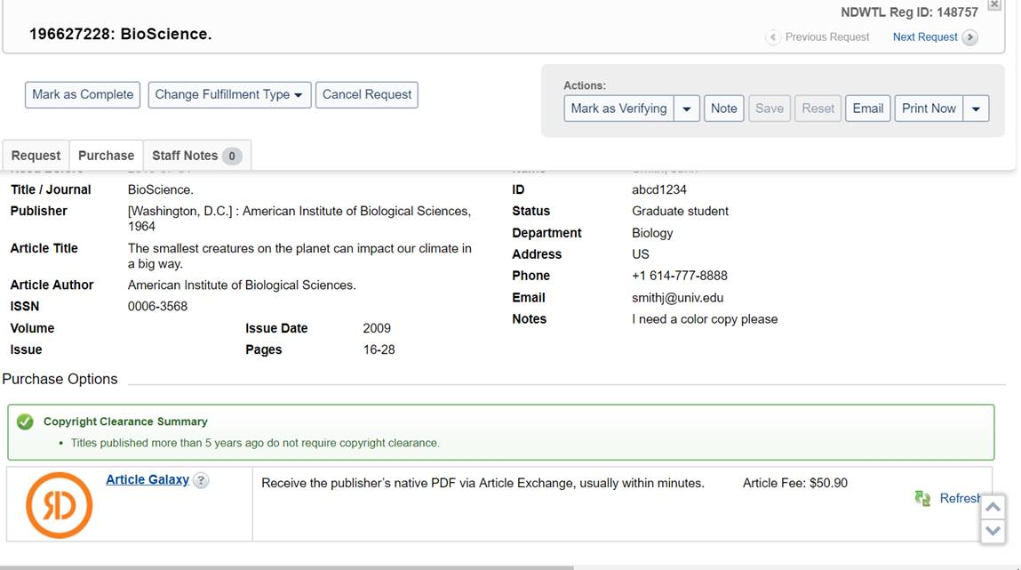
TIPASA

Slide 16
Beyond the AGS collection… add-on service for articles and book chapters scanned from print
Access to the collections of:
  British Library
  National Library of Medicine
  Technische Informations Bibliothek
  Zentral Bibliothek der Medizin
  ….and many other national libraries
slower turnaround

Slide 17

Coming Soon!
Article Galaxy Scholar Platform
Automating Mediation for Affordable High Touch Service
Notes:
We are pleased to announce the upcoming release of Article Galaxy Scholar. Article Galaxy Scholar is a one-of-a-kind workflow solution designed to improve end-user experience and content access while reducing library staff time. It accomplishes this by automating the mediation of article fulfillment for content beyond your subscriptions. It’s a solution that connects end-users to Open Access articles, purchase options, or interlibrary loan to fulfill their full-text needs.

Slide 18
A workflow solution with these goals:
Give users pathways to the content – no dead ends!
  Fully check Open Access before anything else
  Buy articles when you want to
  Offer ILL when you want to
Improve the user experience – no matter what the outcome
Reduce staff time by automating basic mediation functions
Set a budget and stay within it
Notes:
The service has a number of goals – first and foremost to give users pathways to the content. No more dead-ends! It accomplishes this by ensuring that Open Access is always checked on every article request. Then, the library can authorize single article purchases from specific titles, for specific users, and within specific limits (more on these details in a moment). All other article requests will be referred to interlibrary loan. So in additional to improving the user experience, the service will save you staff time by automating basic mediation functions before requests even reach your ILL staff. And the various threshold and limit features will give you the ability to stay within your budget.

Slide 19



Automated mediation with Article Galaxy Scholar
Link Resolver
AGS
Open Access?
Article Purchase?
Interlibrary Loan?
Notes:
CHANGE THIS SLIDE TO BE OA first, then a decision between PURCHASE or ILL
The Article Galaxy Scholar platform brings together an efficient, user-friendly Open Access discovery integration with a collection of over 40,000 journals, just upstream of ILL. The goal is to expand your library’s search results. Based upon your custom settings, Article Galaxy Scholar makes it easy for your staff to manage on-demand access around the clock for selected patrons or to specific journals -- while controlling spend and reducing costly mediation time.

Slide 20

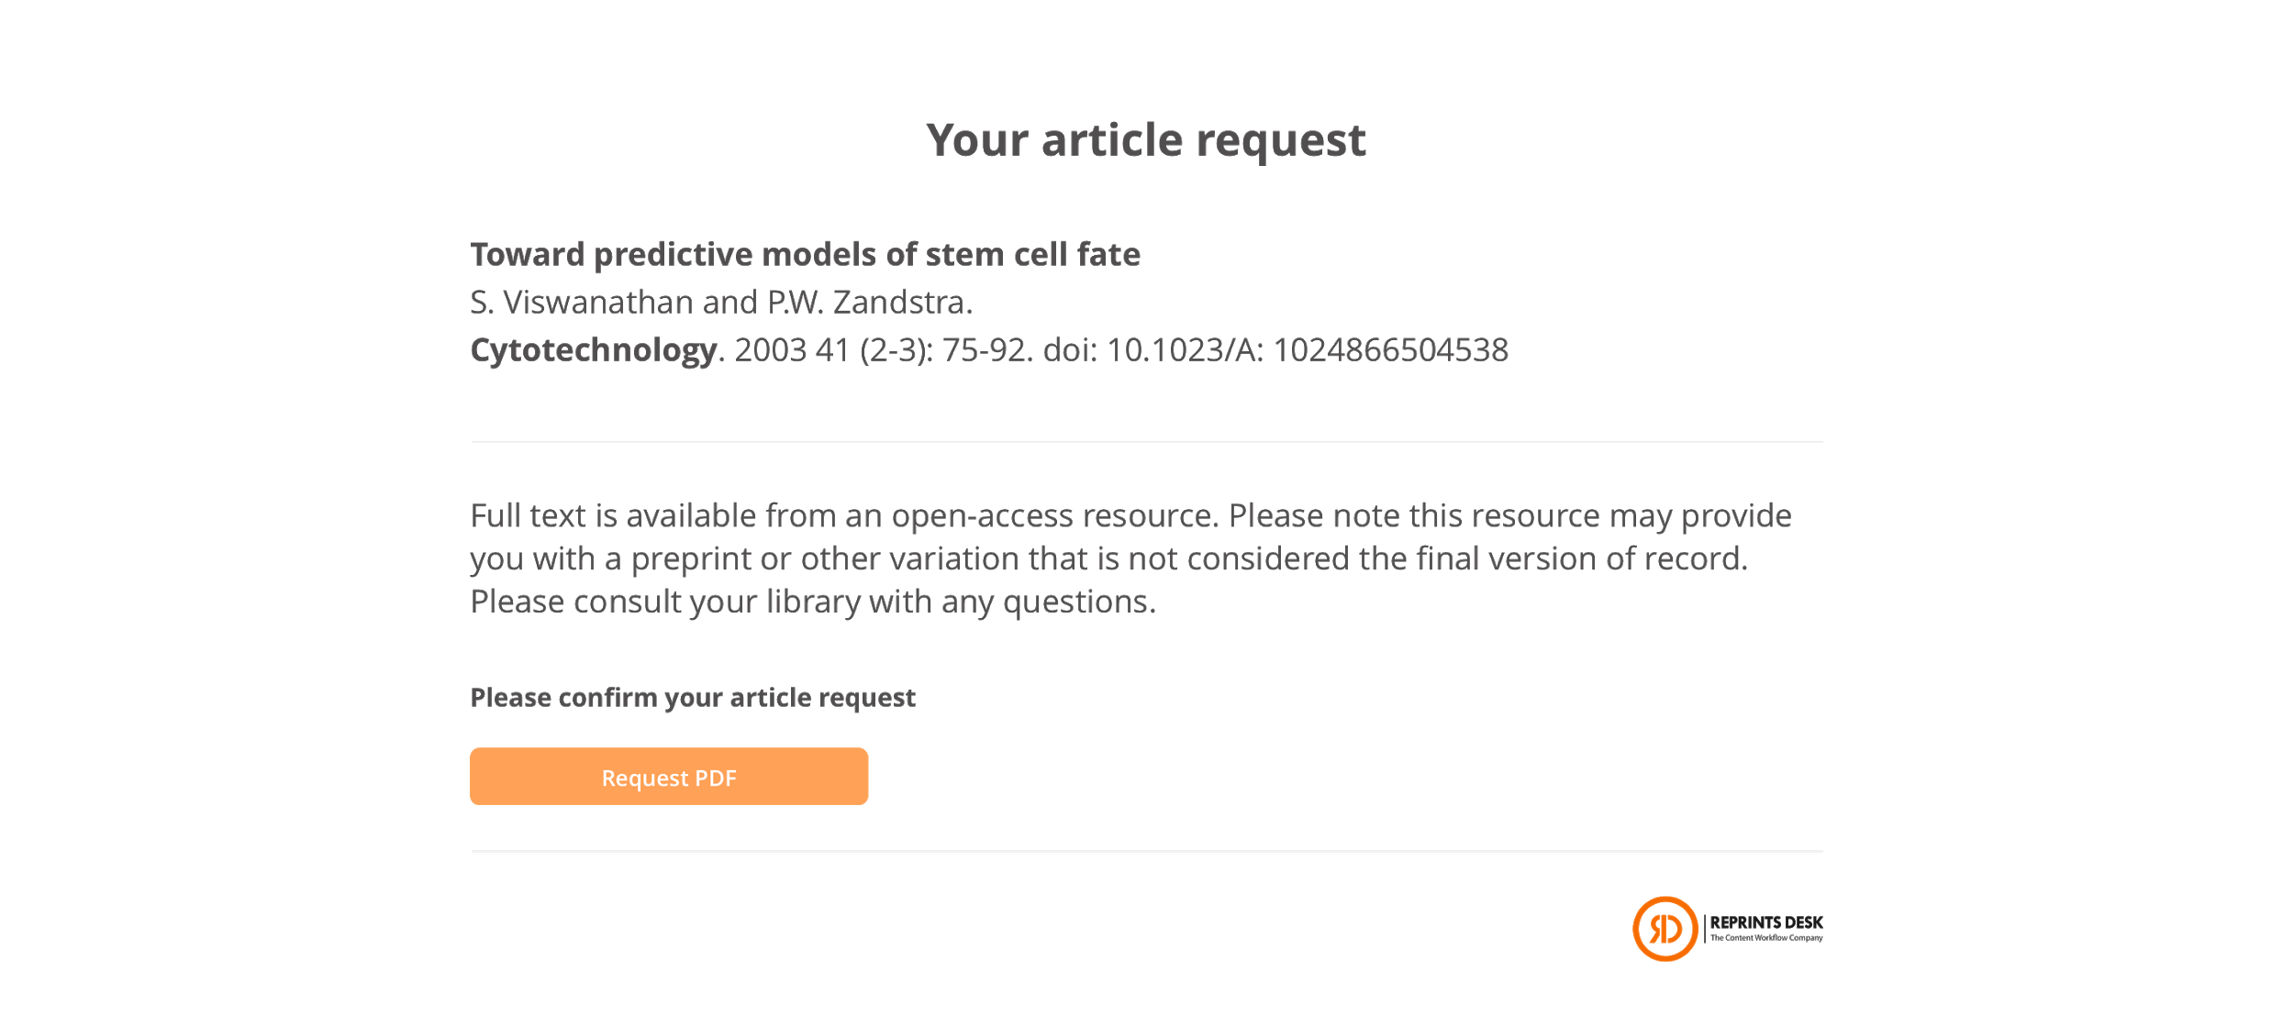
Your Library Logo
Notes:
NO DEAD ENDS
Imagine a student entering a search in your library discovery layer. If they encounter an article not currently in your holdings, Article Galaxy Scholar can help facilitate this just-in-time demand.
Instead of a paywall for those articles outside your collection, users would see one of three fulfillment options. (*animate splash page*) First, the OA filters would kick in, and surface any freely available or open-licensed versions of the article your user is seeking.

Slide 21
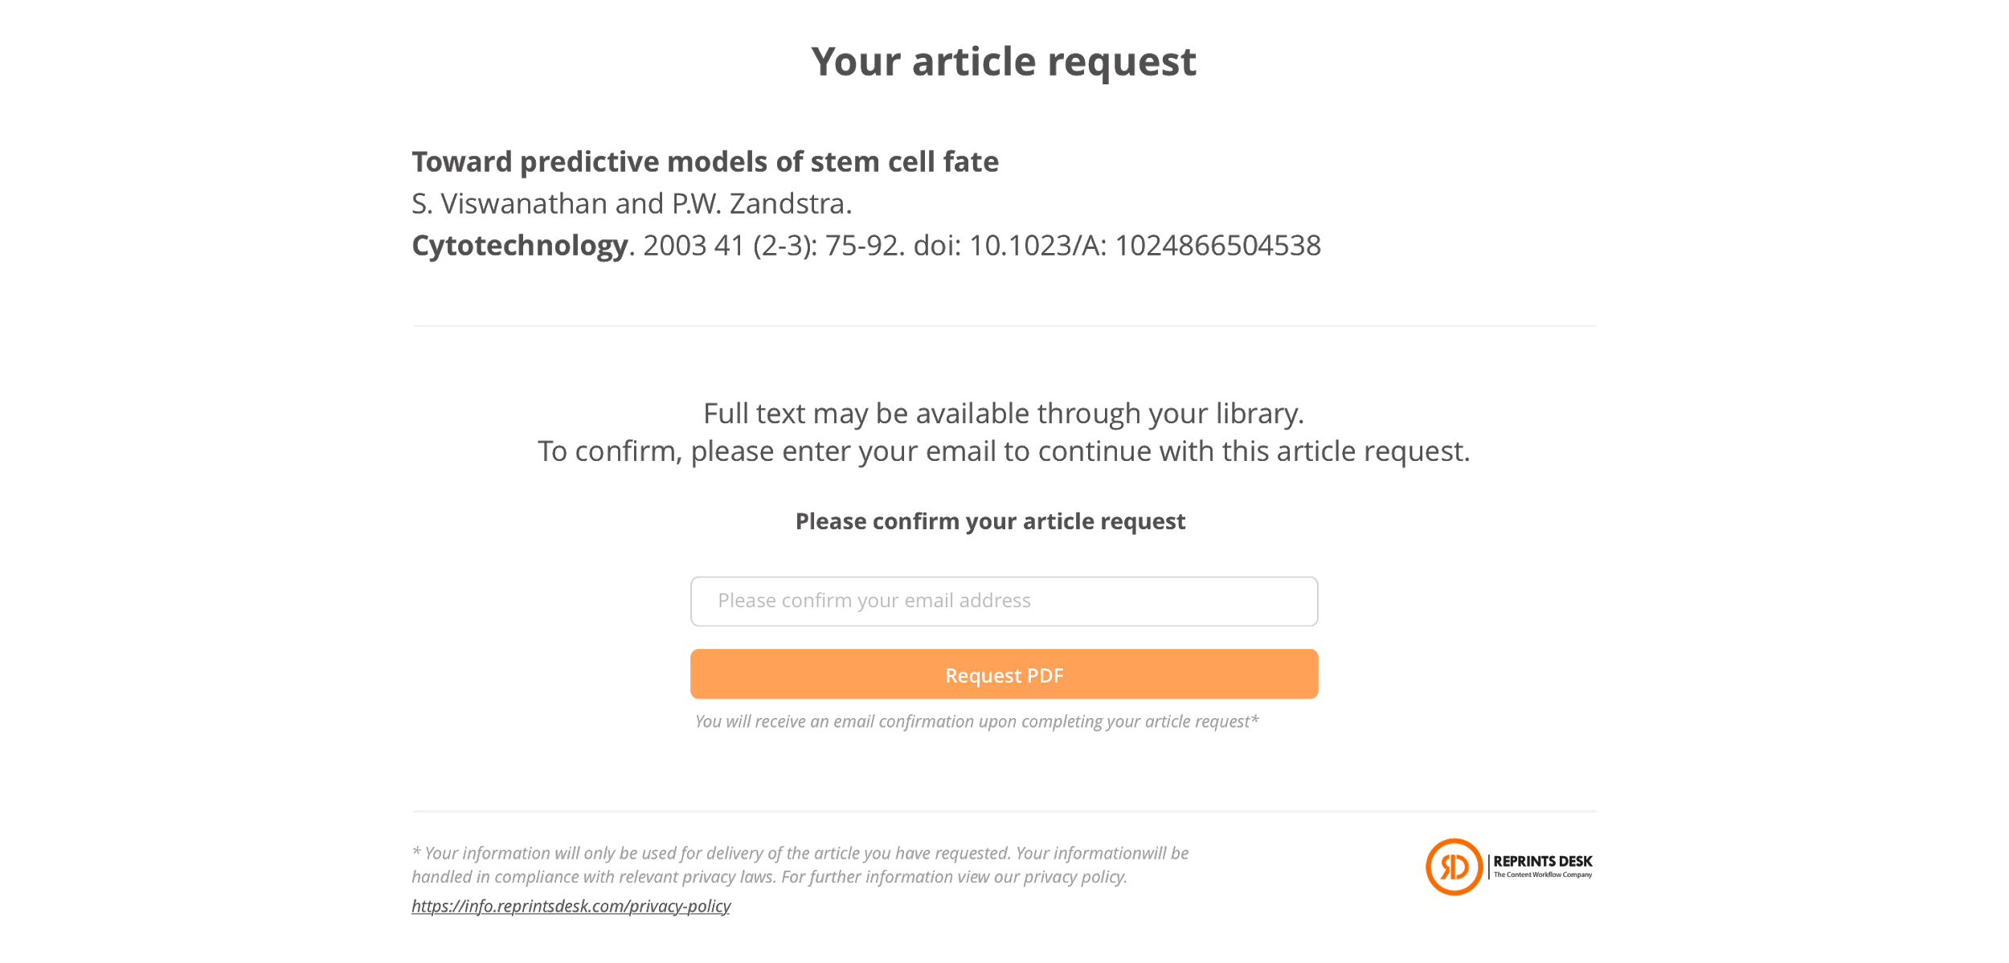
Your Library Logo
Notes:
If an Open Access version of the requested article is not available, you may choose to direct preferred users to a purchase option. Based on your custom configurations, we will can deliver articles within minutes to approved users, select journals or publishers, and within your budget range.

Slide 22
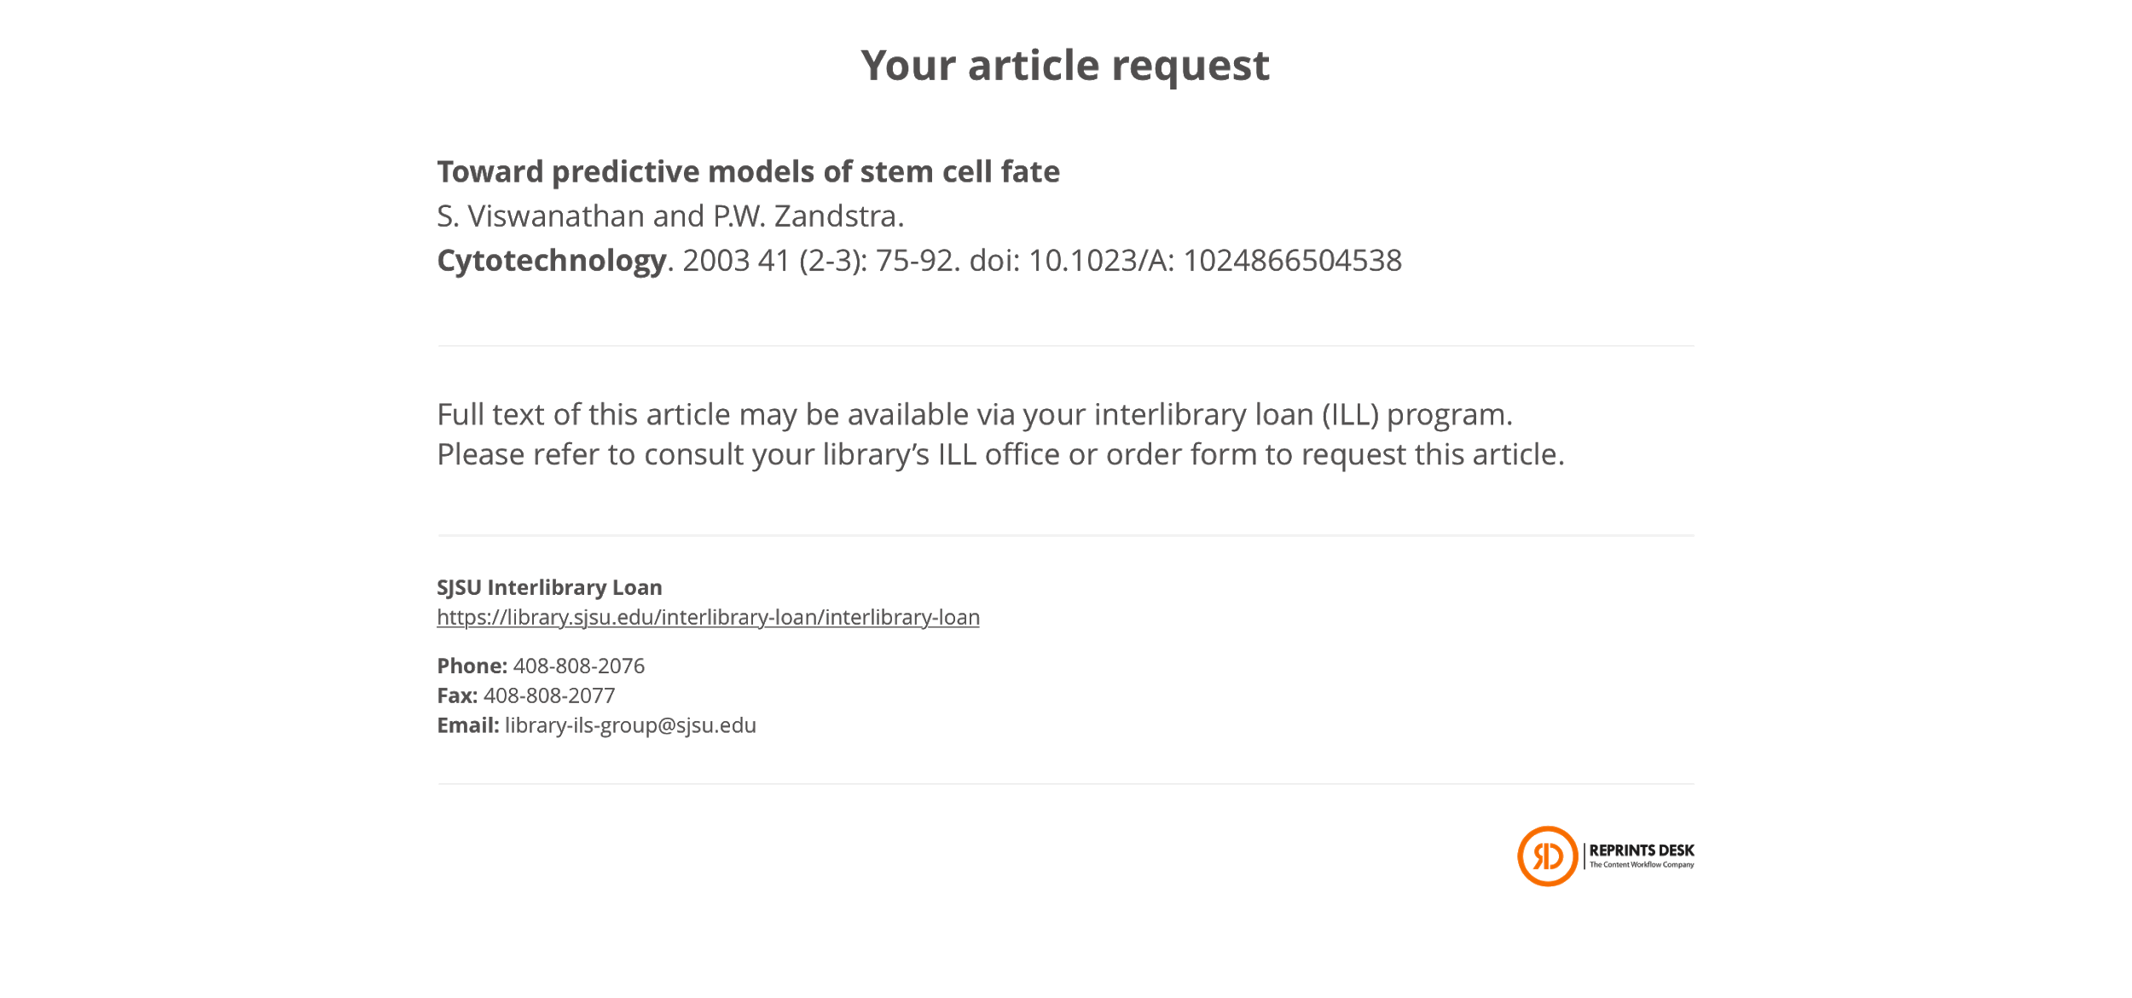
Your Library Logo
Notes:
The third self-service option refers users to the interlibrary loan office. All 3 automated fulfillment options include your library branding and keep users within the context of their information search.

Slide 23

Cascading fulfillment options, upstream of ILL
AGS verifies IP
Article requested
Link Resolver
Open Access version?
No -- what about a
Purchase option?
OA = Yes!
Check user profile & library settings?
No -- check with Interlibrary Loan?
Purchase = Yes!
Notes:
The Article Galaxy Scholar platform is easy to set up and integrate with your existing library systems. The custom configurations give you control to manage costs -- by limiting purchases to select publishers, journals, or to preferred users.
Working in concert with your link resolver and library discovery service, Article Galaxy Scholar can extend your holdings at the article level without duplicating expense or increasing demand on your interlibrary loan resources.

Slide 24
Article Galaxy Scholar Platform Features
Purchasing Control – Easy to set-up mediation parameters including purchase by publisher, journal, cost, user, CONTU
Analytics – Get insights with comprehensive usage and purchase reports, invoices, and alerts
Open Access – Includes robust OA filtering and integration
Outstanding Customer Support – Includes Award-winning Article Galaxy service powered by Reprints Desk
Notes:
All these precise custom settings make it easy for your staff to manage on-demand access around the clock while carefully managing spend and library resources. Analytics provide you with the data necessary to balance budgets and invoices. Our robust Open Access features extend your library’s search results, surfacing a greater range of content options to patrons. And our outstanding customer support stands behind the Article Galaxy Scholar platform, as you have come to expect with all Reprints Desk products. Thank you for your interest!

Slide 25







SOME OF OUR HAPPY CUSTOMERS
25

Slide 26
THANK YOU!
Tony Landolt (tlandolt@reprintsdesk.com) 510-303-3231
Notes:
This is all for our presentation today
Again we would like to thank each and every one of you for your time today
We appreciate your interest and look forward to getting to know you and your companies better
Thank you!

