Slide 2
Project ReShare Empowering Libraries through Sharing, Innovation, and Trust
Jill Morris, PALCI Executive Director
Chair, Project ReShare Steering Committee
IDS Project Conference 2019
“All Systems Go: Improving Systems & Workflows”
Utica, NY

Slide 4
Today’s Themes
Cultivate Agency
Innovate: Collaborate to find solutions to the problems we see
Trust: Foundational to it all

Slide 5
About Me

Slide 6
About PALCI
501(c)(3) Nonprofit
70 Academic & Research Libraries
Foundations in Resource Sharing
Home to:
E-ZBorrow Service
Prospective Collection Building
Affordable Learning PA
PA Digital – PA Hub of the DPLA
CC-PLUS Consortial Usage Statistics Tool
Project ReShare

Slide 7
About
Resource Sharing Reimagined
collaborative - innovative - creative - resourceful
Notes:
For the past year a cohort of academic, consortial, and commercial partners have engaged with Project ReShare, a groundbreaking effort to construct a new resource sharing platform for and by the library community. The platform is Open Source, and it is the outcome of a strategic collaboration between a host of industry partners. Initially focused on patron-initiated consortial borrowing, the ReShare partnership intends to develop the platform into all aspects of library resource sharing, propelling the community toward a larger vision of increasing opportunities for collaboration around shared collections. ReShare software development is well underway after an extensive user experience design process, with a Minimum Viable Product due out later this year.

Slide 8
Why ? Why Now?

Slide 9
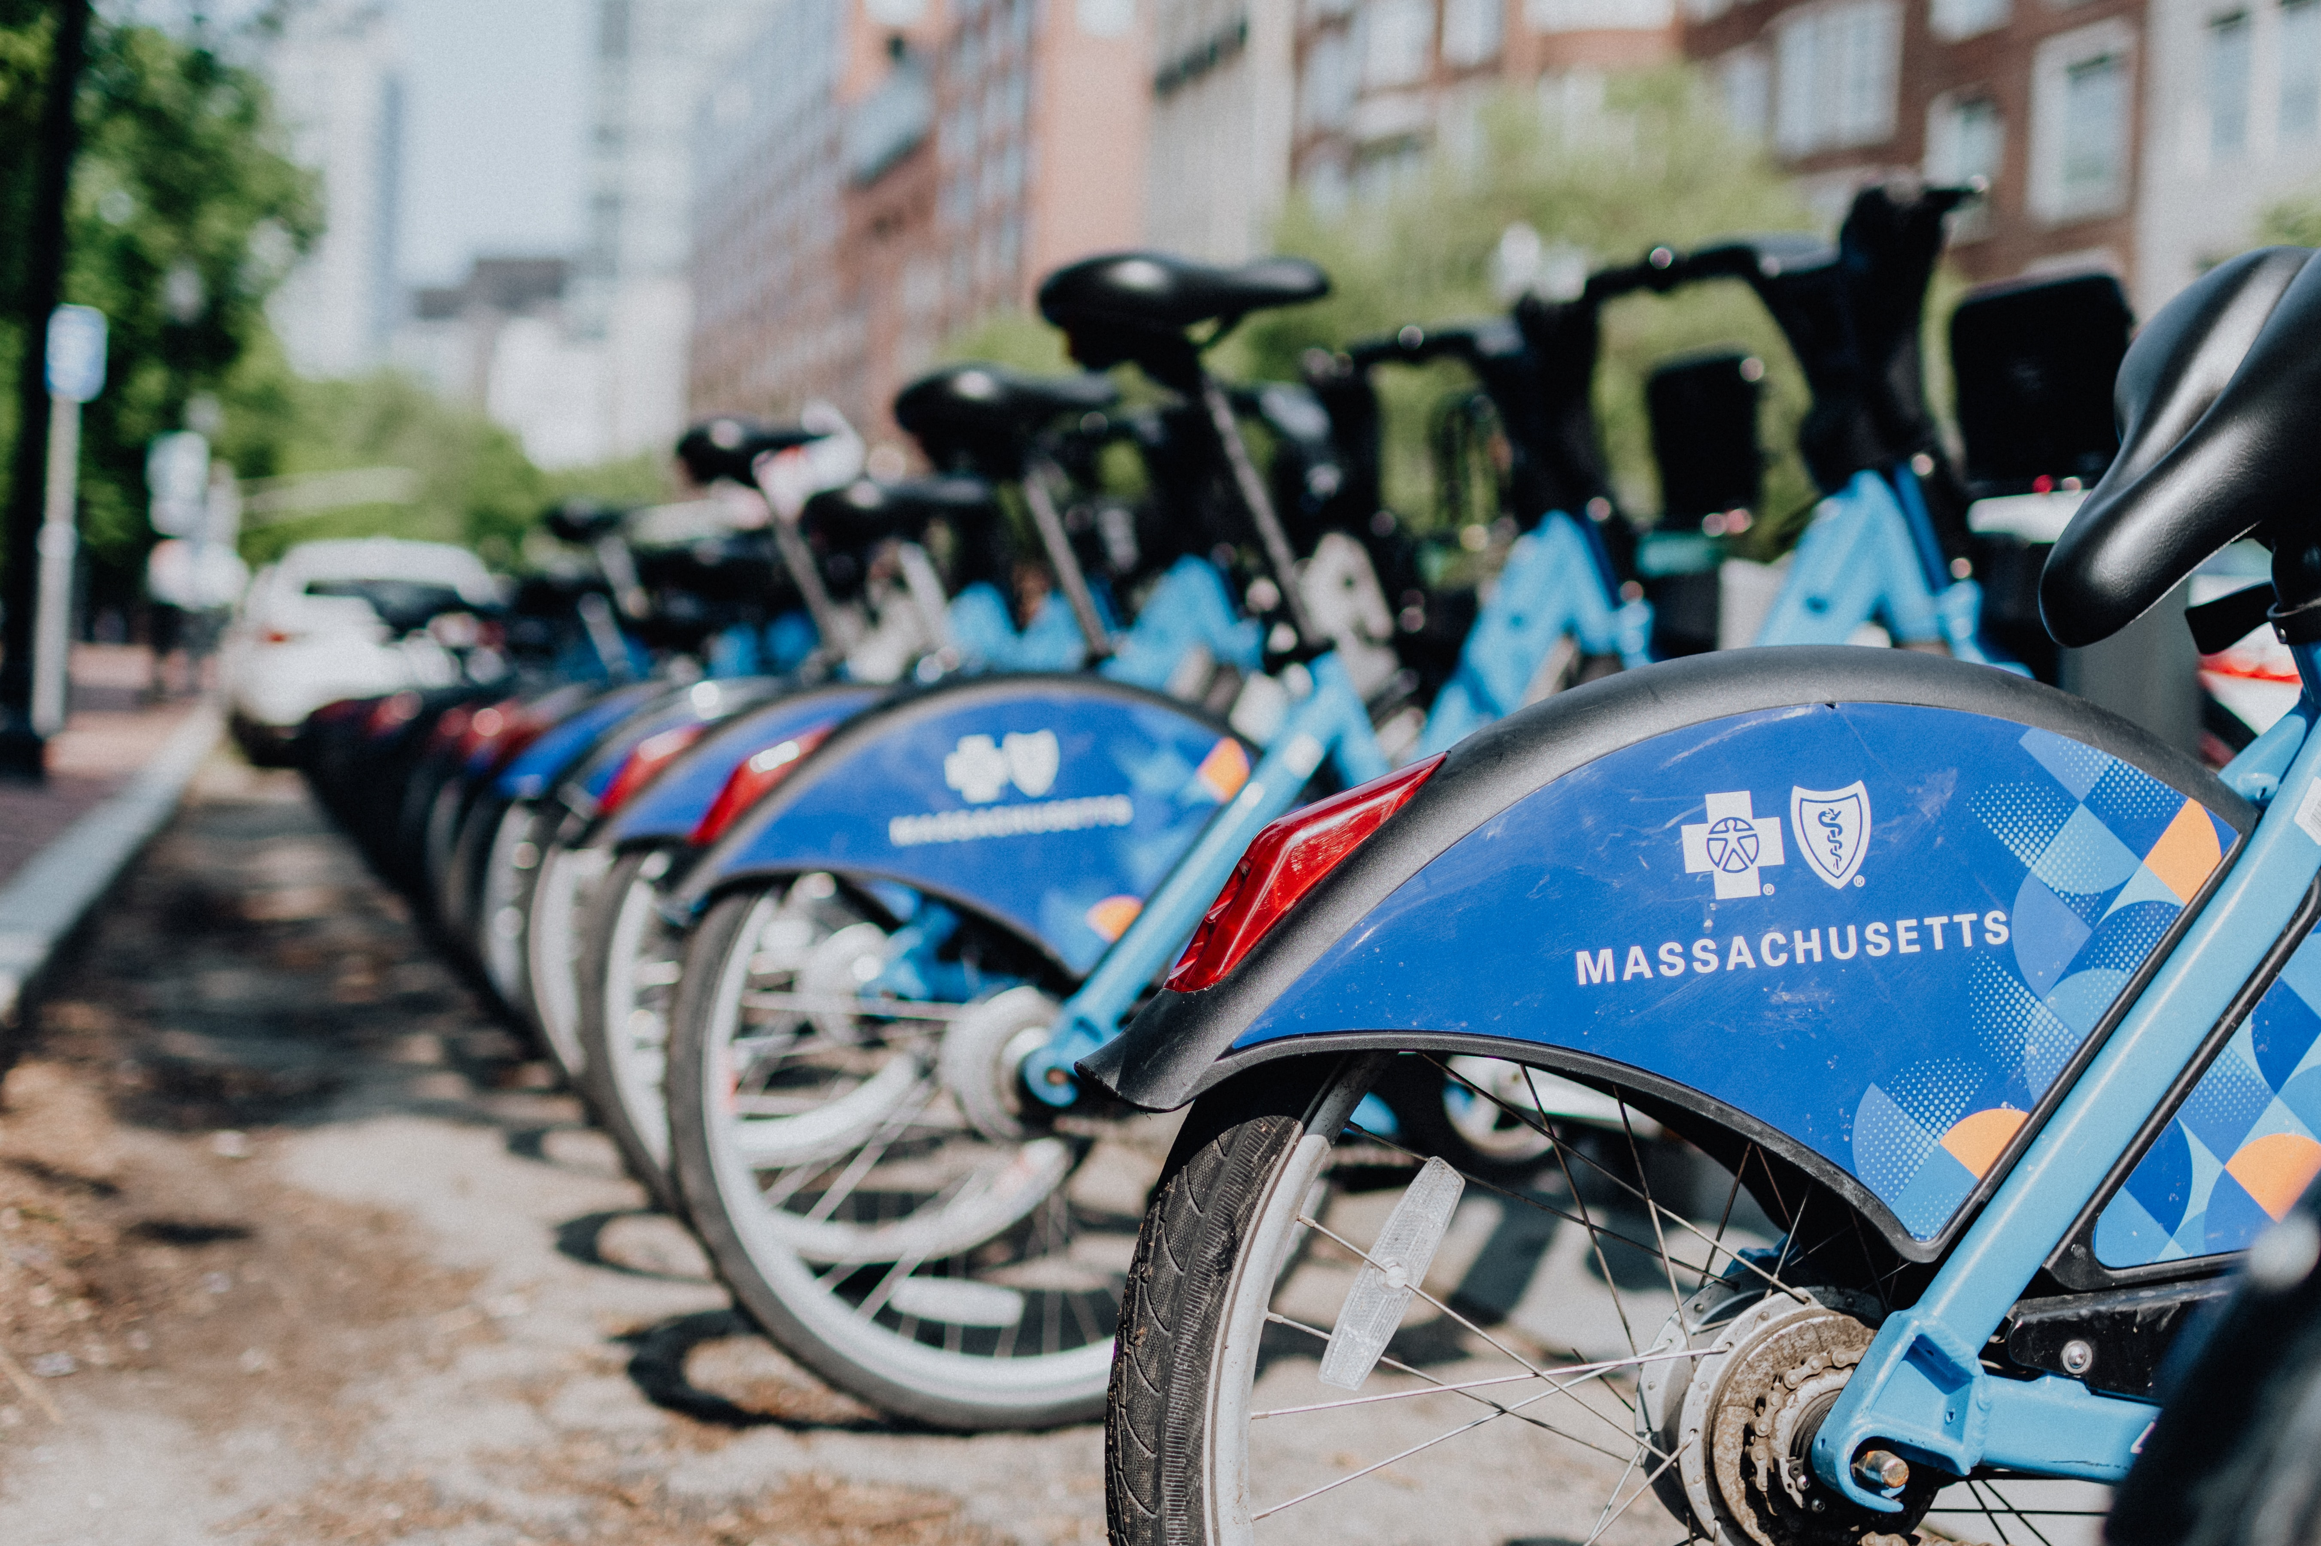
Looking around...
The world is transitioning to a new Sharing Economy – a model based on sharing or renting assets owned by individuals that are not currently being used, unlocking value in expensive assets.
Large-scale sharing is enabled by trust and technology.

Slide 10
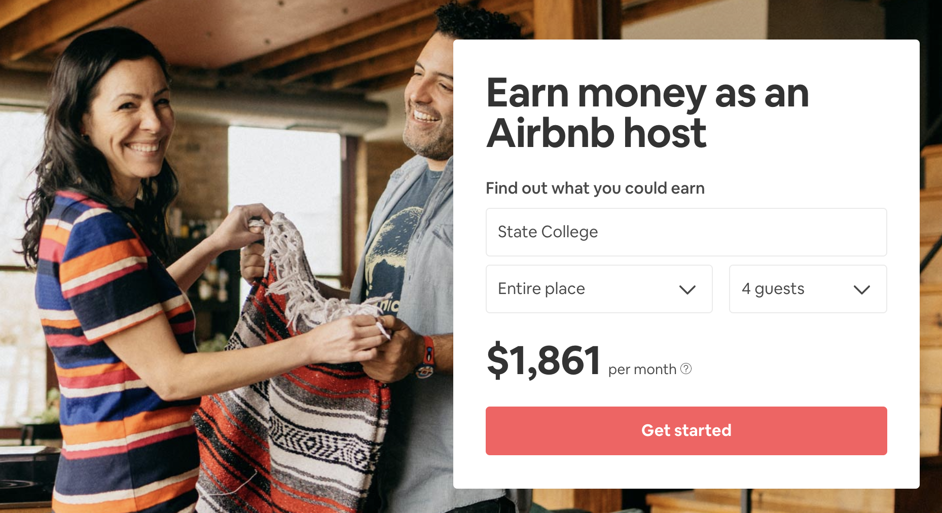
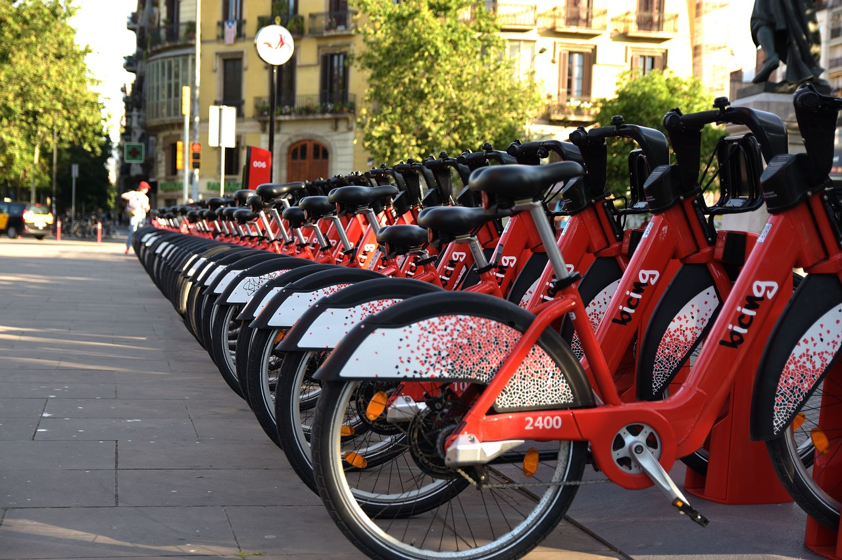
Examples

Slide 11
Libraries’ Under Pressure
Libraries have always shared, but we’ve also traditionally owned.
Traditionally, our value has resided in the collections we could provide.
Increase Pressure
Ownership → Access
Notes:
Economic pressures, changing business models, changing technologies are pushing libraries to evolve from a primarily ownership-based economy to a sharing economy at an even greater rate than we’ve experienced in the past, and we’re expected to do it more efficiently.
From The Membership Economy: “Ownership and access are at two ends of a continuum, and right now the pendulum is swinging away from owning – as individuals grow frustrated with the burdens of owning, caring for and storing too miuch stuff, they are looking for ways to minimize that stress.”
Prioritizing library space for patrons
Reduced shelf space for books
Tight materials budgets
The “collective collection”
Legacy systems and workflows
Shared print initiatives / Print retention initiatives
Increased reliance on sharing for print / returnable items

Slide 12
Notes:
Technology Changes…
Shifting expectations
Focusing on user experience
Unlocking needs and connecting people

Slide 13
Our Patrons’ Challenges
A fractured discovery to delivery process based on backend library systems rather than the user’s wants / needs
Opaque availability / loanability, turn-around time, loan period information
Multiple user accounts across multiple systems
Systems based on managing item-by-item requesting and routing not the user’s project
Poor communications & inconsistent arbitrary policies

Slide 14
Big 10 Academic Alliance
A Vision for the Next Generation Resource Delivery
“...the discovery to delivery process is fragmented with too many services and options presented to patrons.”
“Access and delivery options should be communicated in terms that matter to the patron…”
https://www.btaa.org/library/discover-to-deliver/reports

Slide 15
Our Staff Challenges
Fractured systems and system-imposed legacy workflows
Ineffective cross-consortial sharing
Lack of interoperability and multiple “flavors” of standards
Market consolidation -- Less competition, fewer truly vendor neutral solutions, lack of agency, lack of choice, lack of development
Software system silos

Slide 16
Notes:
Challenges add up to needed change, but our options are limited and our current solutions are broken.

Slide 18
is a Community producing a Community-owned solution
Steering Committee
=
OSS
Product Management Team
Subject Matter Experts
Notes:
Commercial and Nonprofit organizations, Libraries, Consortia, Software developers sharing a vision, coming to the table as experts
Innovating with this unique collaboration: Large, small libraries, large and small consortia, Public and academic libraries, Across ILS and discovery systems of all types

Slide 19
is Cultivating Agency
Wikipedia Definition:
Agency is the capacity of individuals to act independently and to make their own free choices.
Synonyms:
Power, Authority, Weight, Influence, Direction, Clout, Leadership, Significance, Sway, Effect

Slide 20
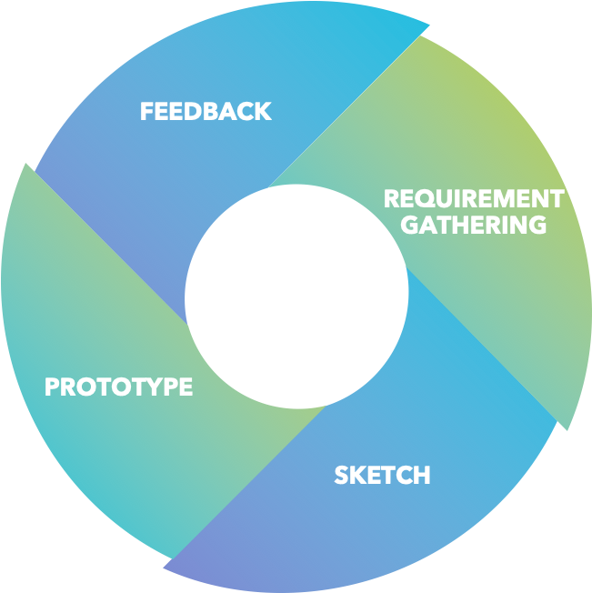
is a Process
Site visit testing
SME meetings
Definition of happy (no errors)
and unhappy path (errors)
UI and UX work
Notes:
Inclusive
Transparent
User-centered

Slide 21
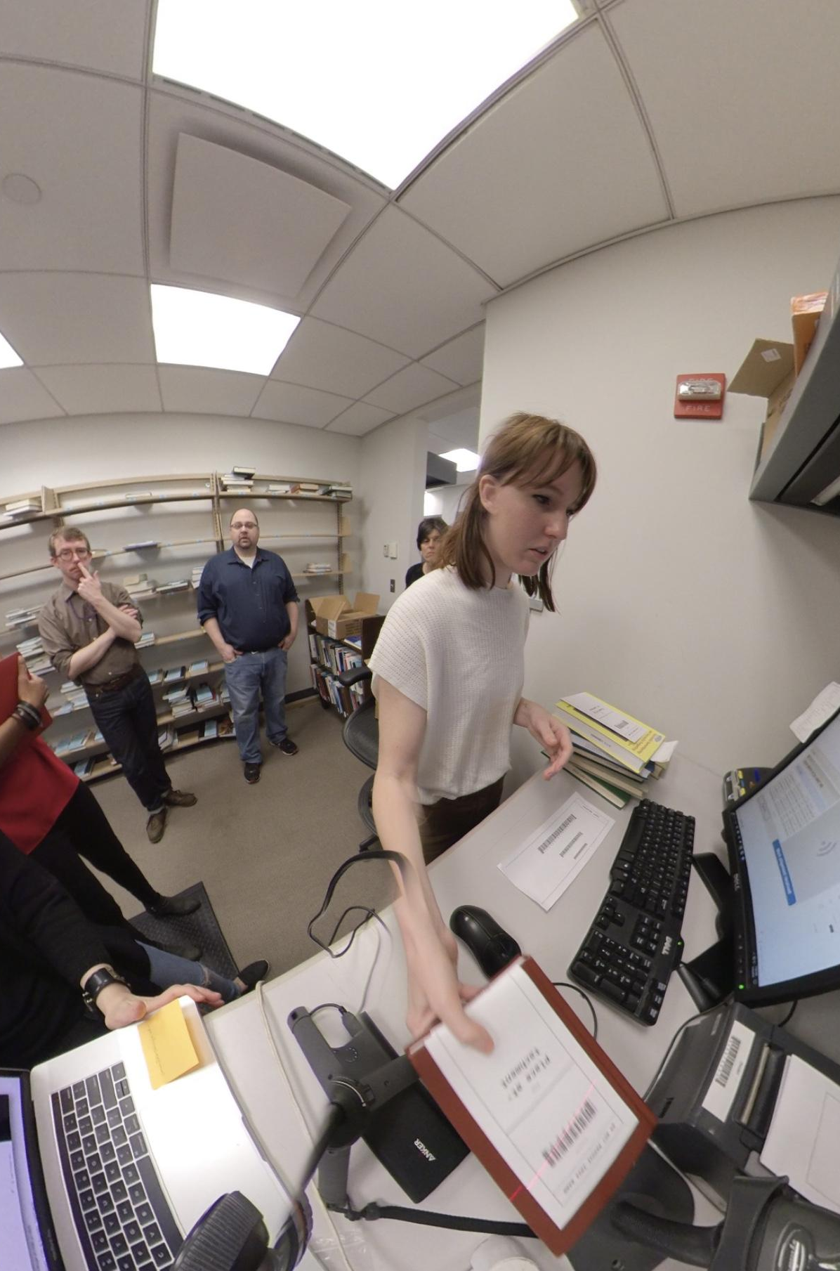
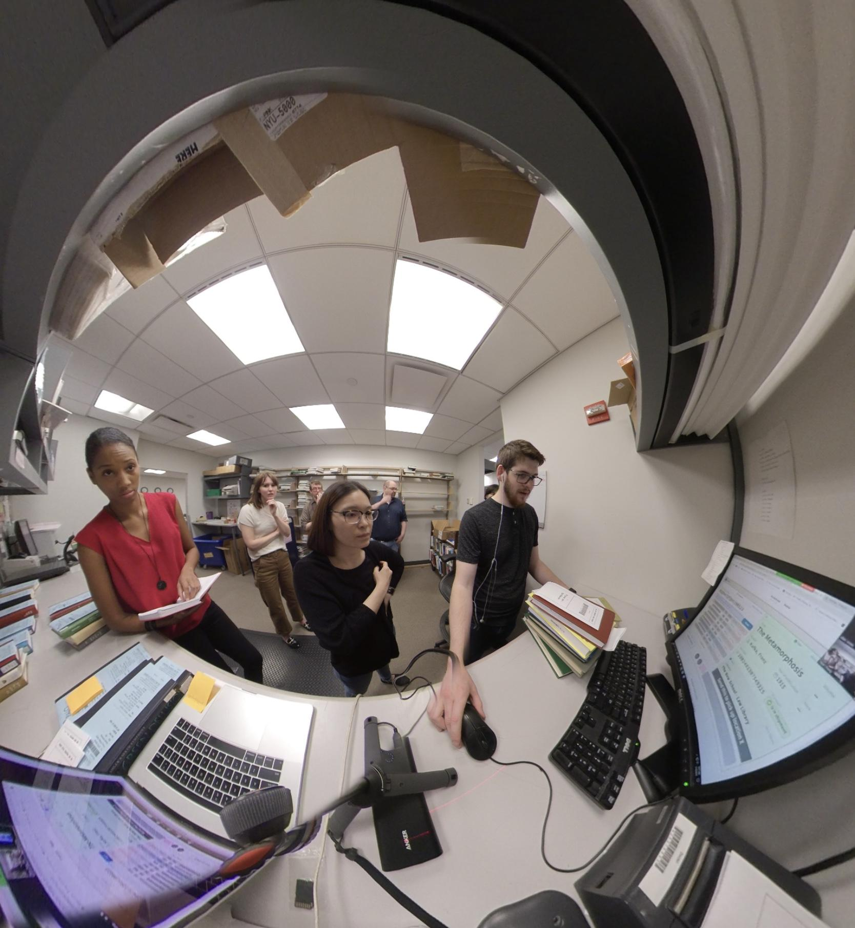
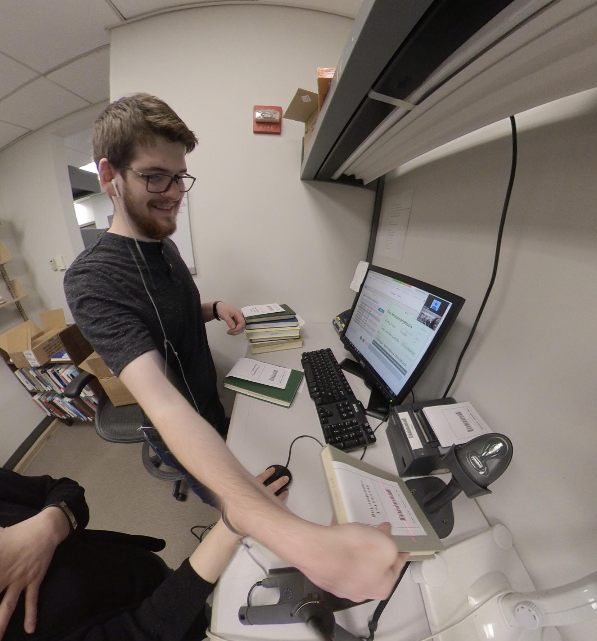
Site Visits - NYU
Notes:
LESSONS learned – Student workers:
Staff spend most time in the request/supply app troubleshooting, while normal material processing operations happen in check-in/checkout
Some type of escalation/routing action is required for error processing (route to status) of different kinds that go to different staff to resolve (sometimes bibliographic, sometimes patron privilege, etc.)
Books missing or additional items from shipment require some type of in-app messaging to supplier
Conversations of lending and supplier libraries tend to happen in private email instead of within transaction
LESSONS Learned -- Library staff
Staff spend most time in the request/supply app troubleshooting, while normal material processing operations happen in check-in/checkout
Some type of escalation/routing action is required for error processing (route to status) of different kinds that go to different staff to resolve (sometimes bibliographic, sometimes patron privilege, etc.)
Books missing or additional items from shipment require some type of in-app messaging to supplier
Conversations of lending and supplier libraries tend to happen in private email instead of within transaction

Slide 22
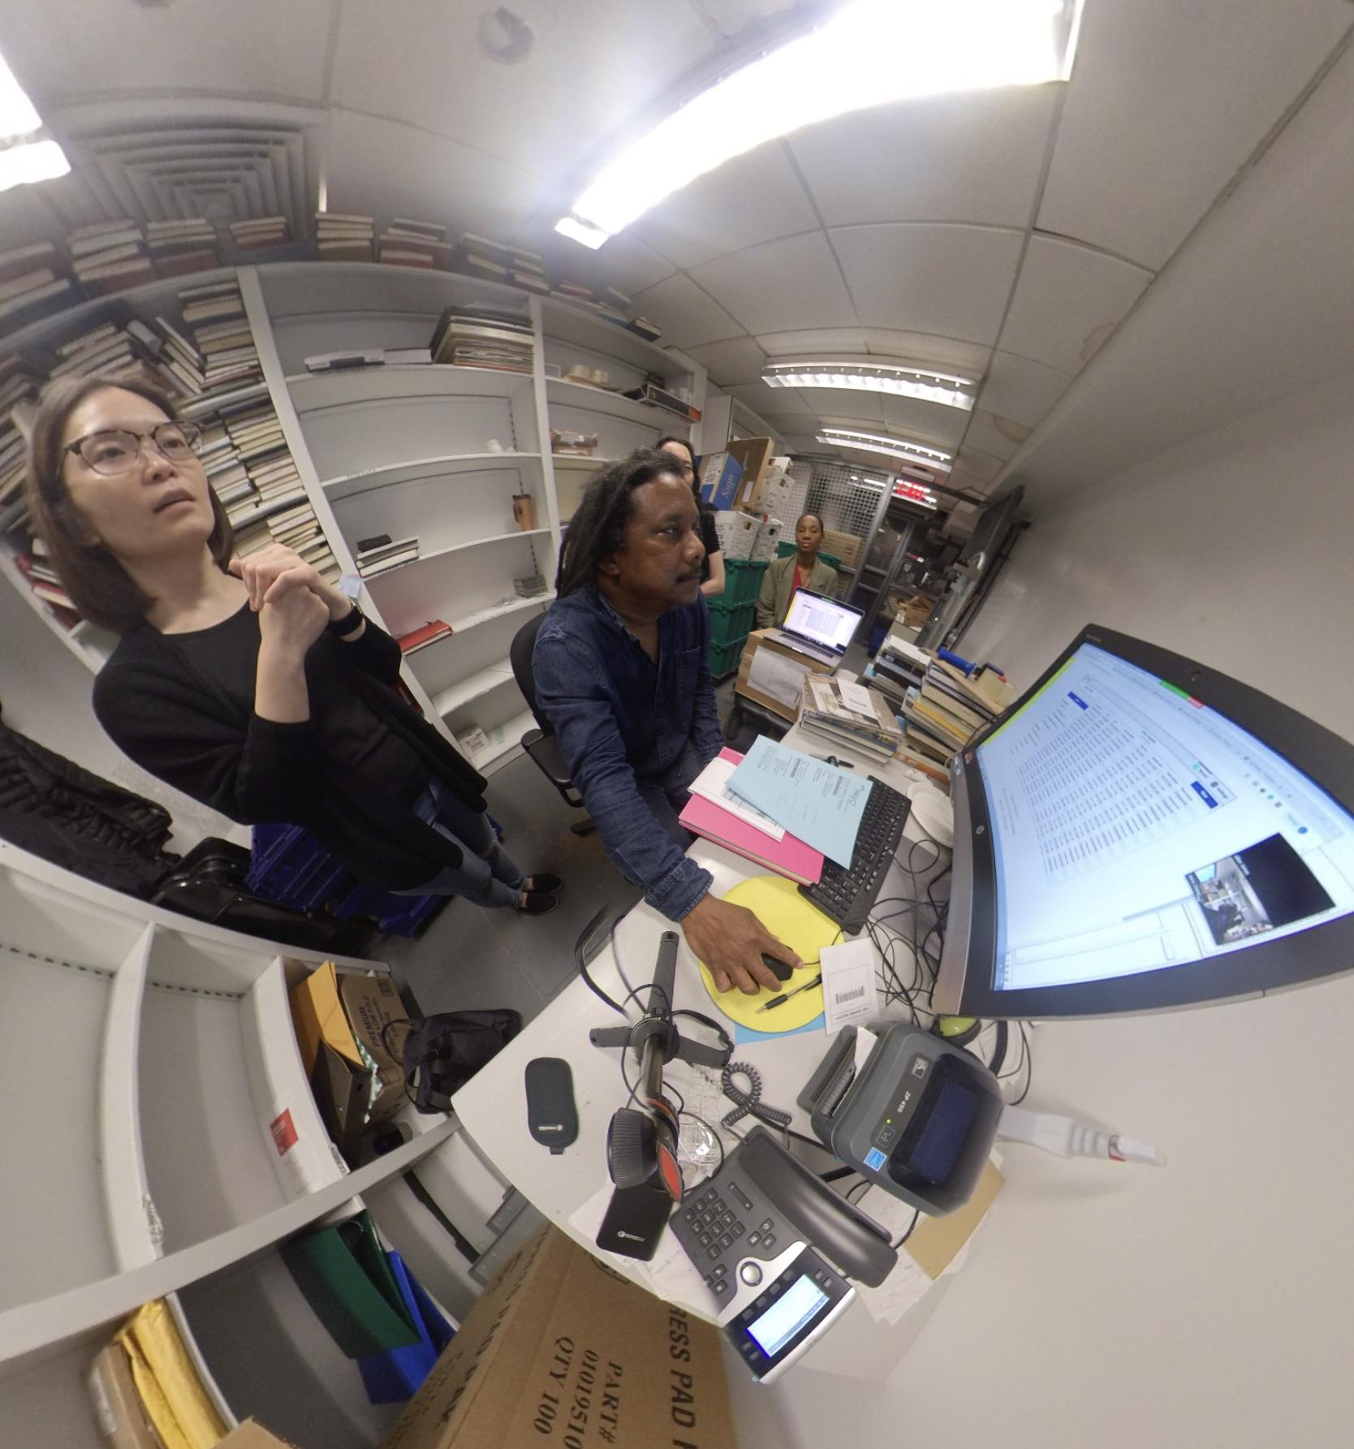
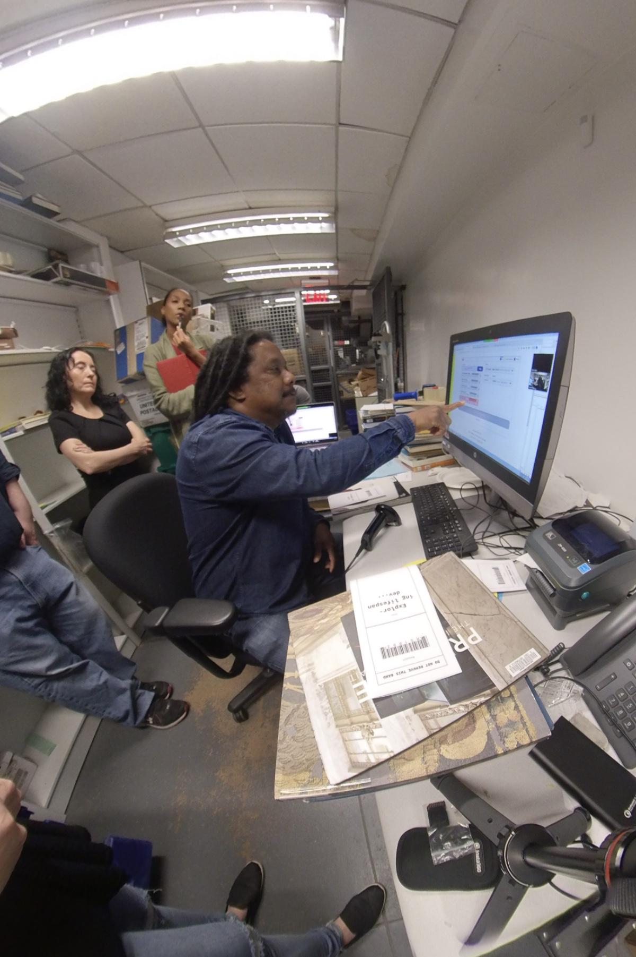
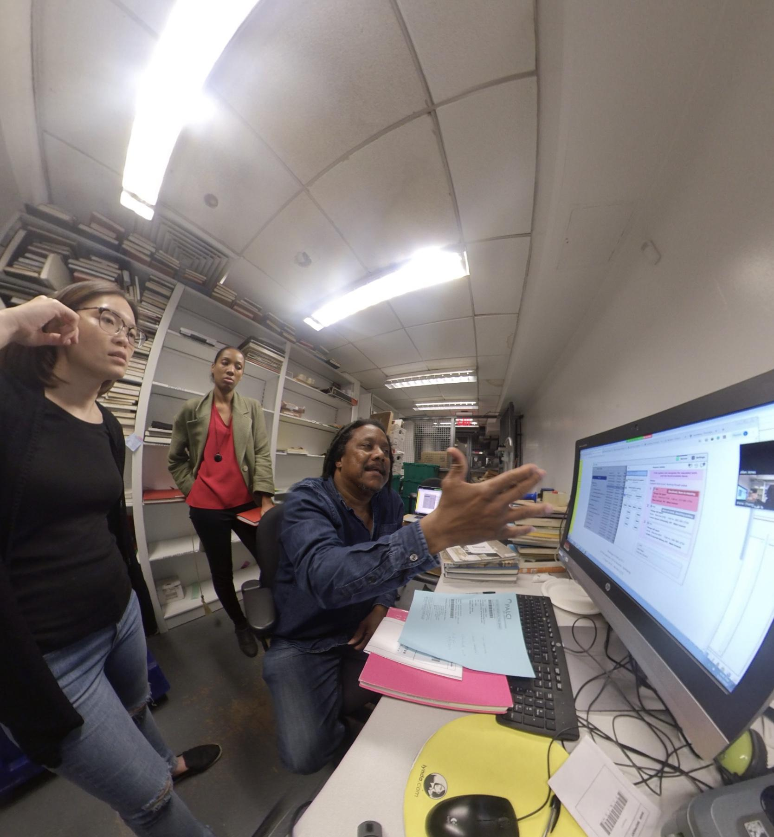
Site Visits – The New School

Slide 23
is a Method for Innovation
The organization should not bend to the app, the app should be flexible enough to fit the organization.
Support consortial and cross-consortial borrowing, resource sharing and interoperability
Build with full implementations of open-protocols (NCIP, Z39.50, ISO10160, ISO18626)
Design with prototypes and physical workflows because it’s cheaper to change the design than to change programming
Develop concepts, conventions and taxonomies, and test in the field, then iterate

Slide 24
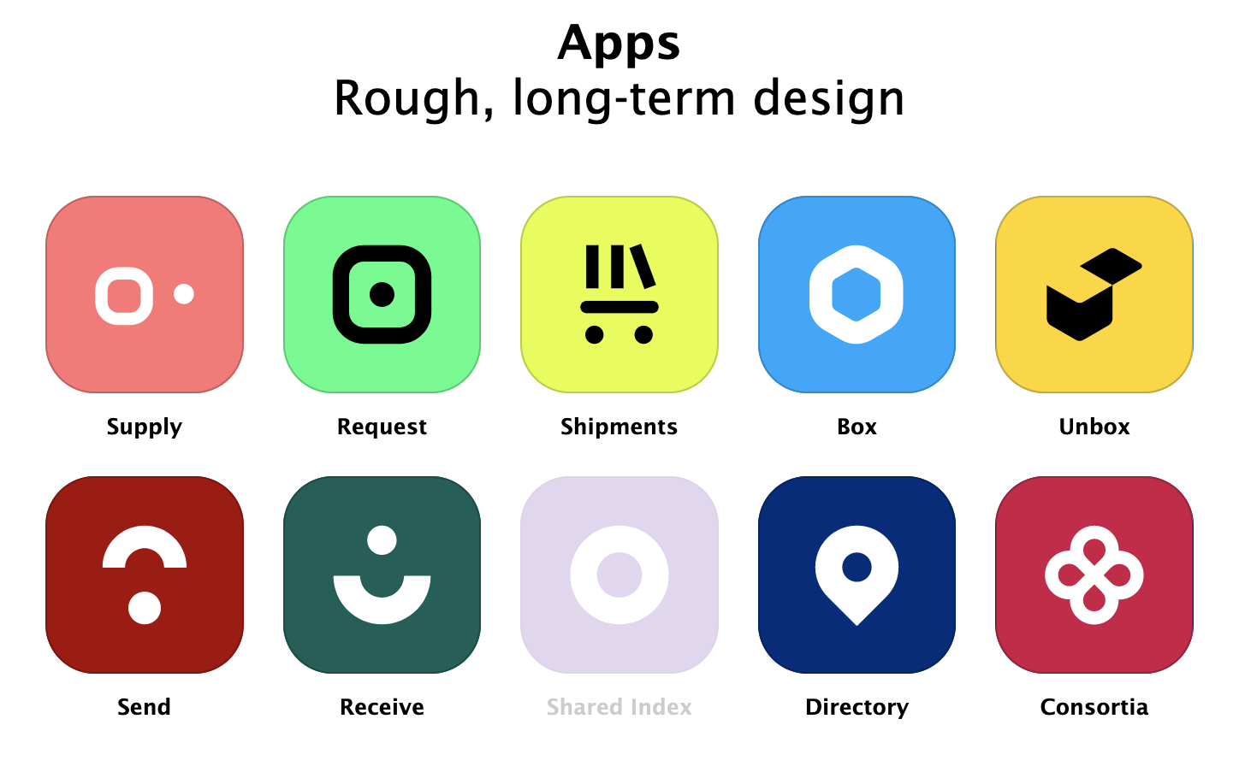
Staff processing
Shipping
Student processing
Settings & configs

Slide 25
: The Big Ideas
Discovery and delivery are independent, flexible
Break down barriers between consortia and systems
Put the patron in the center

Slide 26
is a peer to peer system
(with optional shared index)

Slide 27
The role and implications of ISO18626
Modern, web-friendly descendant of ISO10160/10161
Used in ReShare to model requests and requests exchanges
The default mechanism used by ReShare nodes to communicate with each other
BUT! ReShare uses a protocol switchboard, so it can use any protocol to communicate with a peer

Slide 28
The role and implications of ISO18626
What this all means:
A commitment to standards compliance is good for patrons.
A standards-based architecture is inherently flexible.
Notes:
ReShare nodes can communicate with peers across consortial boundaries
ReShare nodes can interoperate with other ISO18626-compliant systems
ReShare nodes can interoperate with 10161-based and other systems with appropriate adapters

Slide 29
A Speedy Timeline
Phase | Description
Spring 2019 | Mockups & Library Directory Application
Summer 2019 | Working Prototypes
Late Fall 2019 | Alpha/Minimally Viable Product (MVP)
Late Fall 2019 | Reporting Tools
Spring 2020 | Software Testing/Pilots
Summer 2020 | Launch

Slide 30
is about Trust...
“ ...It is trust that allows us to take down walls, remove barriers, and eliminate friction at borders.”
- Thomas Friedman, The World is Flat
“Our distrust is very expensive.”
– Ralph Waldo Emerson
“To inspire trust is to create the foundation upon which all truly successful enterprises – and relationships – stand.”
- Stephen M.R. Covey, The Speed of Trust
Notes:
Transparency
Openness
Community
We’re not questioning our intentions – they’re out there for everyone to see

Slide 31
Good Reads & References
https://www.mhprofessional.com/9780071839327-usa-the-membership-economy-find-your-super-users-master-the-forever-transaction-and-build-recurring-revenue-group
https://www.simonandschuster.com/books/The-SPEED-of-Trust/Stephen-M-R-Covey/9781416549000

Slide 32
Takeaways & Audience Challenge
Use the ReShare example in your own life.
Think about the problems you encounter, the times you feel helpless, or are forced to choose between a list of mediocre options.
Find a buddy and talk about it.
Advocate for solutions that enable choice.
Practice courageous leadership. Take action.
Find trust, or, if you can’t, then create it.
Notes:
ReShare is one example of a community motivated to empower itself, create agency, effect positive change, and build trust.

Slide 33
Thank You!
Contact Me:
Email jill@palci.org
Twitter @jillianemorris
Project ReShare
Email info@projectreshare.org
Website https://projectreshare.org
Twitter @projectreshare

