Slide 1
Wrap-up
RUG Fall 2018

Slide 2
2019 OCLC Resource Sharing Conference

Slide 3
ELD Delivery Service Bid
In preparation for the upcoming request for proposal (RFP), Empire Library Delivery will be asking members to provide additional information about the service.
Monthly Statistics - All locations have been asked to report how many bags and items are sent on a monthly basis. Locations should report statistics using the delivery statistics form sent in the monthly newsletter and posted on the ELD home page under reporting statistics.
https://www.esln.org/services/empire-library-delivery/
Survey - In mid-October, a survey will be sent to all ELD member library directors. Please work with your director to provide the necessary information to complete this.

Slide 4
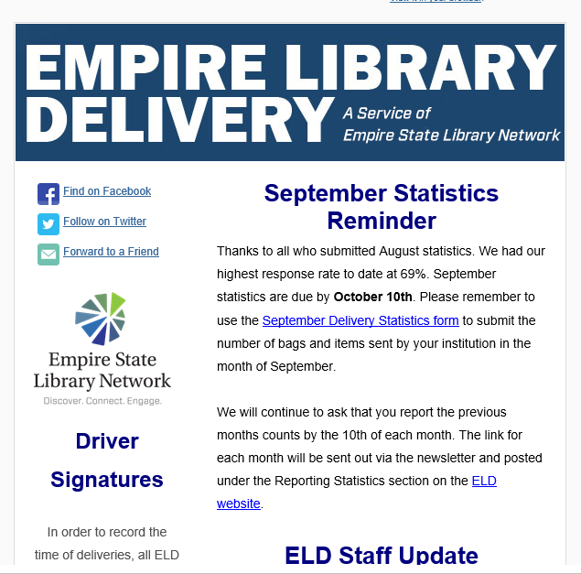
How many of you receive the ELD Newsletter?
September was sent on 9/28/2018
August was sent on 8/28/2018
Contains:
Links to Statistics form
Staff changes
Hub changes
Holiday closings

Slide 5
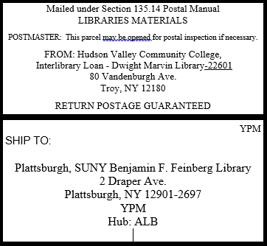
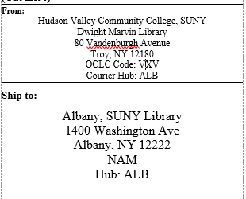
ELD Reminders
Bags - No tape, wait for ink to dry on the label, full address with OCLC symbol and HUB
Address Labels – Full address for lending and borrowing library, Hub, and and OCLC Symbol
As of July 5th, Empire State College, YEM has been added to Empire Library Delivery (ELD) Service
Hub moves: Purchase, SUNY (ZPM), Pace Law (VZL), Westchester Community College (WCC), and Manhattanville (VYE) moved to Newburgh (NEW).
Genesee Community College, SUNY (YJA) moved to Buffalo (BUF).
Questions? Contact admin@esln.org.

Slide 6
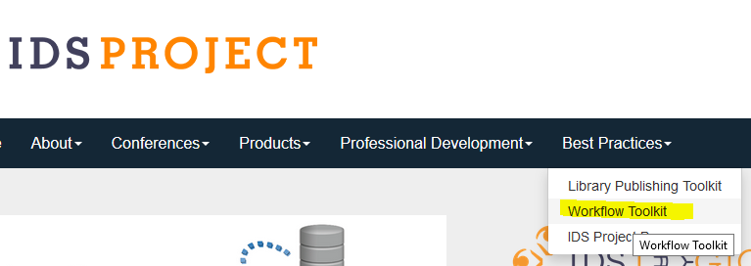
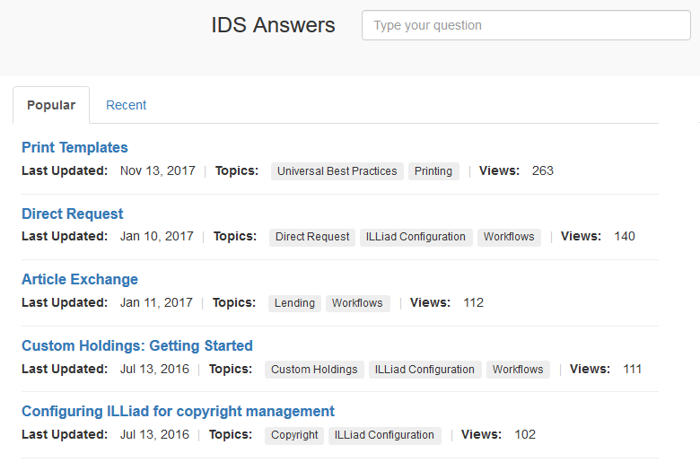
Workflow Toolkit

Slide 7
Topics for Summer All Region User Group

Slide 8
Spring 2019 RUG Meetings
Western will be at SUNY Geneseo
Metro will be … TBD
Eastern will be … TBD
Hands on Alma
Training
Need a campus with a large computer lab!!!!

Slide 9
Do you have questions about who your mentor is?
Contact the Mentor Coordinator
Name: Elise Thornley Phone: 607-777-3032 E-Mail: thornley@binghamton.edu

